Slide 1

Agent Observability Playbook
For AI & IT admins and AI business leaders
A practical guide covering what agent observability is, why you need an agent observability program, the roles involved, and how to stand up the program.​
AGENT 365

Slide 2

What’s inside this playbook
01
The setup: Why agent observability, and why now.
02
How the Agent 365 Observability Program works & key roles:
The Agent Observability Process, the five principles, the roles, and
the cadence.
CONTENTS
03
The Agent Observability Process within Agent 365: Guidance for leveraging high-value signals within Agent 365 to take action.
04
Real situations: The ownerless agent, agent drifting beyond its scope, and the agent with a sudden usage spike.
05
The proof: Microsoft Digital’s Customer Zero story for Agent 365.
06
Summary: The everyday workflows and the maturity path for a successful agent observability program.
Agent 365 Observability Playbook

Slide 3
Executive Summary
Part 1 · The setup · Executive summary
Primary audience
AI & IT admins who run the agent fleet. Secondary audience: AI business leaders who back the program.
Key roles:
For AI & IT admins with AI Administrator or Global Administrator access
Leaders and auditors with read-only access via AI Reader/Global Reader
Learn more about admin roles →
The challenge: Agent sprawl
The operating model
The outcomes
Agents are appearing across platforms — Microsoft, custom-built, and third-party — faster than any team can track, and many run with no clear owner, purpose, or value. There’s no shared way to see them across IT, Security, and Identity, so sprawl grows unwatched and risks increase.
Run observability as an ongoing program, not a one-time task: You need the right tools to continuously discover agents in your environment, evaluate what needs attention, and monitor agents as they evolve. Observability is a team sport across IT, Security, Leadership, and others. The primary surface is the Microsoft 365 Admin Center and the Entra, Defender, Purview, and Intune tools you already own.
One complete, living inventory — agents are visible, owned, and watched. You get control before sprawl outpaces you: Ownership is clear, risks surface early, and decisions come from one shared source of truth. Adoption and value follow.
Takeaway: Agent 365 gives you the control plane to turn agent sprawl into a managed, observable fleet. This playbook gives you the program (roles, cadence, and operating model) so you can create a clear plan to observe and manage agents at scale.
Microsoft · Part 1 · The setup
Executive Summary

Slide 4
Agents are multiplying faster than anyone can see them.
Part 1 · The Setup
Agents are the next shadow IT.
1.3B+
18x
29%
business agents expected by 2028
YoY agent growth in the Microsoft 365 ecosystem
of employees already use AI agents their company hasn’t approved
IDC Info Snapshot, 1.3 Billion AI Agents by 2028, doc #US53361825, May 2025
2026 Work Trend Index Annual Report >
Microsoft Cyber Pulse Report ›
Source
Why observability matters
Agents are showing up faster than any team can track them — built by Microsoft, by your own employees, and installed through 3rd-party vendors. Many run with no owner, no clear purpose, and no oversight. Without a shared way to see them, that sprawl becomes ungoverned risk: shadow agents reaching data nobody approved, duplicate spend, and no single source of truth across IT, Security, and Identity.
Microsoft · Part 1 · The setup
The agent sprawl problem

Slide 5
Microsoft Agent 365
PART 1 · THE SETUP
The control plane for agents
One place to see, govern, and secure agents — built on the Microsoft tools you already run.
AGENT 365

Slide 6
Agent 365: The control plane for agents
Part 1 · The Setup
Agent 365 gives you one place to see and manage every agent in your organization — and it runs on the Microsoft tools your team already uses: the Microsoft 365 admin center, Entra, Defender, Purview, and Intune. This guide covers the
Observe pillar.
Core Agent 365 pillars
This Guide
Observe
Govern
Secure
Gain visibility into agents across enterprise environments, understand how they’re used, and act quickly on performance, behavior, and risk signals before they impact the business.
Onboard agents with IT oversight and govern agent access to resources and data, including applying device-based guardrails for agents operating on enterprise-managed endpoints.
Secure agent identities, control access to resources, help prevent data oversharing and leaks, and help defend against threats and vulnerabilities with enterprise-grade security solutions.
The agent observability process
Discover → Evaluate → Monitor
What it covers
Helps
Protect agent identities & access
Prevent oversharing and data leaks
Defend against threats and vulnerabilities
What it covers
Bringing agents under control from day one
Agent lifecycle management
Controlling what agents can access and do
Microsoft 365 admin center
Want the full tour of Agent 365? Click here to learn: Agent 365 overview
Microsoft · Part 1 · The setup
Observe · Govern · Secure

Slide 7

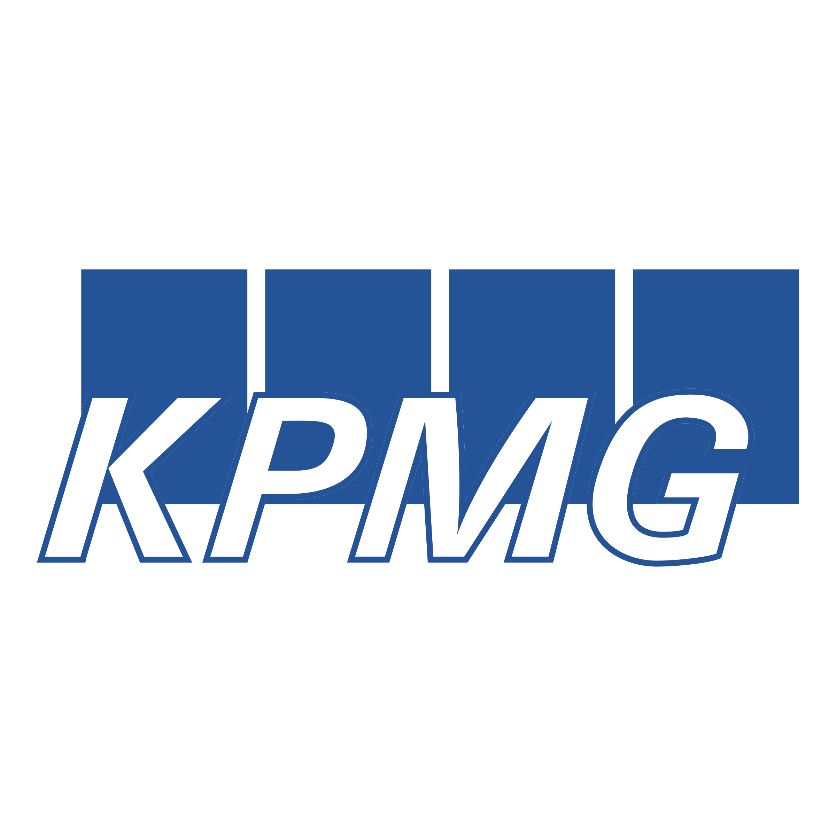
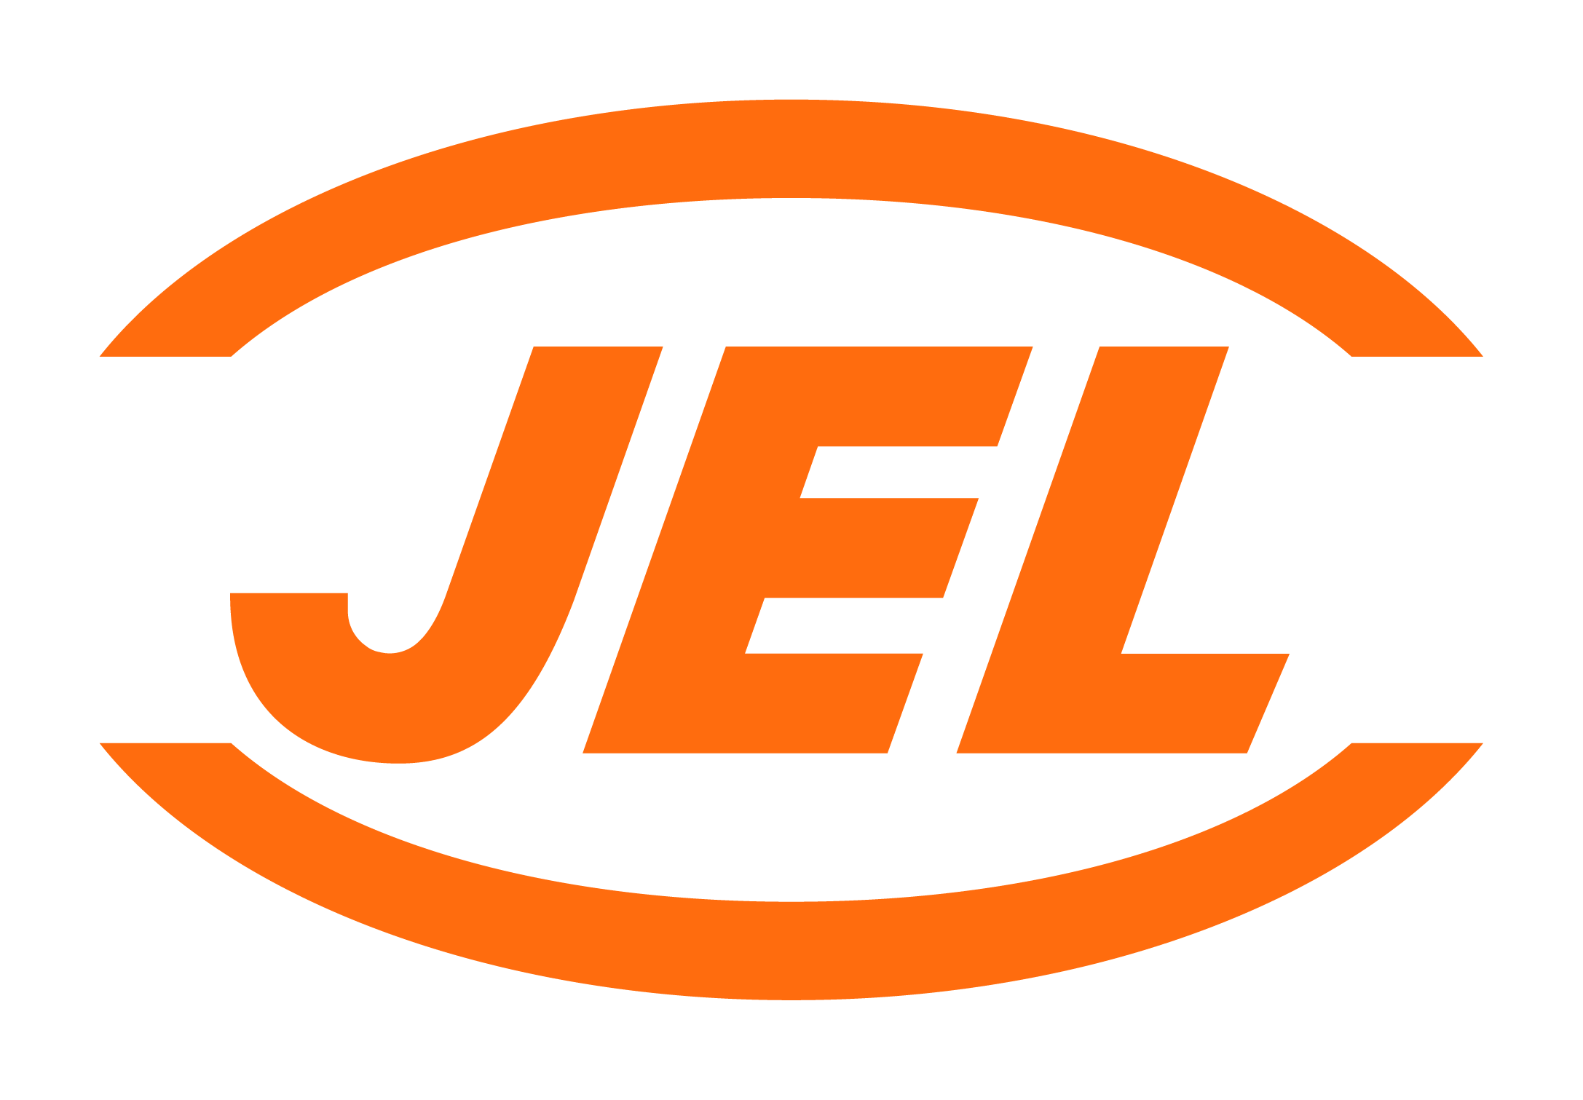
How Agent 365 helps teams handle sprawl today
Part 1 · The Setup
Get the confidence to move from agentic AI experimentation to enterprise-scale operations with a control plane to observe, govern, and secure every agent across your organization.
What most teams do now
VS
Agent 365 advantages
Manage agents in silos — per team, per platform, creating multiple sources of truth.
One place to see and manage agents across your Microsoft and ecosystem-partner platforms.
Block or restrict agents in bulk — which can push people toward shadow AI.
Granular controls to manage and provision agents at scale.
Buy a new standalone solution to manage agents — adding complexity.
Extends the tools you already use — Entra, Purview, Defender, Intune, the M365 admin center — not a new stack.
Agent 365 proof points
“
“
“
…scale and govern AI agents with confidence, while maintaining enterprise-grade security and control.
…innovate faster while maintaining the trust, security, and controls required at global scale.
…a single control plane to improve oversight across the agent lifecycle.
Yuji Shono
Head of Global AI Office, NTT DATA Group Corporation
Lisa Heneghan
Global Chief Digital Officer, KPMG International
Nicholas Fam
Tech Lead, Jurong Engineering Limited
Microsoft · Part 1 · The setup
WHY AGENT 365

Slide 8
What is agent observability?
Part 1 · The Setup
Agent observability is being able to see the agents in your organization — where they runs, what they does, what they can reach, and who owns them — and keeping that picture current as agents come, go, and change. Agent observability is the first step to managing, securing and optimizing your agent fleet.
Agent observability answers three questions
What you observe
Discover
Can you find every agent across your environment: Microsoft, custom-built, and third-party?
Evaluate
Do you know what each agent does, what it can reach, and who owns it?
Two altitudes — the whole fleet at-a-glance, and any single agent in detail: Its data, tools, MCPs, and APIs. Across Cloud, Endpoint, and Network.
Monitor
Can you spot sprawl, risk, or ownerless agents before they become incidents?
Microsoft · Part 1 · The setup
What is Agent observability

Slide 9
The Agent Observability Program
PART 2 · THE AGENT OBSERVABILITY PROGRAM
The operating model for agent observability
Owners, rhythm, and best practices.
THE AGENT OBSERVABILITY PROGRAM

Slide 10
Why run agent observability as a program?
Part 2 · The agent observability program
Because agents never stop multiplying, discovering them can’t be a one-time task.
A one-time discovery
An ongoing program
Tells you what you had. It’s stale the moment agents change — and they change
every day.
Keeps the picture current — with a named owner, a set rhythm, and clear decisions as agents come and go.
→
Next
Best practices and the operating model that makes the program run — the roles, the rhythm, and the everyday workflows.
Microsoft · Part 2 · The agent observability program
Why a program

Slide 11
Five principles for building out your agent observability program.
01
You can’t govern what you can’t see – get a full inventory of your agents. Observability is the first step in effectively governing and securing your agents.
02
A program, not an one-time task. Your program needs a named owner, defined roles, and clear decisions — not a one-time check.
PART 2 · THE AGENT OBSERVABILITY PROGRAM
03
Establish a rhythm of business. High-risk agents get tighter checks and instant escalations; low-risk agents roll up monthly.
04
Agent management is a team sport. Strategically use coordinated efforts between IT, Security, Compliance, and business stakeholders to manage your agents at scale.
05
Adjust as agents evolve. New agent types and tools keep appearing. This is an ongoing capability, not a finish line.
Agent 365 Observability Playbook

Slide 12
The roles within the Agent Observability Program
Part 2 · The agent observability program
Every organization is different. Treat this as a starting point, not a template to copy. Each row is one role: who they are, where they work, what they do week to week, and bar for calling their part done. Adapt the mix to the teams you already have.
Role | Where they work | What they do | The bar for done
AI/IT admin · program owner | Microsoft 365 Admin Center (AI/Global administrator access) | Works the unowned, unmanaged, and risky agent queue each week and chairs the monthly review, routing every flag to the right role | Every agent has a named owner, Agent ID, the unowned queue is at zero, Shadow AI is surfaced, and no high-risk agents remain.
Identity admins | Entra Portal | Create Agent access packages that provision the right governance practices for agent identity, agent’s user account, and service principal access to resources. | Every agent draws its access from a defined access package – scoped to its job and reviewed, never standing or over-broad.
Security operations admins | Defender Portal | Runs detections to surface shadow agents, triage alerts, and contain confirmed threats | Confirmed threats are contained within MTTR (mean time to remediation).
Device admins | Intune Portal | Block unsanctioned local agents | Unsanctioned local agent is blocked across managed devices – and the block carries to new devices.
Data admins | Purview Portal | Enable AI compliance and prevent data leaks and oversharing | Help protect access to sensitive data, oversharing and leaks. Identify and close AI compliance gaps.
Leadership · sponsor · BDM | Microsoft 365 Admin Center (AI/Global reader access) | Makes agent registration required, sets the keep-or-retire bar, and makes the scale, cap, or retire policies | Enforce agent registration policies and decide on go forward strategy for escalated agents.
Agent builders/makers | Agent building platforms (like Copilot Studio) | Registers each agent at creation, states what it’s for, and fixes flags against their own agent | Nothing ships unregistered; agent flags get resolved.
Microsoft · Part 2 · Key players
Seven roles · One program

Slide 13
The rhythm: Daily, weekly, monthly, quarterly.
Part 2 · The agent observability program
How often you act depends on the step and the risk. Treat these intervals as a starting point, not a fixed rule — adjust the cadence, and who owns each pass, to fit your own team’s size, risk tolerance, and how many agents you’re managing. A smaller or lower-risk group might combine a few of these; a larger or more regulated one may run some more often. Whatever rhythm you land on, set your import schedule to run at least as often as your sweep —otherwise you’re working from a list that’s older than your cadence.
When | What you do | Who | Why
Daily | Check the admin center for agents flagged at risk and Shadow AI; act on anything urgent. | AI / IT admin | Threats and risky behavior can’t wait.
Weekly | Sweep for new, low-usage, or ownerless agents; assign owners or retire agents. | AI / IT admin | Ownerless agents pile up fast and create risk.
Monthly | Evaluate the agent fleet by usage and value (e.g. custom evaluation, assisted hours, value per task category): promote the high-value agents, consolidate duplicates, flag the low-value agents, and determine which platforms provide the most opportunity. | Cross-functional | The shared decision forum to optimize your agent fleet.
Quarterly | Make the investment decisions. Determine which platforms to standardize and fund, where to reduce and reallocate spend, and which to sunset. Set the budget and risk direction for the next quarter. | Leadership | Set agent strategy; keep value high.
Microsoft · Part 2 · Cadence
Adapt to your own needs

Slide 14
What a “Good“ Agent Observability Program looks like
Part 2 · The agent observability program
Two quick self-checks. The left column is what you’re aiming for — the signs the program is working. The right column is your early-warning list — the signs it’s starting to slip. Check yourself against both.
What “Good“ looks like
Watch for risk
✓
Full agent inventory.
Agents show up in the registry, Microsoft or not, cloud or local. You can’t manage what you can’t see, so this is the foundation.
Shadow agents appear faster than you can govern them
You’re finding new local agents quicker than you can register and govern them — the backlog is winning.
✓
Agents owned and managed — the unowned and unmanaged queue are declining.
Each agent has a named person accountable for it, so when something breaks you already know who’s on the hook to fix it.
The unowned / unmanaged count is creeping up.
More agents are appearing with no owner or no registration. Ignore it and the gap grows until you’ve lost track of what’s running.
✓
The risky agent queue is trending down over time.
Month over month you find fewer agents with risky behavior — a sign you’re getting ahead of problems, not chasing them.
The risky agent queue is growing instead of clearing.
Risky agents that need a decision are piling up faster than the team resolves them. Issues are waiting instead of getting handled.
✓
Your most used agents are known and supported.
You can see which agents are actually used and delivering. The ones that matter get rolled out more widely; the ones with low usage get retired, ensuring your agent registry is focused on observing the agents that count, not dead weight.
A weekly sweep or monthly review got skipped.
The routine checks that keep the program honest didn’t happen. One skipped review is how small gaps quietly become big ones.
Microsoft · Part 2 · The agent observability program
Aim left · Act on right

Slide 15
The Agent Observability Process
PART 3 · HOW TO RUN THE AGENT OBSERVABILITY PROCESS
Discover → Evaluate → Monitor
Three steps that run continuously — find every agent, decide what needs attention, and watch as they change.
THE PROCESS

Slide 16
The agent observability process: Discover → Evaluate → Monitor
Part 3 · How to run the agent observability process
Read the three steps left to right. Each card shows what your team does (ACTIVITIES) and what you get (BENEFITS). The wide arrow underneath is the part people miss: Monitor keeps finding new and changed agents, so the work loops straight back into Discover and the inventory never goes stale.
Discover
→
Evaluate
→
Monitor
Activities
Activities
Activities
D1 Helps enable cross-platform agent discovery
D2 Surface local shadow agents
D3 Use the Agent Map to explore your organization’s agent landscape (generated from telemetry for SDK-integrated agents covered in appendix; learn more here)
E1 Review the Agent registry
E2 Review ownerless, unmanaged, and risky agents
E3 Review Shadow AI
M1 Watch behavior, access, usage, and drift
M2 Triage signals as they surface
M3 Refresh and triage unmanaged agents
Benefits
Benefits
Benefits
Agents are visible — no blind spots, including shadow agents → Observe
A living inventory → Observe
A registry of tools, plugins, and MCP servers that govern how agents interact → Observe
List of ownerless / unmanaged agents that need a decision → Govern
Detection of shadow AI → Govern
List of agents at risk → Secure
Active status on agents → Observe
Risky behavior → Secure
Fast-growing / low-value → Govern
● | Observe — complete visibility of key signals
● | Govern — an ownership/lifecycle decision needed
● | Secure — a security investigation/decision needed
Agent 365 Observability Playbook
Discover · Evaluate · Monitor — Three steps that run continuously.

Slide 17
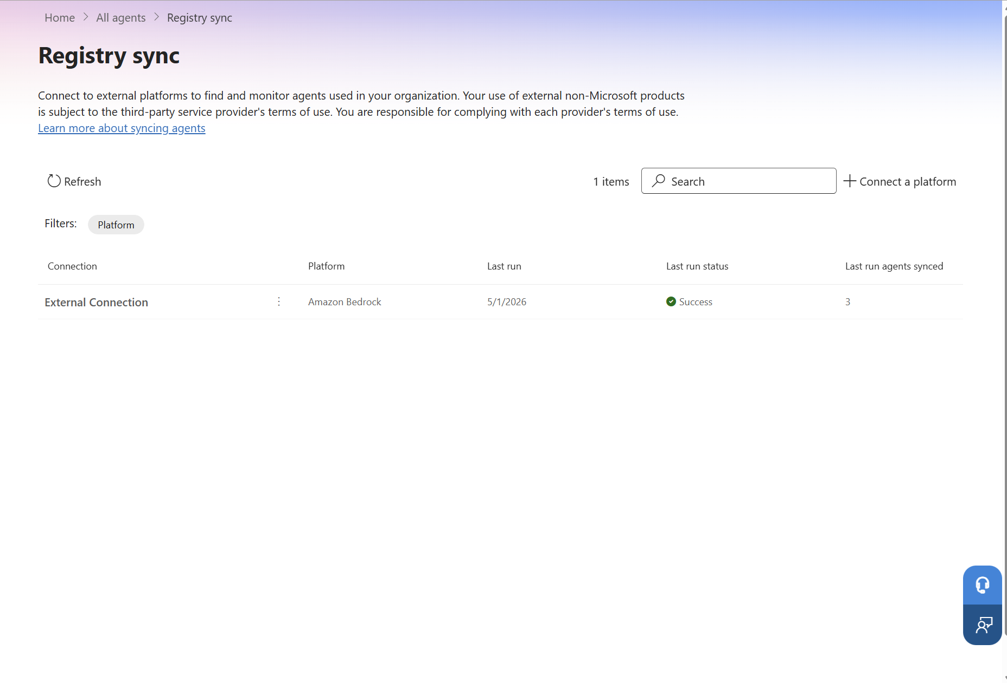
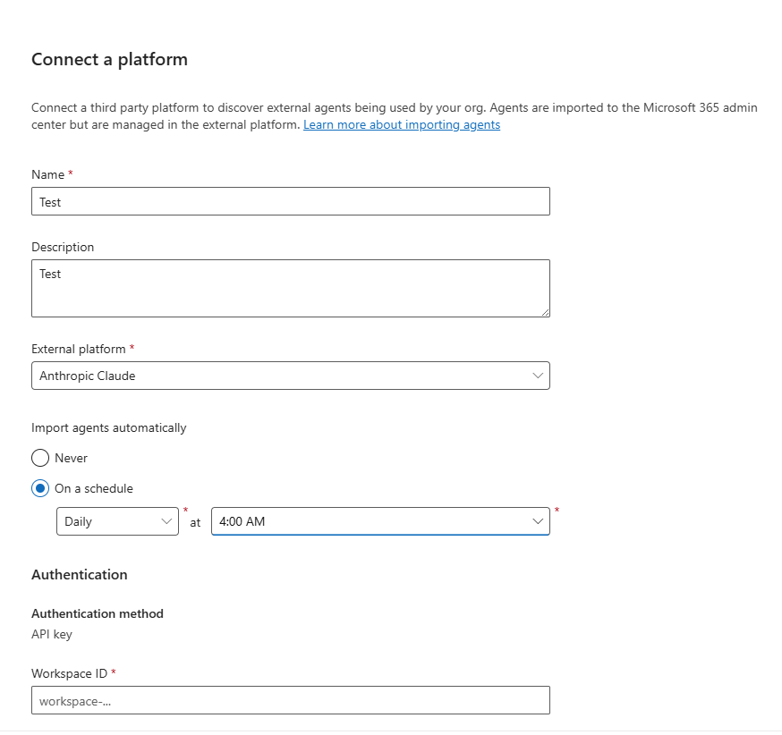
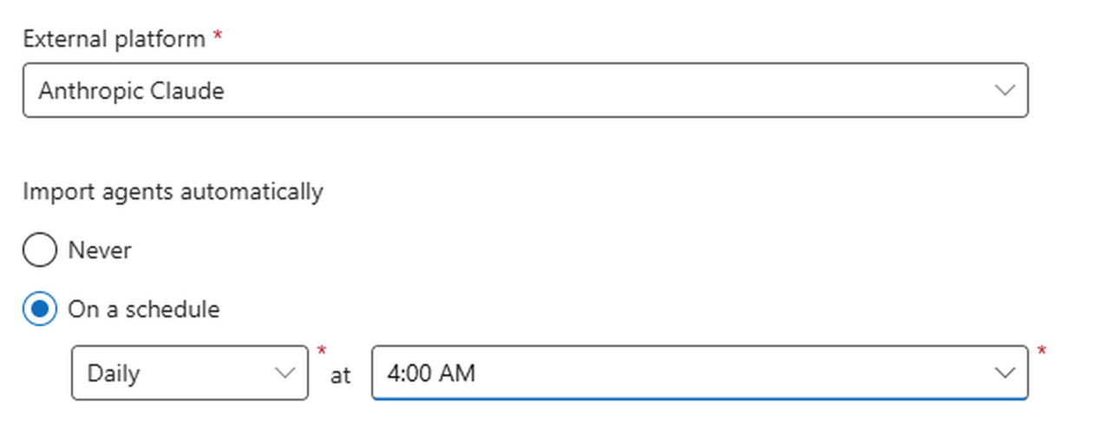
(D1) Discover: Enable cross-platform discovery
Part 3 · How to run the agent observability process
Plenty of your agents run outside Microsoft. They run on platforms like Amazon Bedrock or Anthropic Claude, and until you connect those platforms the agents built there never show up in your inventory. Enable cross-platform discovery of agents to build up your agent inventory. Once enabled, you can authenticate to external platforms and decide how often Agent 365 imports its agents, either manually or on a set schedule.
01
02
03
→
→
Open Registry sync to review the external platforms already connected to your tenant.
Connect a platform and authenticate — the fields vary by platform (an API key and workspace ID here).
Set the import schedule — choose “On a schedule”, then daily or weekly at a set time. Select “Never” and nothing imports until someone refreshes by hand.
*Use the Agent 365 SDK to extend agents built using any agent SDK or platform, with enterprise-grade identity, observability, notifications, security, and governed access to Microsoft 365 data, covered in appendix.*
Microsoft · Discover · Cross-platform · Part 3 · How to run the agent observability process
Discover · Cross-platform

Slide 18
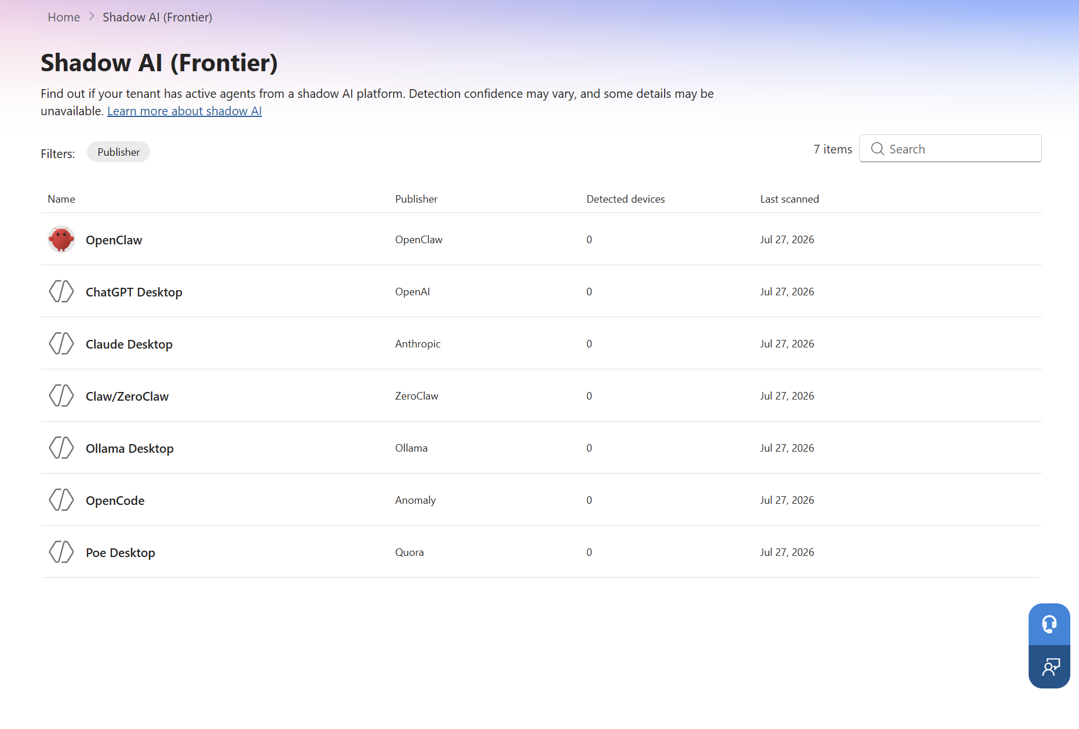
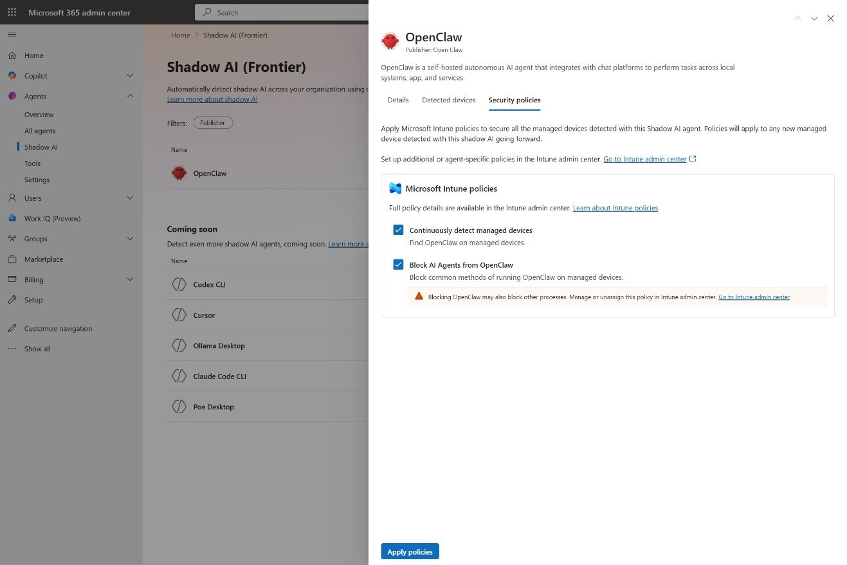
(D2) Discover: Surface local shadow agents
PART 3 · HOW TO RUN THE AGENT OBSERVABILITY PROCESS
These agents don’t run in your cloud tenant. An employee installs one straight onto their own machine, so it stays off the books and out of the registry – no owner, no oversight. That’s the risk: Some shadow agents can reach across local files, apps, and chat, and nobody signed off on it. This page is the one place that surfaces them, ensuring an agent no one approved doesn’t keep running unnoticed.
01
02
→
Scan for local agents — agents running local devices/endpoints.
Inspect a local agent — its description, detected devices, and security policies.
*Microsoft Intune enrollment for managed Windows devices required. Click here for full list of requirements.*
Microsoft · Part 3 · How to run the agent observability process
Discover · Shadow agents

Slide 19
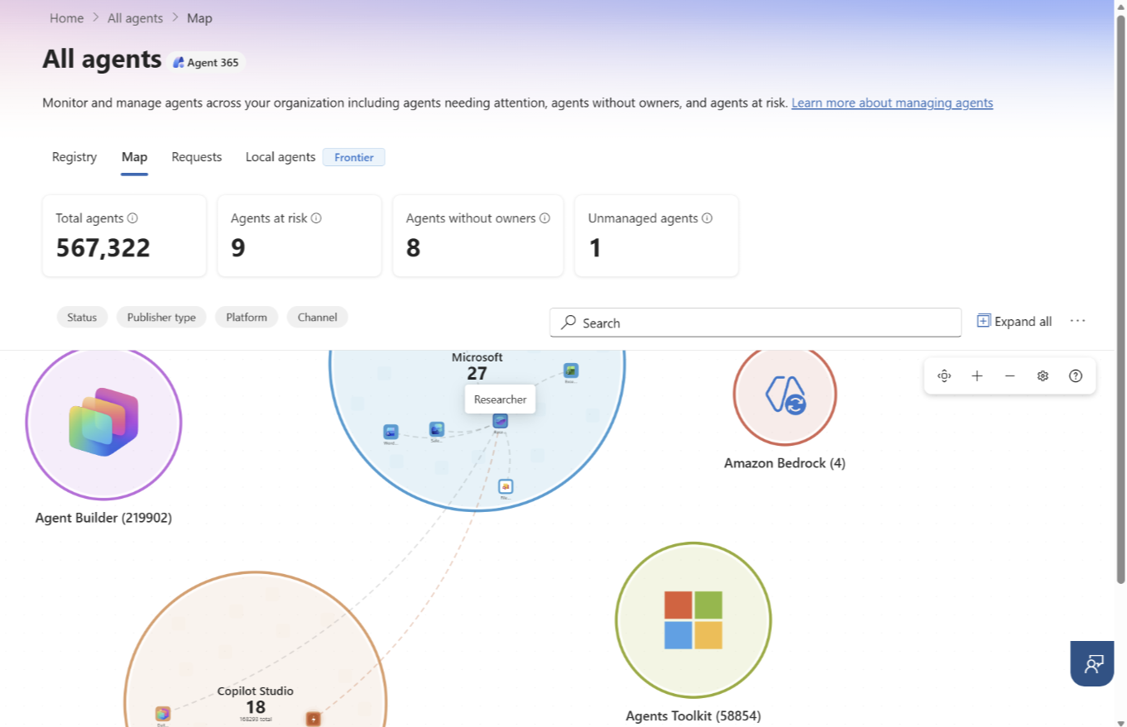
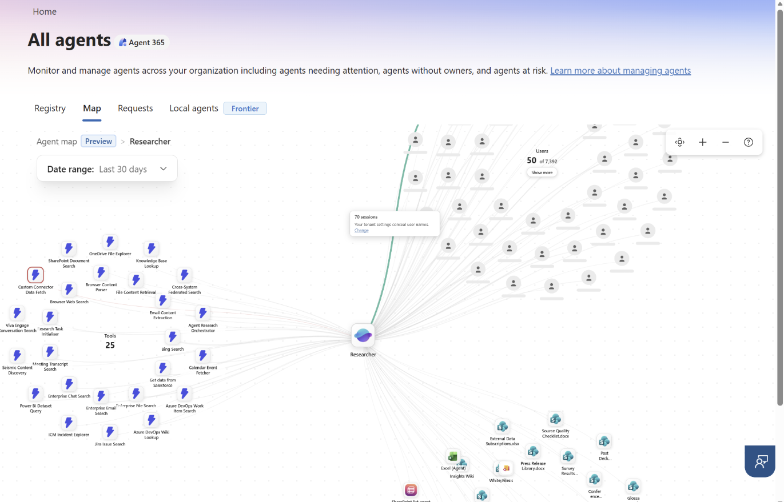
(D3) Discover: See your fleet on the Agent Map
PART 3 · HOW TO RUN THE AGENT OBSERVABILITY PROCESS
The Agent Map brings your whole fleet into one picture. In the Microsoft 365 admin center (Agents > All Agents > Map), every agent appears as an icon grouped by the platform it was built on, ensuring a large estate is readable at a glance. It’s the visual companion to the Registry list — the same agents, arranged so the big clusters, the outliers, and the gaps stand out at a glance. Generated from telemetry from SDK-integrated agents; learn more in appendix.
01
02
→
Read the clusters — the whole estate grouped by platform, with summary cards up top.
Select your desired agent — once the agent is selected, click “All connections“ and you can view a map of its details (like connected tools, sessions, and connected agents.
Microsoft · Part 3 · How to run the agent observability process
Discover · Agent map

Slide 20
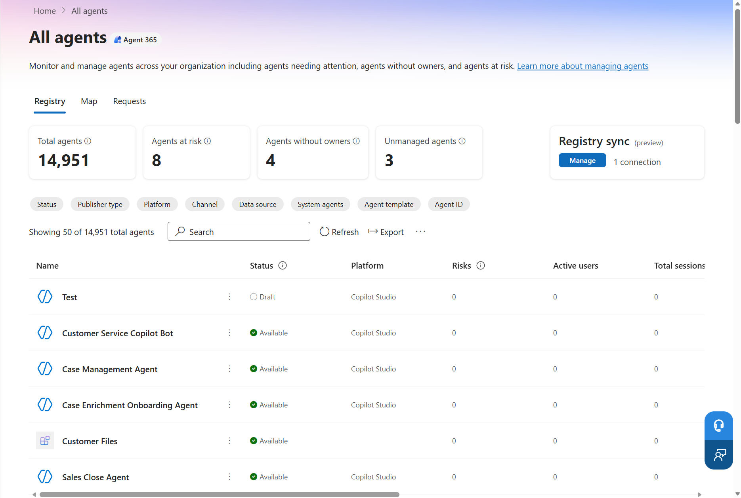
(E1) Evaluate: Review the agent registry
PART 3 · HOW TO RUN THE AGENT OBSERVABILITY PROCESS
The Agent Registry is your system of record for all of the agents in your organization — the source of truth to assess agent inventory, find specific agents via filters, and understand the actions to take based on current agent status.
14,951 agents
Agent registry example
System of record
Surfaces every agent in your environment
Example filters
Publisher — Microsoft · partner · your org · shared
Identity — with or without an Agent ID (learn more in appendix)
Channel — Copilot · Teams · Outlook · SharePoint
What to look for
Growing agent registry
Unmanaged agents
Ownerless agents
Agents at risk
The Agent Registry in the Microsoft 365 admin center — one system of record for every agent, with status, owners, risk, and Entra Agent ID at a glance. Agent ID is the governed identity that makes each agent authenticated, owned, and traceable here. More in appendix.
Microsoft · Part 3 · How to run the agent observability process
Click here to learn: The Agent Registry Click here to learn: Securing AI agents with Entra Agent ID

Slide 21
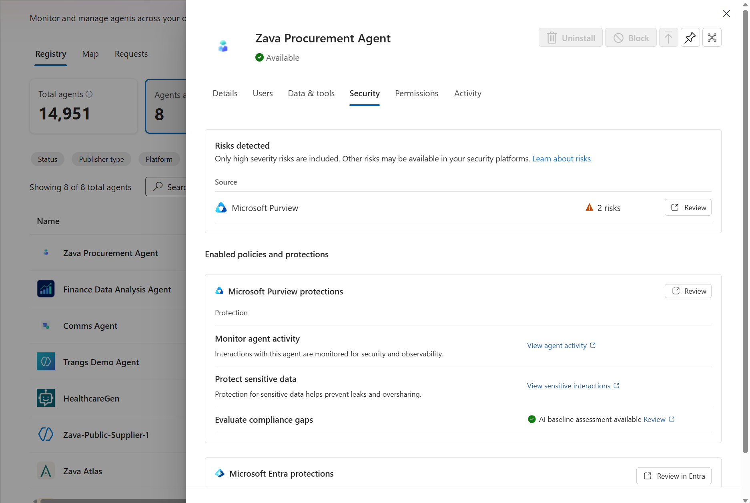
(E2) Evaluate: Review the ownerless, unmanaged, and risky agents
PART 3 · HOW TO RUN THE AGENT OBSERVABILITY PROCESS
This is where flagged agents become decisions. Take the ownerless, unmanaged, and risky agents surfaced and review their key attributes.
Review · key agent attributes
Deep-dive each agent that warrants attention — the same tabs you see in its detail view.
Details
Users
Data & Tools
Security
Permissions
Activity
Act · example actions to take
Change agent access
Block or uninstall risky agents
Investigate data & tool access
Review agent risk & policies
Microsoft · Part 3 · How to run the agent observability process
Click here to learn: Purview for Agent 365

Slide 22
(E3) Evaluate: Review Shadow AI (Preview)
PART 3 · HOW TO RUN THE AGENT OBSERVABILITY PROCES
Decide for every local agent the Shadow AI page surfaces – block it or investigate it.
Where agents surface
BLOCK (unsanctioned) → Intune
Help prevent execution on managed devices
The clear no — a policy violation, or a high-reach, unsanctioned agent like OpenClaw. Push an Intune policy to every managed device: The binary can stay, but it can’t run, and the block carries to all managed Windows devices enrolled in Intune.
OWNER AI/IT admin (Intune)
Investigate → security
Then: Block or onboard
Anything you’re not sure about — dig into what it is, what data and tools it reaches, and who’s using it. Loop in Security and open the AI Assets Dashboard in Defender.
THEN DECIDE Block it — or, if it’s worth keeping, begin onboarding: Give it a managed identity (Entra Agent ID) and register it into the fleet. A deliberate project with IT & identity admins, not a one-click adopt.
The Shadow AI page surfaces known local agents
OWNER Security admins (+ IT/Identity admins to onboard)
*Requires permission from Microsoft Intune administrator to view detected devices, details or apply security policies across a shadow AI platform. Click here for more information.*
Microsoft · Part 3 · how to run the agent observability process
Evaluate · Shadow AI · Block or Investigate

Slide 23
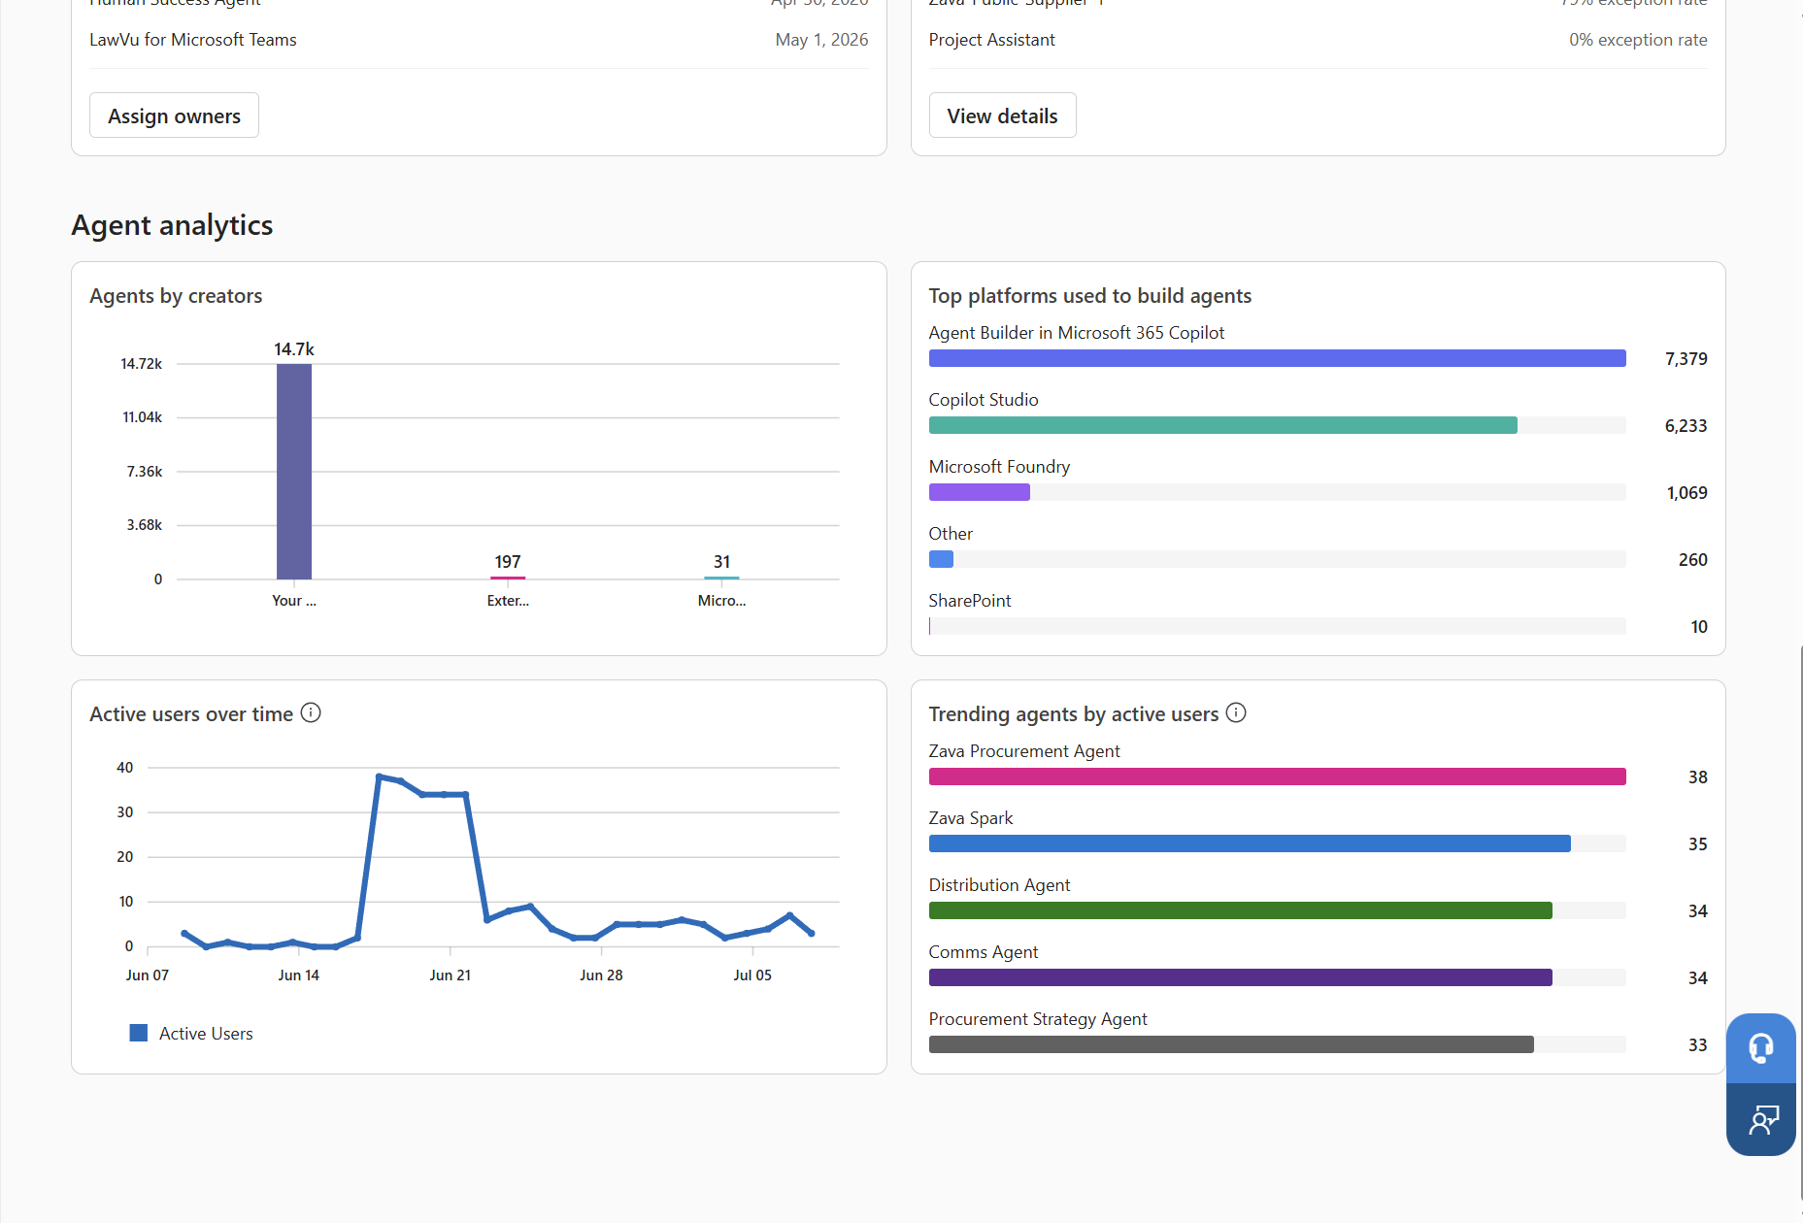
(M1) Monitor: Watch agent behavior, access, usage & risk
PART 3 · HOW TO RUN THE AGENT OBSERVABILITY PROCESS
The Agent 365 overview page helps you keep an active read on every agent in production.
GIVES YOU | In depth agent analytics
Agent Analytics
What to look for
Watch for agent behavior, requests, usage, and exceptions.
For example
Active users over time
Trending agents by active users
Top platforms used to build agents
Microsoft · Monitor · Watch · Part 3 · How to run the agent observability process
Click here to learn: Observability for admins · The Observability SDK

Slide 24
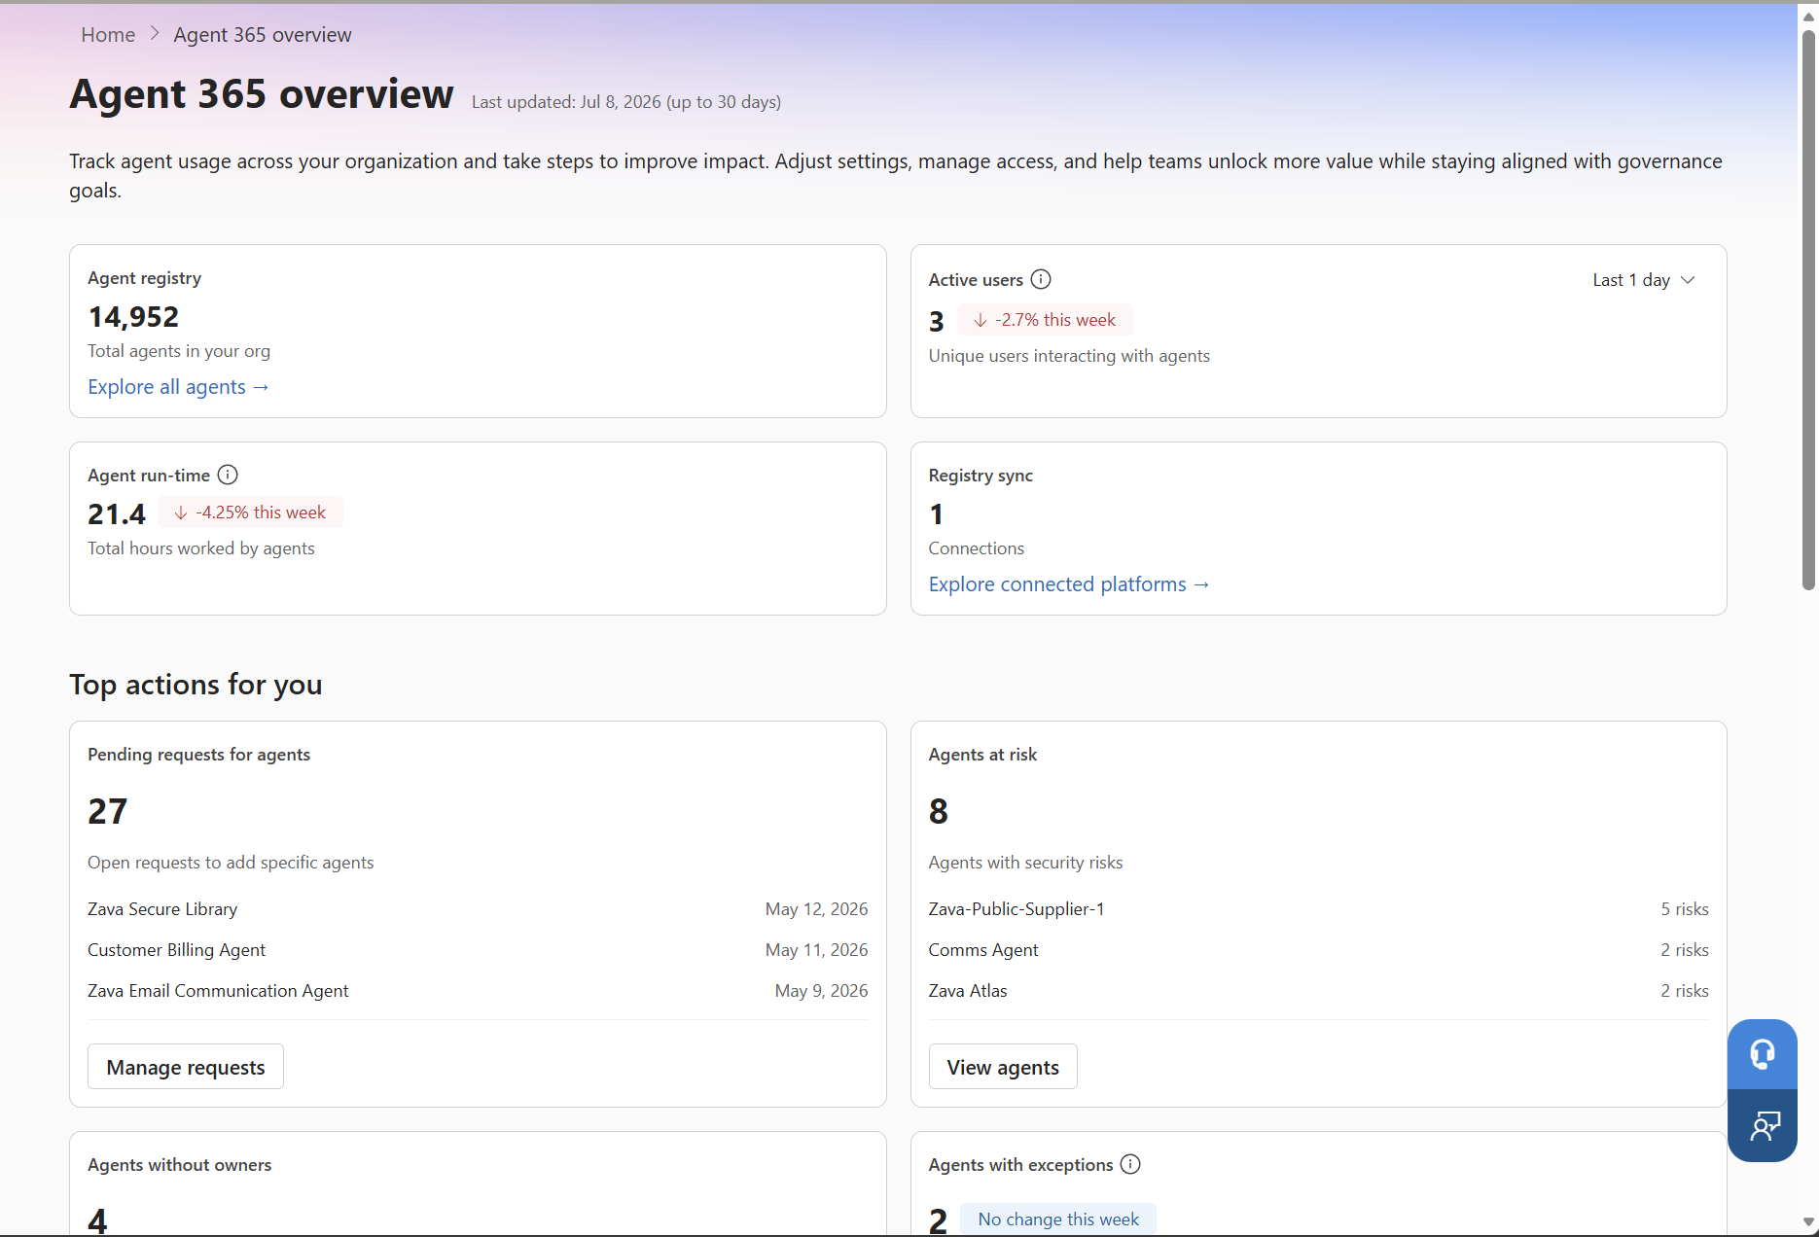
(M2) Monitor: Triage agent signals as they surface
PART 3 · HOW TO RUN THE AGENT OBSERVABILITY PROCESS
The Agent 365 overview page helps you keep an active read on agents in production.
Signals that surface
Signals to Triage
Route signals to the right owner the moment it surfaces.
A spike in agents at risk
Growing number of agents without owners
A trending agent — usage climbing fast
Example actions to take
Risky Agents → Secure (Entra + Defender + Purview)
Fast-growing or low-value → Govern (Viva Insights + Copilot Credits + BDM)
The Agent 365 overview surfaces the signals — agents at risk, without owners, with exceptions, and pending requests.
Microsoft · Monitor · Triage · Part 3 · How to run the agent observability process
Click here to learn: Observability for admins · The Observability SDK

Slide 25
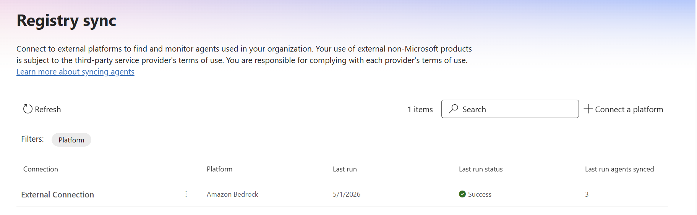
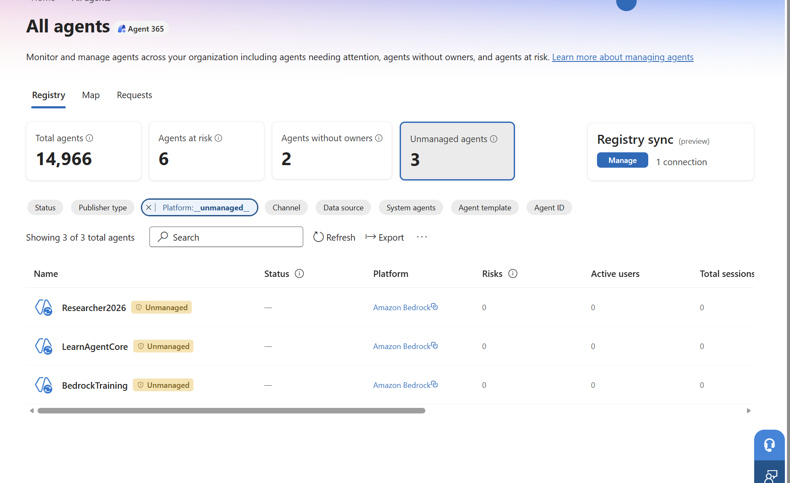
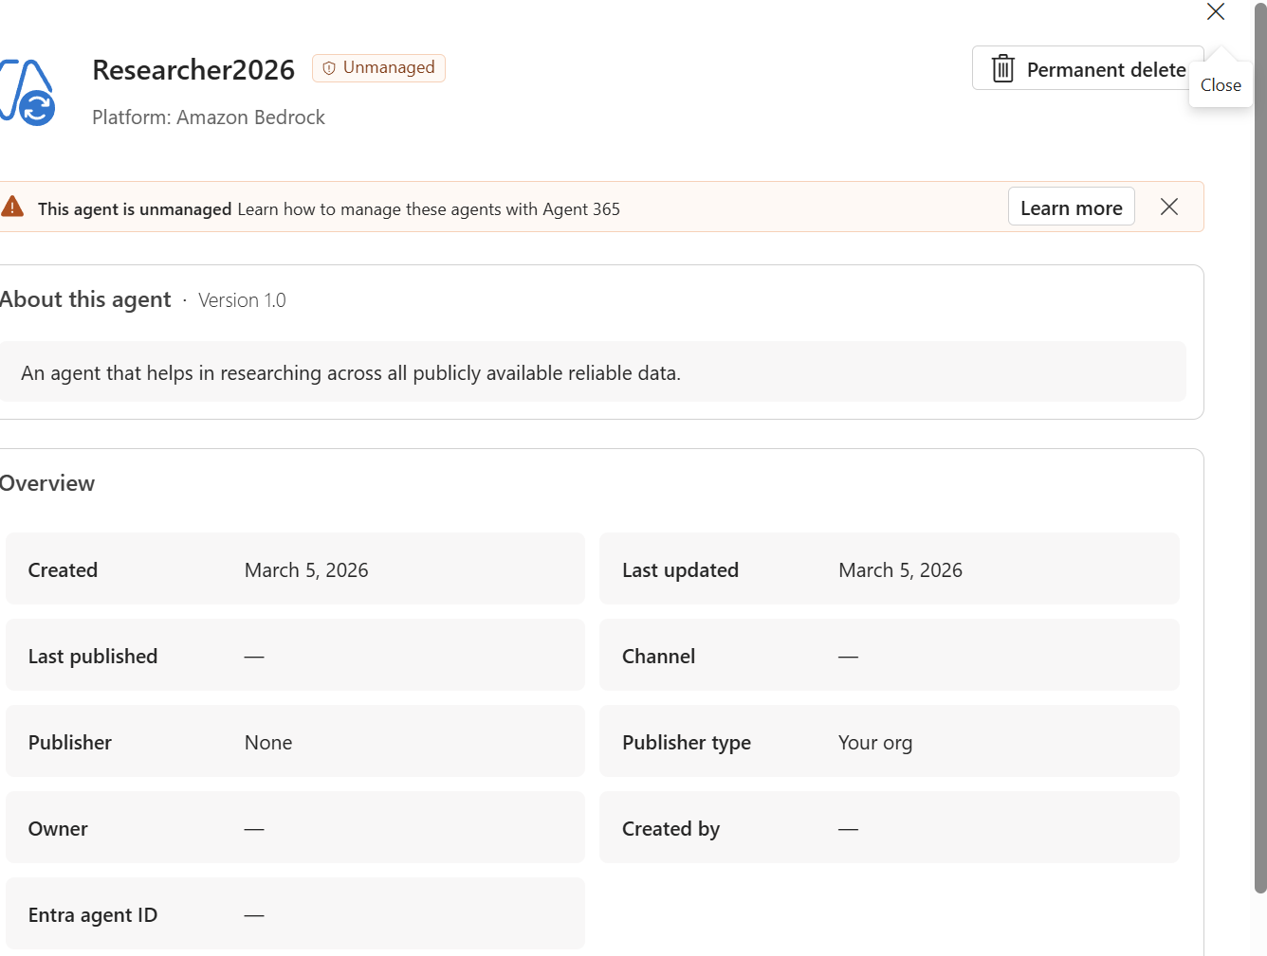
(M3) Monitor: Refresh and triage unmanaged agents
PART 3 · HOW TO RUN THE AGENT OBSERVABILITY PROCESS
Monitor for unmanaged agents outside of your set schedule. If you set a schedule when you connected the platform, the count on the All agents page is only as current as the last scheduled import — daily or weekly, whichever you chose. Refresh by hand when you don’t want to wait: Right after connecting a platform, during a weekly sweep, or while you’re working an active issue. Then check what surfaced, open each agent to see what it is and what it can reach, and decide what to do.
01
02
03
→
→
Refresh the registry sync — the count reflects the last scheduled import. Refresh manually when you need the current picture now.
Check the Unmanaged bucket — see which new agents surfaced (here, 3 on Amazon Bedrock).
Inspect and act — open each agent and decide to bring it under management, or investigate further.
Microsoft · Monitor · Triage · Part 3 · How to run the agent observability process
Monitor · Unmanaged Agents

Slide 26
Agent Scenarios
PART 4 · AGENT SCENARIOS
The agent observability process applied
Using Agent 365 to tackle three common situations, start to finish — an ownerless agent, an agent drifting beyond its scope, and an agent with a sudden usage spike.
SCENARIOS

Slide 27
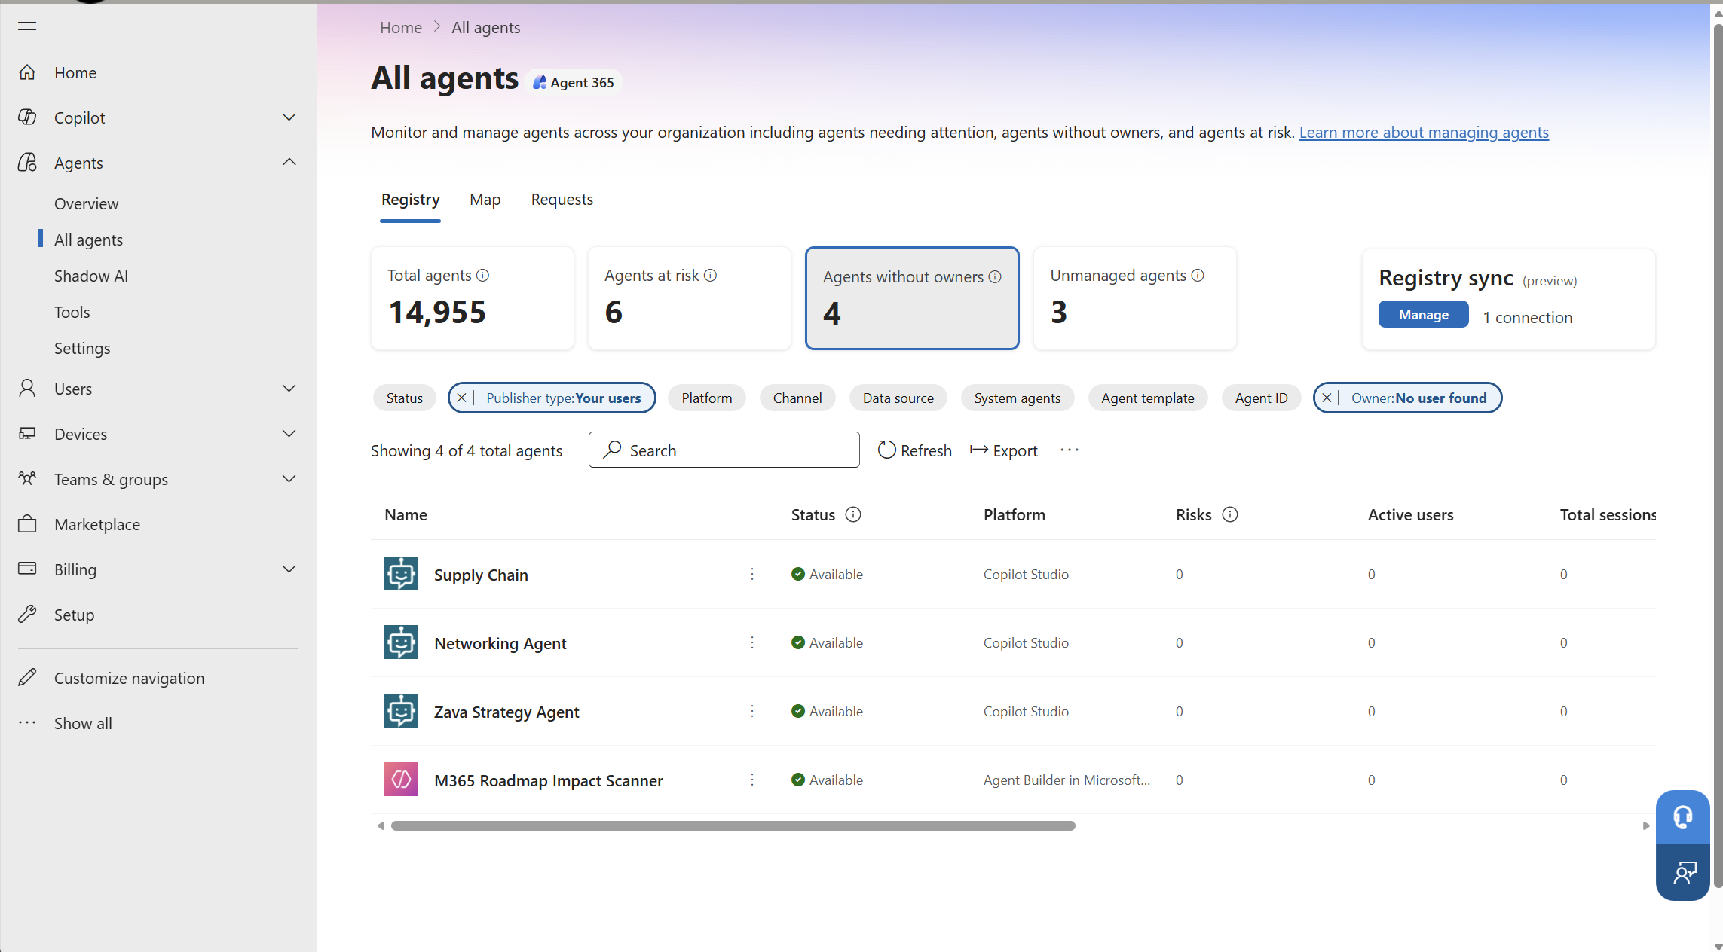
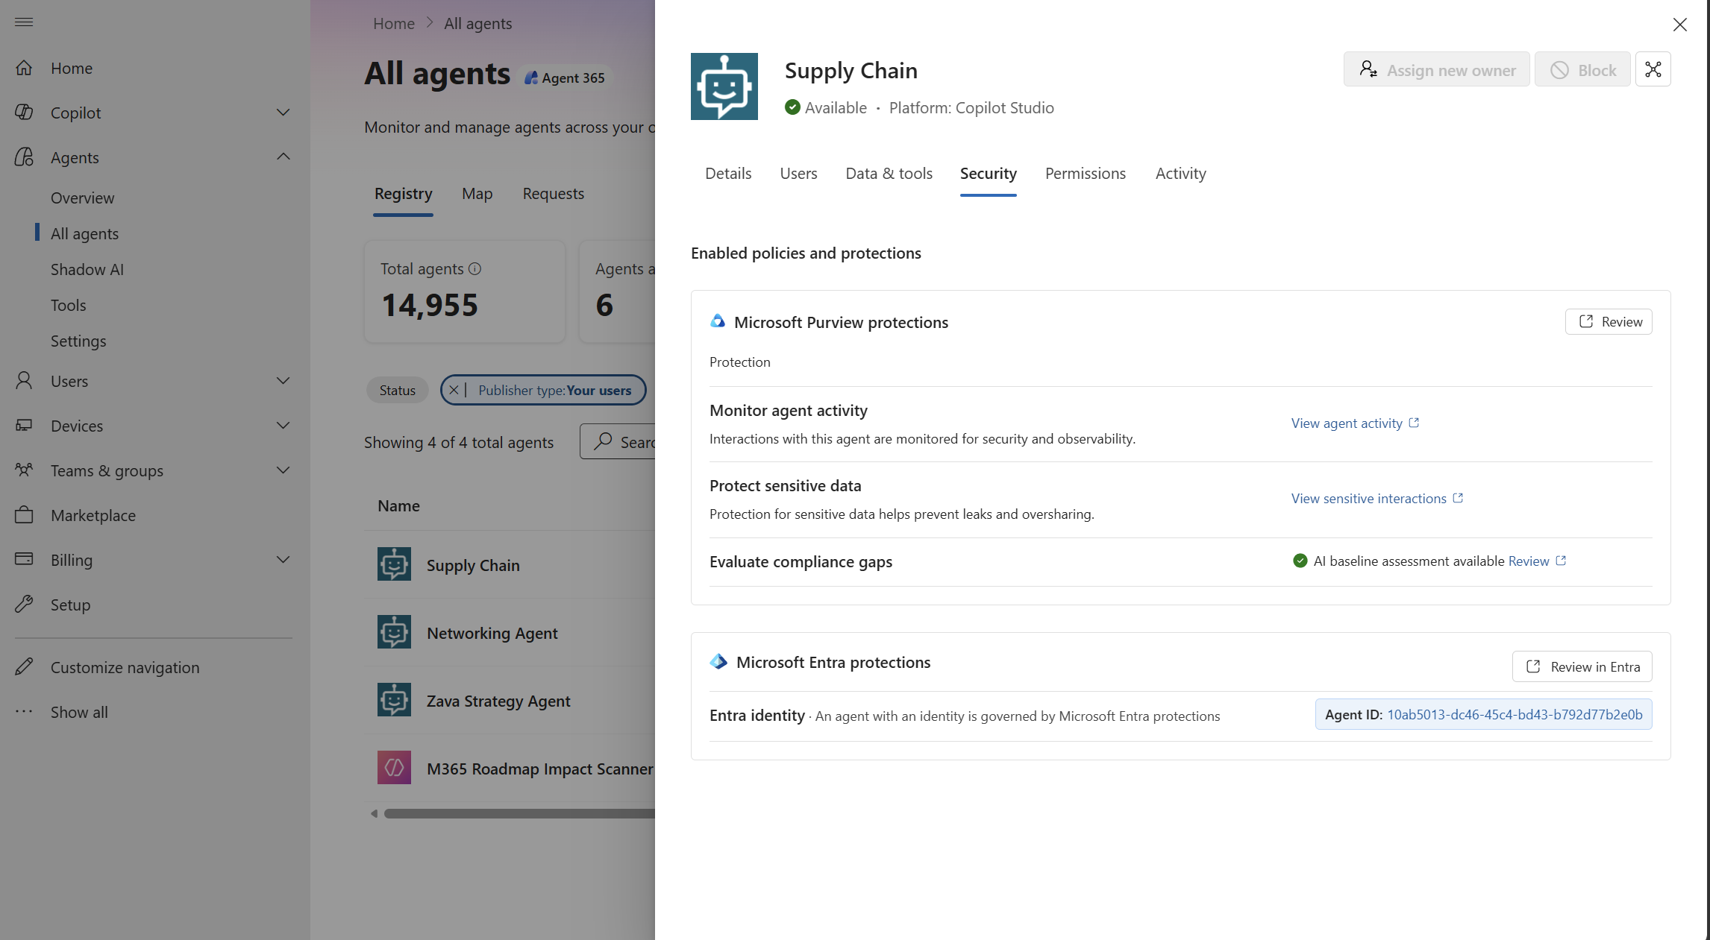
Agent Scenario: Ownership gap
PART 4 · AGENT SCENARIOS · GUIDE
An associate built an agent to manage client supply chain logistics, then left the firm. It still runs on confidential client content — no owner, no review cadence, no one accountable if it leaks. Multiply that across everyone who has ever offboarded, and ownerless agents becomes a standing exposure no one is watching.
The worry
01
02
Discover · Steps 1–2
Evaluate & Decide · Steps 3–5
→
1
Open Agent 365 — the All agents tab lists every agent in the tenant.
3
Open the agent — its profile opens from the list.
2
Filter to ownerless — set Owner to “no user found.“ Here, 4 agents surface.
4
Review Security — its Purview & Entra protections.
5
Reassign owner (option 1) — keep it running under review.
Block (option 2) — quarantine until it’s vetted.
Illustrative click-path — exact labels and screens may change as Agent 365 evolves.
Discover → Evaluate → Decide

Slide 28
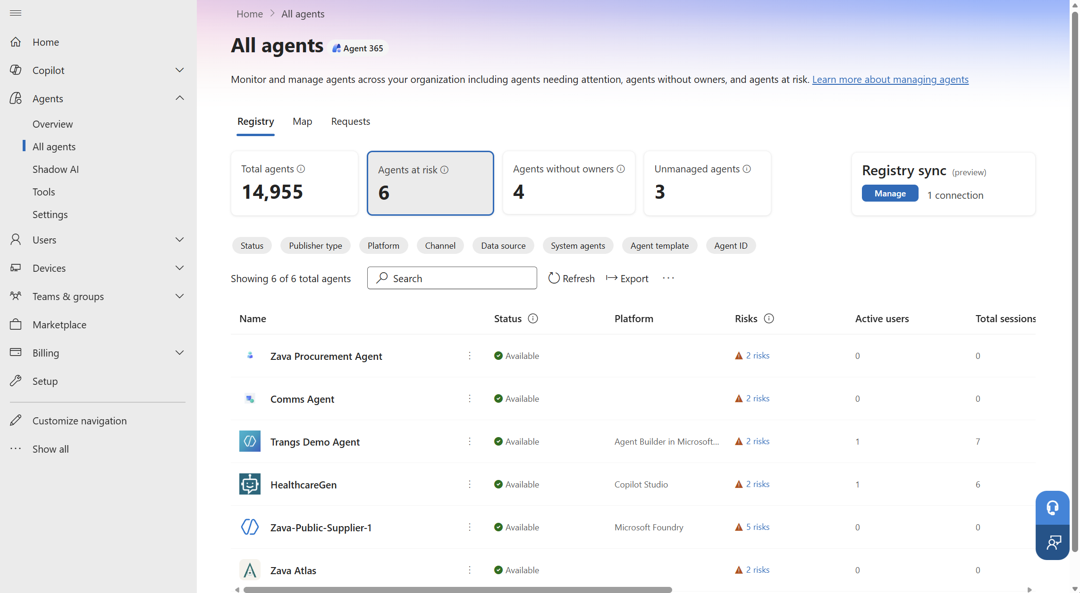
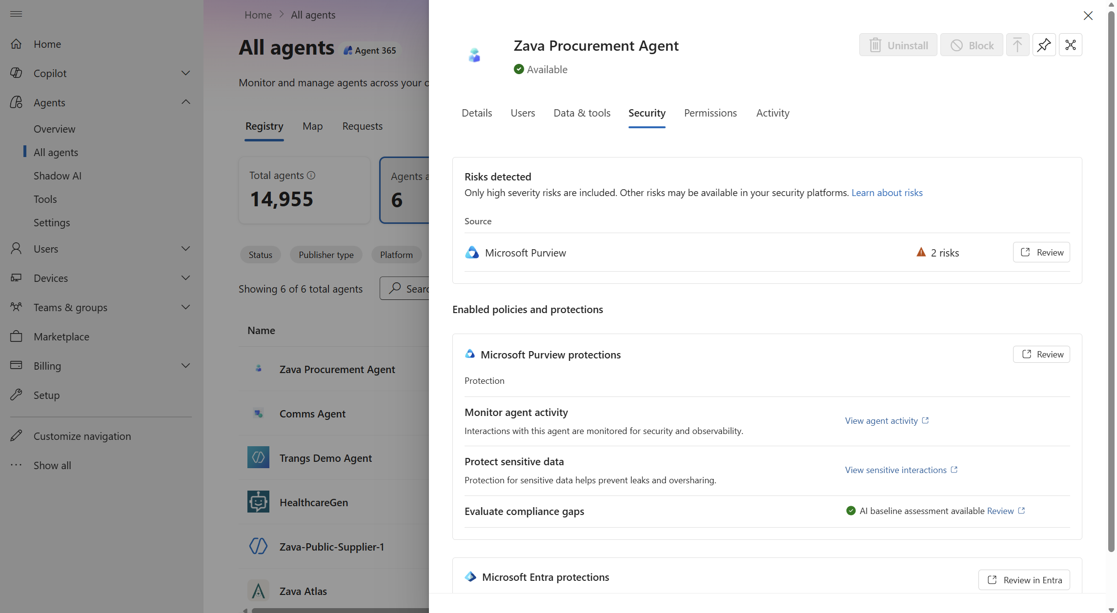
Agent Scenario: Scope drift
PART 4 · AGENT SCENARIOS · GUIDE
A procurement agent starts calling tools outside its remit and tries to send data past the company boundary. No one approved the new behavior, and without monitoring it can look like normal activity — until data is already moving. At agent scale, one drifting agent becomes an exfiltration path before anyone notices.
The worry
01
02
Discover · Steps 1–2
Evaluate & Decide · Steps 3–5
→
1
Open Agent 365 — monitoring shows every agent’s activity.
3
Open the flagged agent — its profile opens.
2
Open Agents at risk — the risky agents surface. Here, 6.
4
Review the risks — Purview flags them here (2 risks).
5
Contain (option 1) — block or uninstall to stop it.
Monitor (option 2) — keep it running; watch the Activity tab.
Illustrative click-path — exact labels and screens may change as Agent 365 evolves.
Discover → Evaluate → Decide

Slide 29
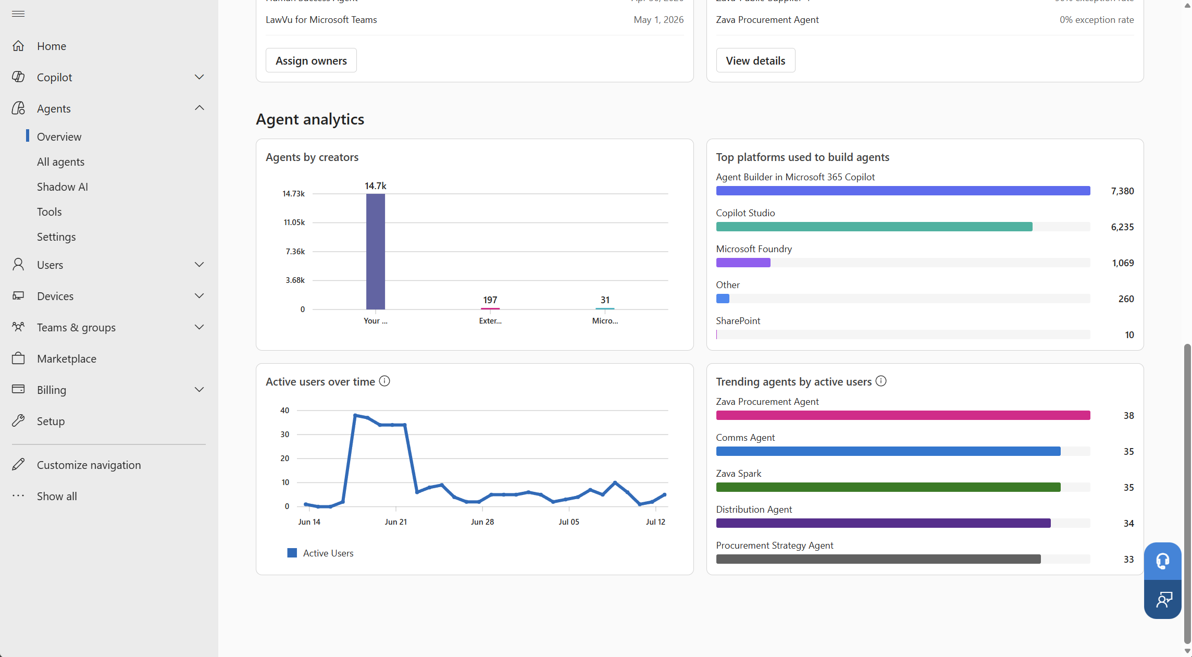
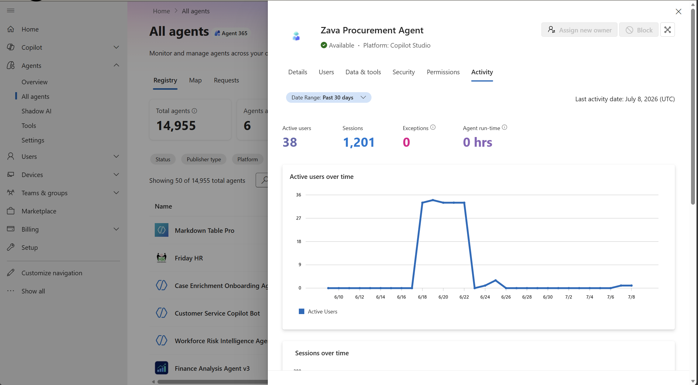
Agent Scenario: Sudden usage spike
PART 4 · AGENT SCENARIOS · GUIDE
The worry
A popular procurement agent keeps getting more use, and it’s genuinely useful. But its share of the workload grows quietly — and without watching adoption, you can’t tell a runaway agent from healthy growth until the cost shows up on someone else’s radar.
01
02
Monitor · Steps 1–2
Evaluate · Steps 3–4
→
1
Open the analytics — usage across every agent.
3
Open the agent — its profile opens.
2
Spot the surge — Trending agents ranks by users. Zava Procurement leads.
4
Read the Activity tab — 38 users, 1,201 sessions; the usage curve.
03
Work with Agent Makers and BDMS
Once the AI/IT admin surfaces the signal, it’s time to work with the agent owner and business leaders to investigate: Weigh the agent’s value against its cost, then scale it, cap it, or retire it. This helps ensures accountability and human over-sight are strategically incorporated every step of the way.
Illustrative click-path — exact labels and screens may change as Agent 365 evolves.
Discover → Evaluate → Decide

Slide 30
Customer Zero
PART 5 · THE PROOF
Agent 365 in production at Microsoft
How Microsoft Digital runs observability across 20,000+ agents — the team, the weekly rhythm, and what
they’re already seeing.
CUSTOMER ZERO

Slide 31
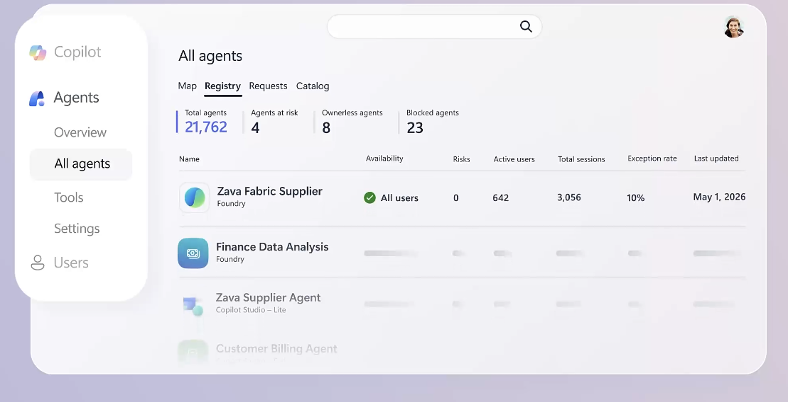
Microsoft’s own agents expanded across multiple platforms faster than expected
PART 5 · THE PROOF · CUSTOMER ZERO
Microsoft Digital runs Agent 365 as Customer Zero in its own production tenant. Because of numerous entry points to building an agent, agent sprawl spread across six platforms (from Copilot Studio to Microsoft Azure AI Foundry and more), each with its own tools and its own view of risk — climbing into the hundreds of thousands, far faster than a manual, platform by platform management program could keep up with. The team needed a program and solution to understand and manage agent usage at scale.
20,000+
6+
agents in the tenant
build platforms, one registry
Sample Agent 365 Overview
Microsoft · Part 5 · The proof
The Problem

Slide 32
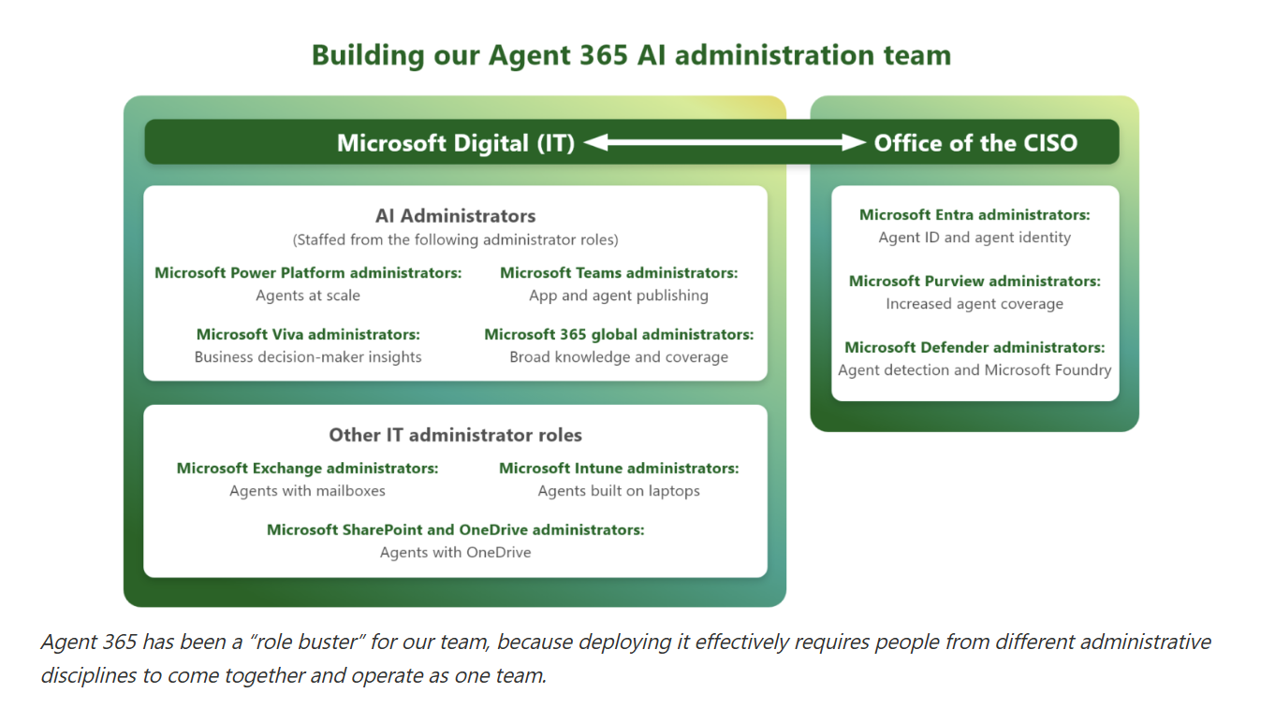
One shared view, one program, one rhythm
PART 5 · THE PROOF · CUSTOMER ZERO
Agent 365 gives AI administrators — and the teams that run security, identity, governance, and platform administration — one shared view of the whole agent ecosystem, while each team still acts within its own discipline.
Read it as three groups: The AI admin org (tenant-level roles), the Office of the CISO (identity and security), and Core Services Engineering (device-level agents). One shared picture — but each team acts in its own lane, with no central choke point.
When we started, I thought the hardest part would be the technology, but it turned out to be building the weekly rhythm where IT, security, identity, product, and business unit teams could look at the same picture, the same week, make decisions from the same facts, and act together. My advice to every IT leader is to establish that governance rhythm before your agent count grows faster than your ability to manage it.“
– Garima Tiwari Principal PM, Agent 365 Customer Zero, Microsoft Digital
▸ Insights reporting brings the business-leader lens — the focus of the next slide.
Microsoft · Part 5 · The proof
The Team

Slide 33
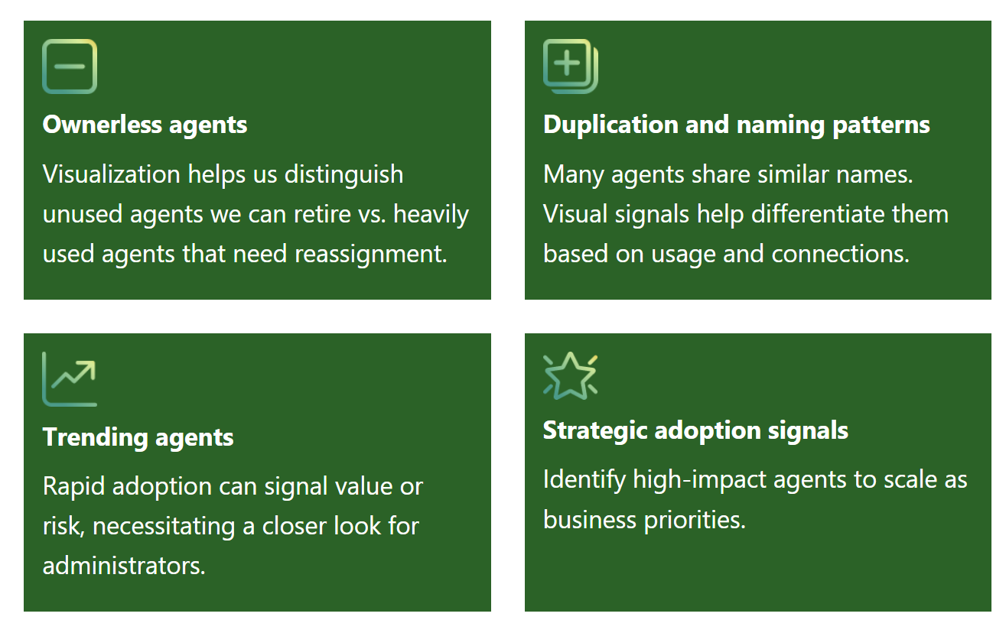
From seeing agents to scaling value
PART 5 · THE PROOF · CUSTOMER ZERO
At Customer Zero, putting every agent in one view did two things: It surfaced what needed action, and it fed the same data into Insights so leaders could see how agents were being adopted. Here’s how the two fit together.
Once every agent sat in one view, the findings came quickly. Cowork went from brand-new to the most-used AI tool for the company in weeks — and Agent 365 as the observability platform. The same view surfaced duplicates, ownerless agents, and cross-platform risks.
This is also where Agent 365 works alongside
Insights reporting — not in place of it.
Agent 365 Oversight for the whole agent estate — the registry, ownership, lifecycle, and governance. It tells IT what to act on next.
Insights Combines that same agent data with your people and org data, so business leaders can see how agents are being adopted and used in their teams.
One path from seeing to value: Admins act on what needs attention, and leaders see where adoption is growing and where to invest next along with training and enablement.
High Value Signals
Microsoft · Part 5 · The proof
Seeing → Value

Slide 34
Making Agent Observability Operational
PART 6 · MAKING AGENT OBSERVABILITY OPERATIONAL
From first steps to full swing
The everyday workflows and the maturity path for a successful agent observability program
OPERATIONAL

Slide 35
From first steps to full swing — where you are.
PART 6 · MAKING AGENT OBSERVABILITY OPERATIONAL
This is a maturity path, not a one-time checklist. Most organizations start at Crawl — just getting agents visible — and grow into Walk and Run over time. Find where you are today, and the rest of the playbook maps your next step.
01
02
03
Crawl
Discover agents
Walk
Evaluate agents
Run
Monitor agents
What you do
Turn on cross-platform discovery and leverage the SDK so agents — Microsoft and non-Microsoft — lands in one registry. Validate the inventory for accuracy, and surface the shadow agents you didn’t know were running.
What you do
Give agents a named owner. Start the operating rhythm — a weekly sweep for new, ownerless, and high-risk agents, plus a monthly review — and determine the appropriate next steps.
What you do
Run the full cadence, and let automation and APIs carry the scale so you’re not doing it by hand. Measure value — scale the agents that earn their keep, retire the ones that don’t — and share it with leadership.
→
→
What “Good“ looks like
Agent visible in one place — a complete, living inventory.
What “Good“ looks like
Agents are owned, the unmanaged queue near zero, and flagged agents routed to the right team.
What “Good“ looks like
Observability runs as ongoing program. You act on trends instead of chasing them, and leaders can see the impact.
◆ You are here
Next
Then
Microsoft · Part 6 · Making Agent observability operational
Crawl → Walk → Run

Slide 36
The everyday workflows — and where to learn more.
PART 6 · MAKING AGENT OBSERVABILITY OPERATIONAL
Examples of high-level operating tasks that keep the program running. Each one belongs to a phase of the agent observability process — the color shows which — and the trigger is the signal that starts it.
Discover
Evaluate
Monitor
Run the program
01
02
03
04
Discover — find new agents
Evaluate unmanaged agents
Evaluate ownerless agents
Evaluate shadow agents
Scan every platform so new agents register.
Assess its purpose and data reach; determine what actions need to be taken.
Reassign the high-value agents; retire the low-value agents.
Bring surfaced agents under management — or investigate further.
Triggered by The scheduled import (daily or weekly), or a new platform connected
Triggered by A newly discovered or registered agent
Triggered by An owner is deactivated; the queue grows
Triggered by The Shadow AI page surfaces local shadow agents
05
06
07
Monitor & work agents at risk
Value review (with the BDM)
Monthly program review
Watch the at-risk agent count and drive that number to zero.
Weigh usage vs. cost — scale, cap, or retire.
The team reviews the month and decides what's next.
Triggered by The agents-at-risk count climbs
Triggered by A usage surge, or the monthly value review
Triggered by The monthly cadence — a set date on the calendar.
Go deeper: Click here to learn: Agent 365 docs
Click here to learn: Customer Zero Inside Track
Microsoft · Part 6 · Making Agent observability operational
Everyday Workflows

Slide 37

Get started with Agent 365
GET STARTED · YOUR NEXT STEP
Two ways to begin — pick the one that fits your team. Work through it yourself with the self-guided resources on the left, or bring in Microsoft's experts and partners on the right.
Get started on your own
Get started with help
WITH MICROSOFT & PARTNERS
01
02
As an admin, go to the admin center and turn on Agent 365 at your own pace, using the self-guided resources below.
Want a hand? Bring in Microsoft's experts or a specialized partner to help you plan, deploy, and roll it out.
GO TO admin.microsoft.com ↗
Microsoft FastTrack
Step-by-step deployment and adoption guidance from Microsoft engineers — at no extra cost for eligible plans (150+ seats).
Explore Microsoft FastTrack ↗
SELF-GUIDED RESOURCES
Get started with Agent 365 — Microsoft Learn ↗
Agent 365 training module ↗
Agent 365 adoption resources ↗
TechWorkshop L200: Observe, Govern & Secure agents ↗
Microsoft partners
Work with a specialized partner to plan, deploy, and scale Agent 365 across your organization.
Find a Microsoft partner ↗
Microsoft Agent 365

Slide 38
Appendix
APPENDIX
Reference & resources
Every link referenced in the playbook, in one place — plus deeper drill-downs on the Agent 365 SDK and the Tools registry.
APPENDIX

Slide 39
Learn more — everything in one place.
APPENDIX · LEARN MORE
Every resource referenced in this playbook, in one place. Click any topic to open it — grouped by the product itself, the connected tools it hands off to, and the proof.
Agent 365 & observability
The connected tools
The proof
Agent 365 overview ↗
What it is and what it does.
Manage agents (admin center) ↗
Run agents from the M365 admin center.
Agent roles & permissions ↗
Who can manage agents, and how.
The Agent Registry ↗
The inventory behind every agent.
Shadow AI requirements ↗
What surfaces local shadow agents.
Observability for admins ↗
See, sort, and watch every agent.
The Observability SDK ↗
Bring non-Microsoft agents into view.
Agent 365 SDK ↗
Build and extend agents anywhere.
Microsoft Entra Agent ID ↗
Give every agent a managed identity.
What is Entra Agent ID ↗
A primer on agent identities.
Purview for Agent 365 ↗
Data security and compliance.
Microsoft Purview SDK for agents ↗
Wire compliance into custom agents.
Defender for AI agents ↗
Detect and contain agent threats.
Intune RBAC ↗
Scope who manages devices.
Viva Insights Agent Dashboard ↗
Adoption and usage insights.
Inside Track — Customer Zero ↗
How Microsoft runs Agent 365 itself.
Every link opens an official Microsoft resource — the one-stop shop for everything referenced in this playbook.

Slide 40
Agent 365 SDK
APPENDIX · GO DEEPER
For agents built outside Microsoft's platforms, the SDK is how developers make them enterprise-ready and visible on Agent 365 — so an agent built on any framework is discovered, observed, and governed alongside everything else.
WHAT THE SDK GRANTS
Identity
An Entra Agent ID — a governed actor, not an anonymous script.
Observability
OpenTelemetry-based — audited, traceable interactions and tool usage.
AGENT 365 SDK
Extends the agent you already built with an enterprise layer
Work IQ & notifications
Governed access to Microsoft 365 tools, plus notifications in Teams, Outlook,
and Word.
Governance
The same policies, ownership, and lifecycle as first-party agents.
MICROSOFT PURVIEW DEVELOPER PLATFORM
Microsoft Purview Developer Platform provides capabilities to integrate your agents and apps with Microsoft Purview to help govern, protect, and manage data.
It offers a fast time-to-value integration pathway for developers to incorporate data protection features into their enterprise apps and agents and helps ensure robust enterprise security.
Click here to learn: Microsoft Purview SDK for agents
AGENT 365 SDK
Notes:
Appendix - Go Deeper: Agent 365 SDK, with Microsoft Purview SDK footnote. ALL Purview footnote copy is quoted verbatim from Microsoft Learn - Microsoft Purview Developer Platform (https://learn.microsoft.com/en-us/purview/developer/): ’Microsoft Purview Developer Platform provides capabilities to integrate your agents and apps with Microsoft Purview to help govern, protect, and manage data.’ | ’It offers a fast time-to-value integration pathway for developers to incorporate data protection features into their enterprise apps and agents, ensuring robust enterprise security.’
Additional VERBATIM sentences available if you want more detail (from https://learn.microsoft.com/en-us/agent-framework/integrations/purview): ’Microsoft Purview provides enterprise-grade data security, compliance, and governance capabilities for AI applications.’ | ’By integrating Purview APIs within the Agent Framework SDK, developers can build intelligent agents that are secure by design, while ensuring sensitive data in prompts and responses are protected and compliant with organizational policies.’ | Why integrate: ’Prevent sensitive data leaks: Inline blocking of sensitive content based on Data Loss Prevention (DLP) policies.’ and ’Enable governance: Log AI interactions in Purview for Audit, Communication Compliance, Insider Risk Management, eDiscovery, and Data Lifecycle Management.’ | Mechanism: ’In your agent’s workflow middleware pipeline, you can add Microsoft Purview policy middleware to intercept prompts and responses to determine if they meet the policies set up in Microsoft Purview.’
Relocated from slide to notes to make room for the footnote (original SDK closing line, restore on-slide if wanted): ’Who: platform and developer teams - a build-side task, not an admin one. The playbook covers the admin decisions; the SDK (and CLI) are the on-ramp.’ Licensing (E5) intentionally omitted - dates fast, not observability.

Slide 41
Microsoft Entra Agent ID
APPENDIX · GO DEEPER
Microsoft Entra Agent ID is an identity and security framework that extends Microsoft Entra capabilities to AI agents. As organizations deploy assistive, autonomous, and user-like agents, they need purpose-built identity constructs to authenticate, authorize, govern, and protect these nonhuman identities.
The Identity Platform
Works Across Platforms
Security & Governance
Microsoft Entra Agent ID brings together identity management, access protection, governance, and compliance for AI agents. The Microsoft Entra Agent identity platform enables developers to create and manage agent identities, which are specialized identity constructs built for AI agents.
Microsoft Entra Agent ID works with agents built on Microsoft and non-Microsoft platforms. Organizations can integrate third-party agents from platforms such as AWS Bedrock and n8n by using the Microsoft Entra Auth SDK (sidecar) or workload identity federation, giving every agent a governed identity regardless of where it was built.
Microsoft Entra Agent ID extends existing Microsoft Entra security and governance capabilities to agent identities. Agents receive the same identity-driven protections as users and workloads, including adaptive access policies, real-time risk detection, lifecycle management, and network-level controls. All agent authentication and activity is logged for compliance and audit.
Click here to learn: What is Microsoft Entra Agent ID
MICROSOFT ENTRA AGENT ID
Notes:
Appendix - Go Deeper: Microsoft Entra Agent ID. All body copy is quoted verbatim from Microsoft Learn - What is Microsoft Entra Agent ID (https://learn.microsoft.com/en-us/entra/agent-id/what-is-microsoft-entra-agent-id). Additional verbatim sentences available to pull if needed: ’Microsoft Entra Agent ID addresses these needs by providing a unified platform for managing agent identities at enterprise scale.’ | ’The platform supports standard protocols such as OAuth 2.0, MCP, and A2A for authentication and agent-to-agent communication.’ | ’Agent identity blueprints serve as templates for creating individual agent identities with parent-child relationships, enabling consistent security policies across large numbers of agents.’ | ’Agents receive the same identity-driven protections as users and workloads...’ | ’Agent ID is available for all Microsoft Entra customers.’ Licensing lines (E5/E7) intentionally omitted - they date fast and are not observability. This slide is the deep-dive behind the ’Microsoft Entra Agent ID’ link on the Learn more appendix slide.

Slide 42
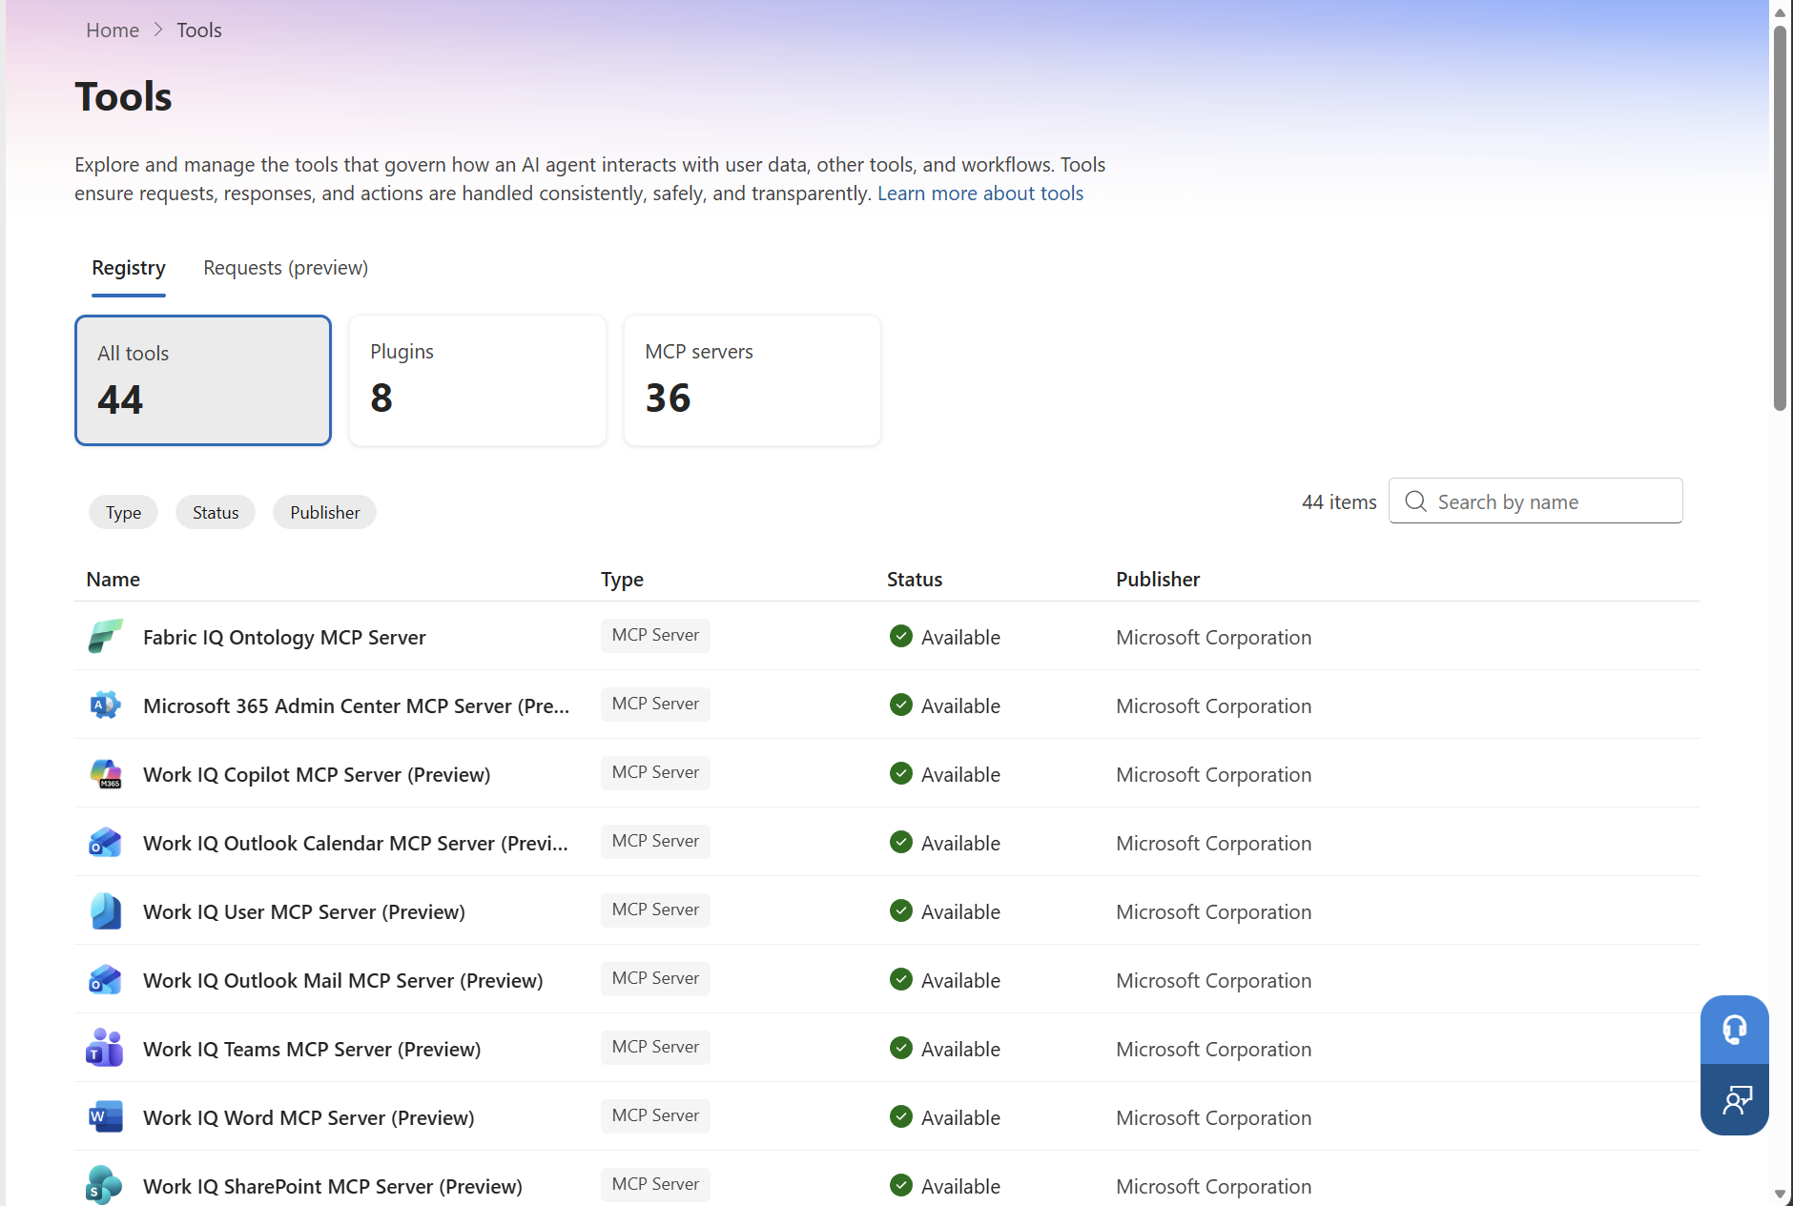
Observe the agent tools
APPENDIX · GO DEEPER
An agent’s power comes from its tools. Alongside the Agent registry, Agent 365 gives you a Tools registry — the catalog of every tool your agents can use, governed with the same model.
A One-time Discovery
Discover — the registry auto-populates. Evaluate — review each tool’s type, status, and publisher. Block any unapproved tools.
What’s
In It
MCP servers, plugins, and connectors. Here: 44 tools, 36 of them MCP servers, and
8 plugins.
Why It Matters
Controlling the tools is how you control what an agent can actually do — a risky tool is a risk to every agent that uses it.
THE TOOLS REGISTRY

