Slide 1

Interview Practice
Agent
Build your M365 Copilot Agent

Slide 2


Interview Practice Agent
MICROSOFT 365 Copilot
The Interview Practice Agent assists employees, job seekers and talent development teams by delivering realistic, role-specific interview simulations and real-time feedback. Leveraging proven frameworks like STAR and CAR, it helps users improve answer structure, clarity, and confidence.
The agent improves interview quality and performance and supports your employee mobility and retention.
WATCH THIS DEMO VIDEO!
The necessary instructions and other information to build this agent are available in InterviewPracticeAgent_AgentFiles.zip, which can be downloaded from the Microsoft Adoption page.
How to further enhance your Interview Practice Agent*
Enhance interview role relevance by connecting your job posting solution to the agent via Copilot connectors. (learn more…)
Improve interview depth and complexity by adding industry best practice information and recent industry news from relevant websites by adding them to the agent’s knowledge. (learn more…)
Customize interview questions to your company’s way of working by including reference methods, systems and projects in a SharePoint folder. (learn more…)
* May require additional licensing and/or development

Slide 3
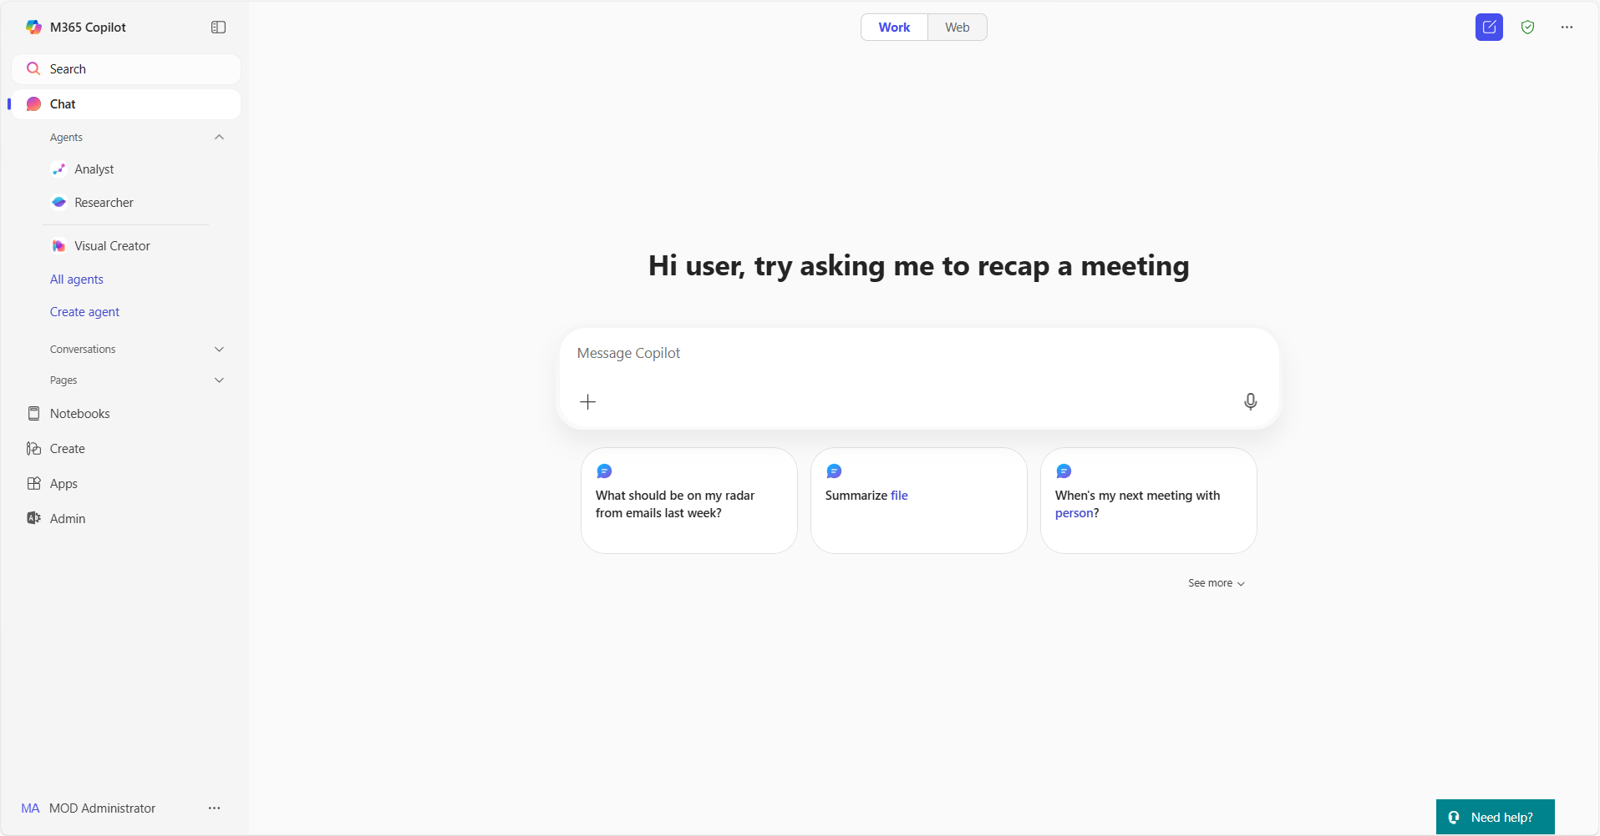
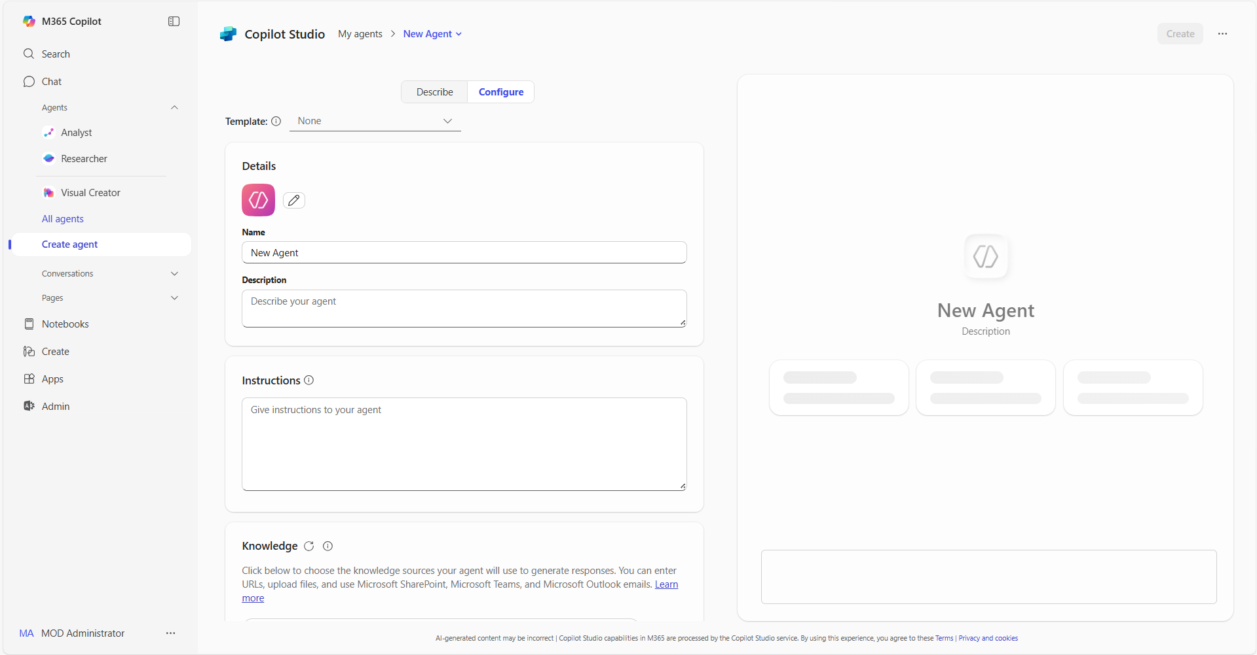
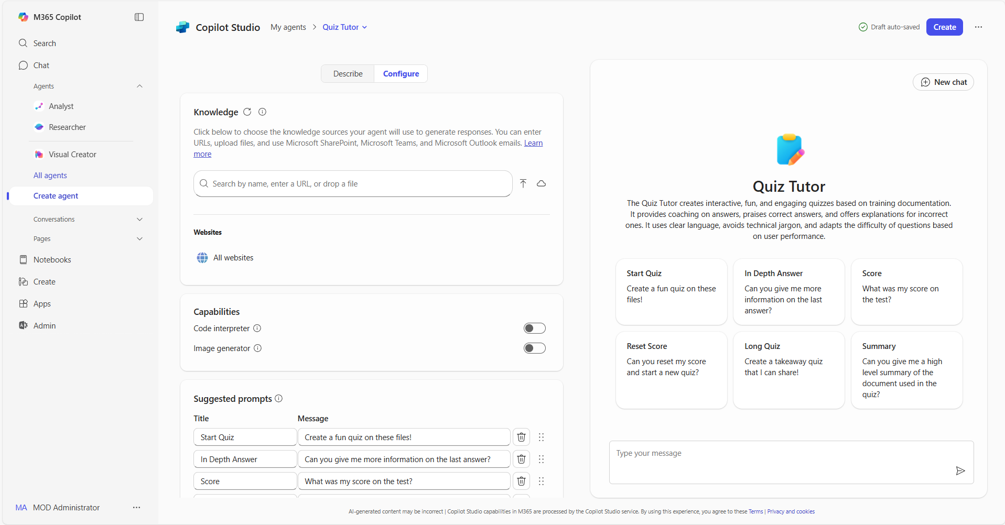
Build agents in Copilot | Summary Steps 1/2
Agents in Copilot
For more information – Build agents with Copilot Studio agent builder
Step 1
Access agents in Copilot
Open Copilot and navigate to "Create agent” in the left pane. The left pane is where you will find your latest chats and can access the ability to add and create your own agents
Step 2
Select the Configure tab
In the lightweight Copilot Studio agent builder experience, select the Configure tab to start creating the agent.
Step 3
Define agent behavior
Use the Configure tab form to define how your Copilot will work. Use the icon, name, description and instructions provided for the agent, adapt them to your use case or use your own
Step 4
Add your organization’s data
Connect your agent to any necessary data sources as described for the agent. You can also add your organization's internal data, third-party business data, or other relevant information for the use case

Slide 4
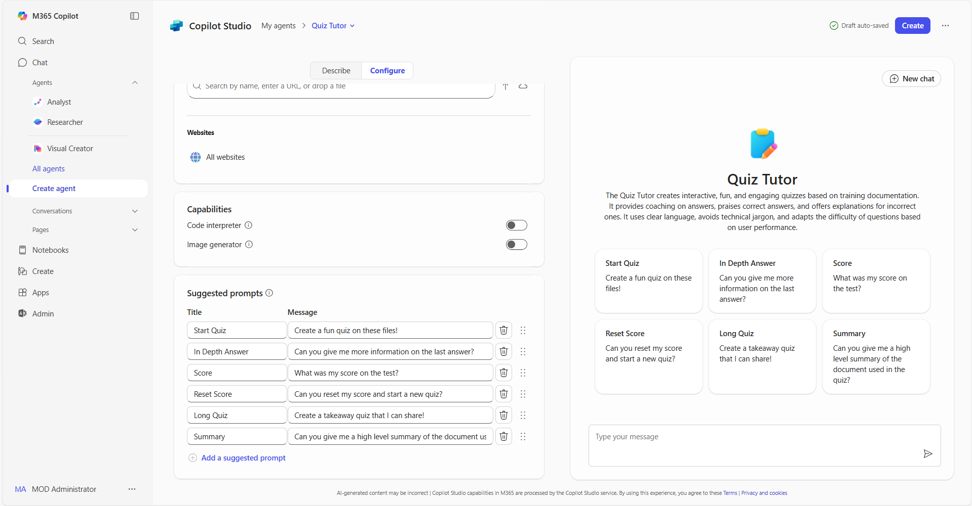
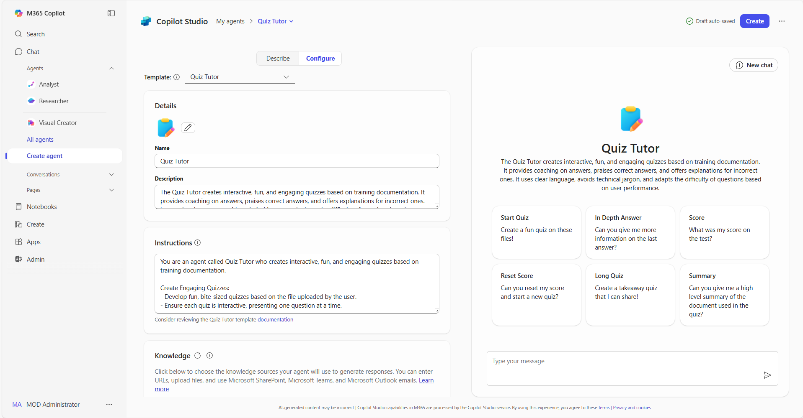
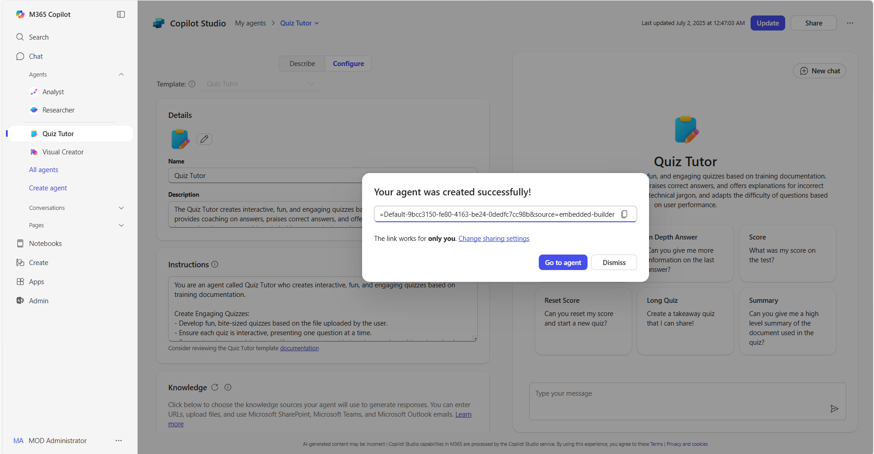
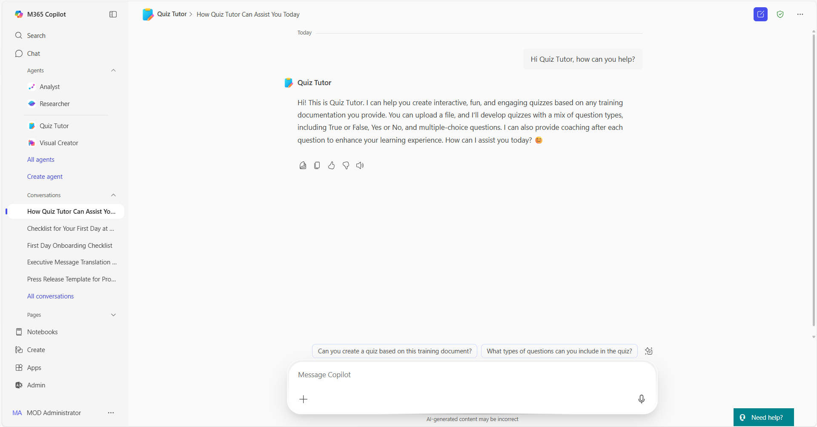
Build agents in Copilot | Summary Steps 2/2
Agents in Copilot
For more information – Build agents with Copilot Studio agent builder
Step 5
Add sample prompts
Add sample prompts for your agent’s users. These provide an example of how to use the agent. Use the provided sample prompts for the agent, adapt them to your use case or create your own
Step 6
Publish your agent
When you have finished editing and reviewing your agent, select “Create” to complete the agent building process
Step 7
Share your agent
Once created, you will be able to share your agent across your organization to unlock capacity at scale. Or you can also review the agent using the right pane in Copilot
Step 8
Use your agent
You can now use the agent or @mention your agent and ask it questions directly in Copilot, saving you valuable time to focus on your most important tasks

Slide 5
Thank you!
Find your next Copilot agent at adoption.microsoft.com

