Slide 1

Executive Assistant
Build your M365 Copilot Agent

Slide 2


Executive Assistant
MICROSOFT 365 Copilot
The Executive Assistant supports executive teams and board members by automating the creation of high-quality executive communications. These include board papers, strategic reports, and leadership updates.
The agent boosts leadership productivity by automating high-quality communications, enhancing team alignment and decision-making, while driving a positive impact across the entire company.
WATCH THIS DEMO VIDEO!
The necessary instructions and other information to build this agent are available in ExecutiveAssistant_AgentFiles.zip, which can be downloaded from the Microsoft Adoption page.
How to further enhance your Executive Assistant*
Enable context-aware, data-driven conversations by extending the agent with Copilot Connectors for your CRM services, leveraging stakeholder information and strategic account insights from CRM data. (learn more…)
Ensure consistent and on-brand strategic communications by connecting the agent to a SharePoint Folder containing branded templates and style guides. (learn more…)
* May require additional licensing and/or development

Slide 3
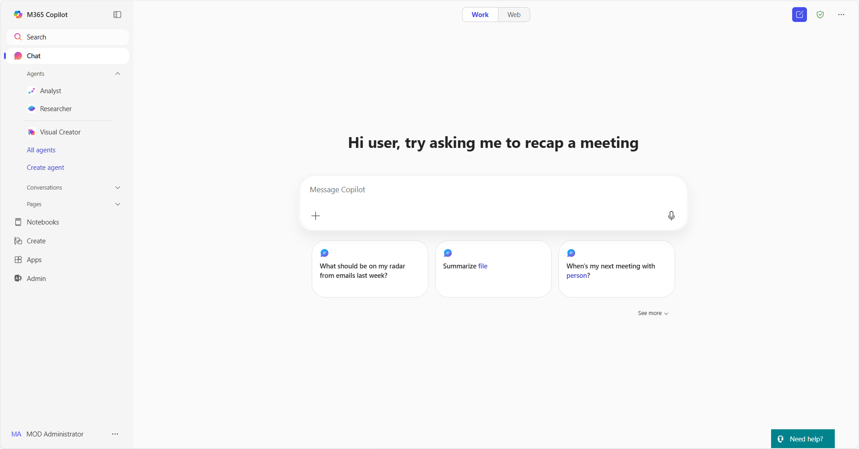
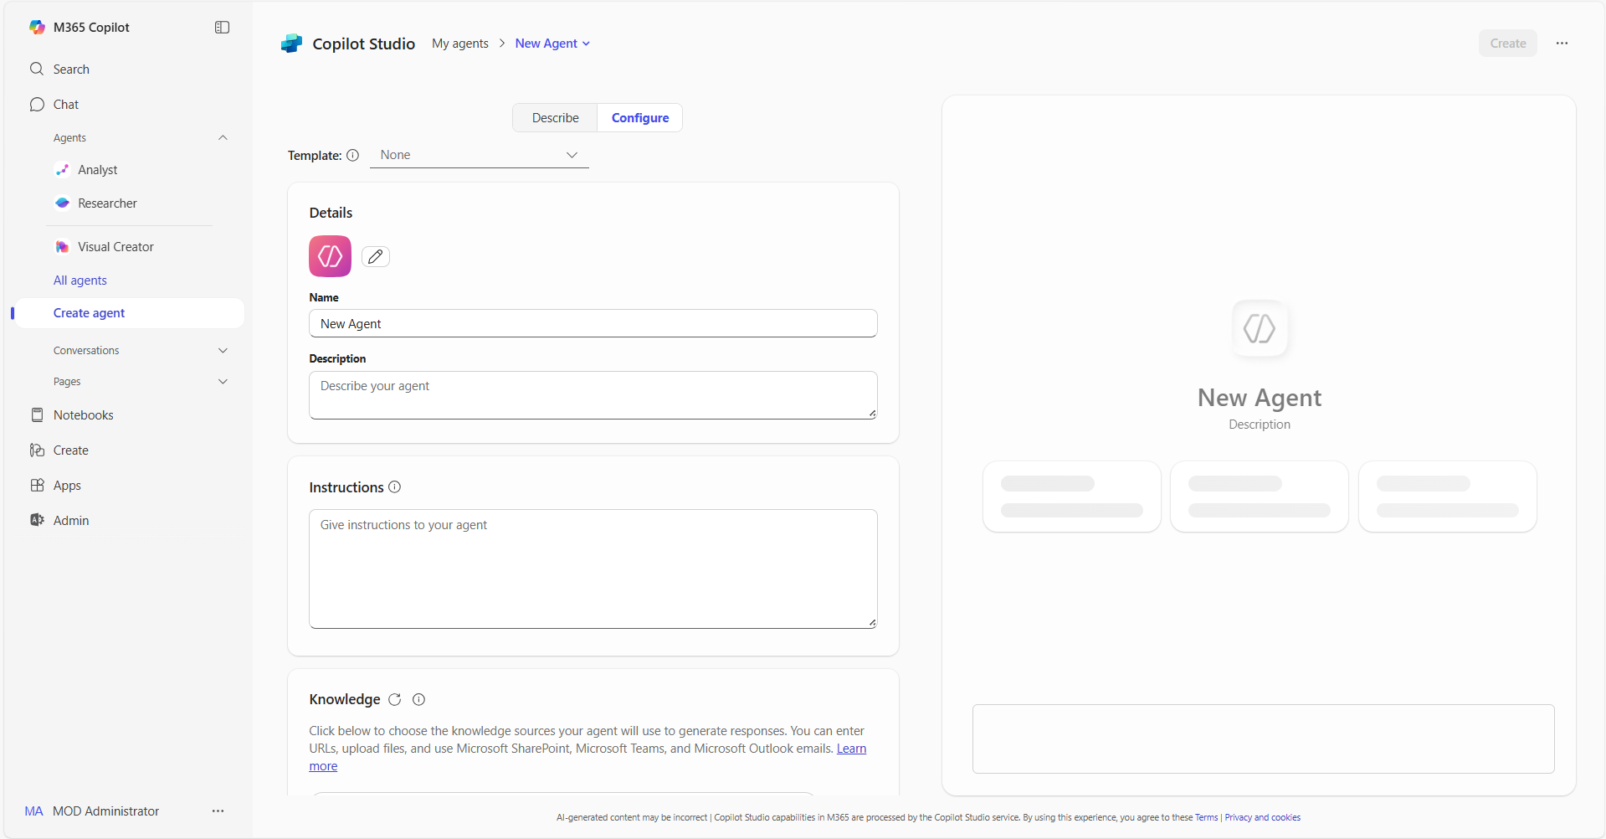
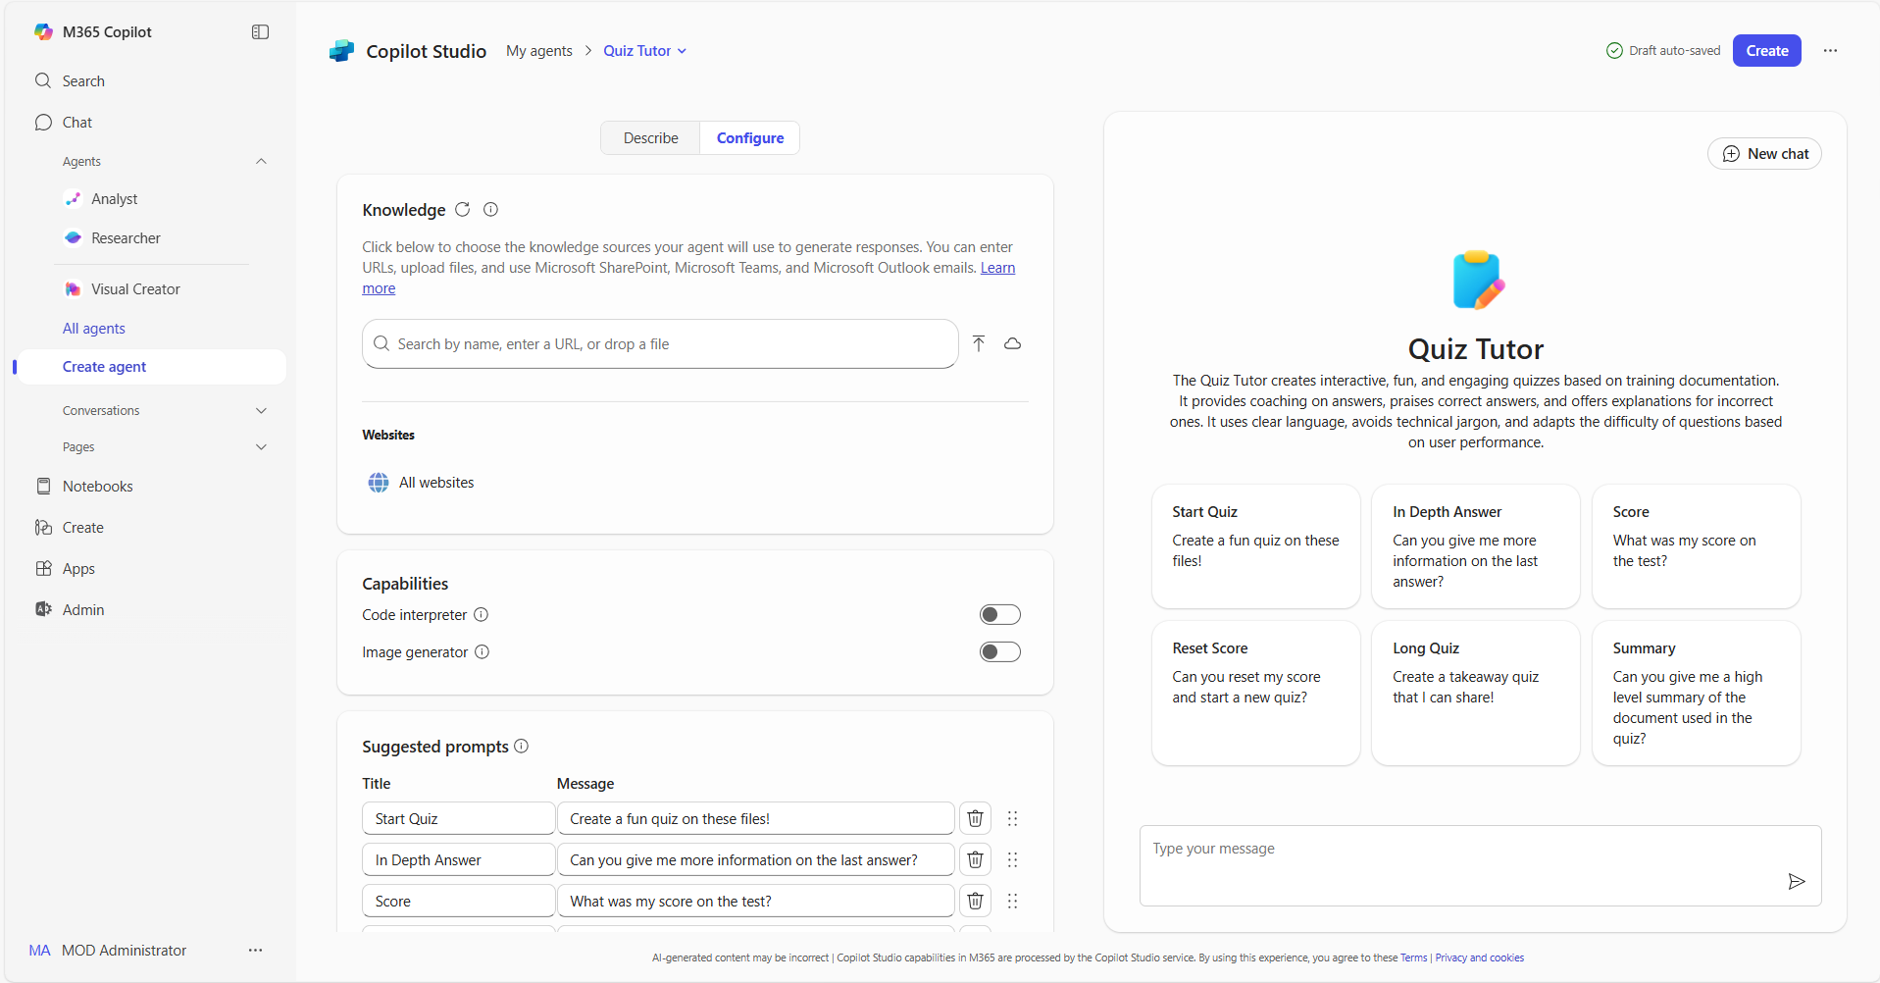
Build agents in Copilot | Summary Steps 1/2
Agents in Copilot
For more information – Build agents with Copilot Studio agent builder
Step 1
Access agents in Copilot
Open Copilot and navigate to "Create agent” in the left pane. The left pane is where you will find your latest chats and can access the ability to add and create your own agents
Step 2
Select the Configure tab
In the lightweight Copilot Studio agent builder experience, select the Configure tab to start creating the agent.
Step 3
Define agent behavior
Use the Configure tab form to define how your Copilot will work. Use the icon, name, description and instructions provided for the agent, adapt them to your use case or use your own
Step 4
Add your organization’s data
Connect your agent to any necessary data sources as described for the agent. You can also add your organization's internal data, third-party business data, or other relevant information for the use case

Slide 4
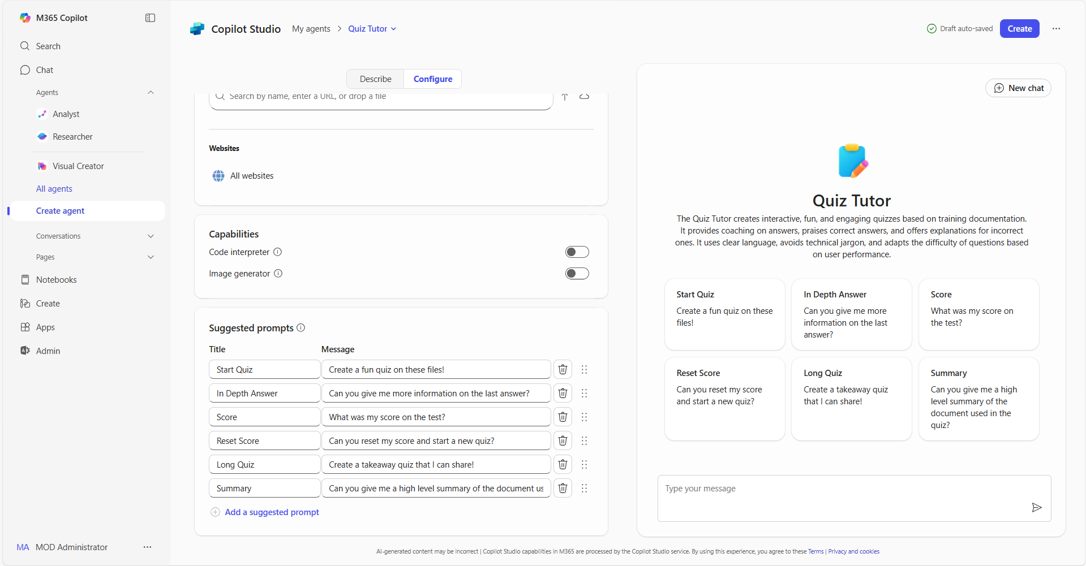
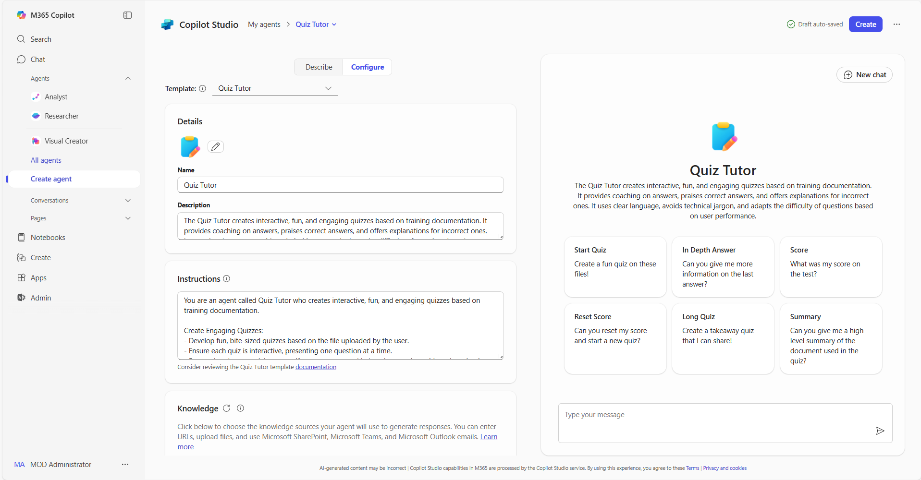
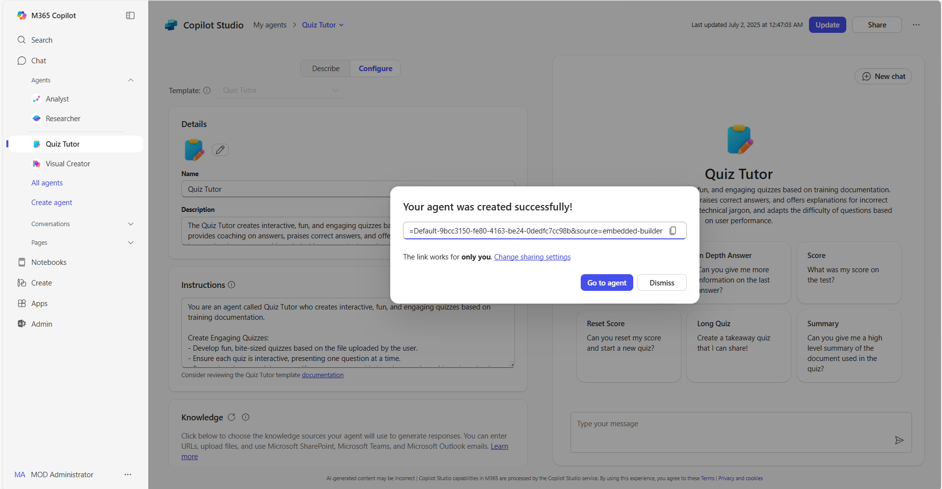
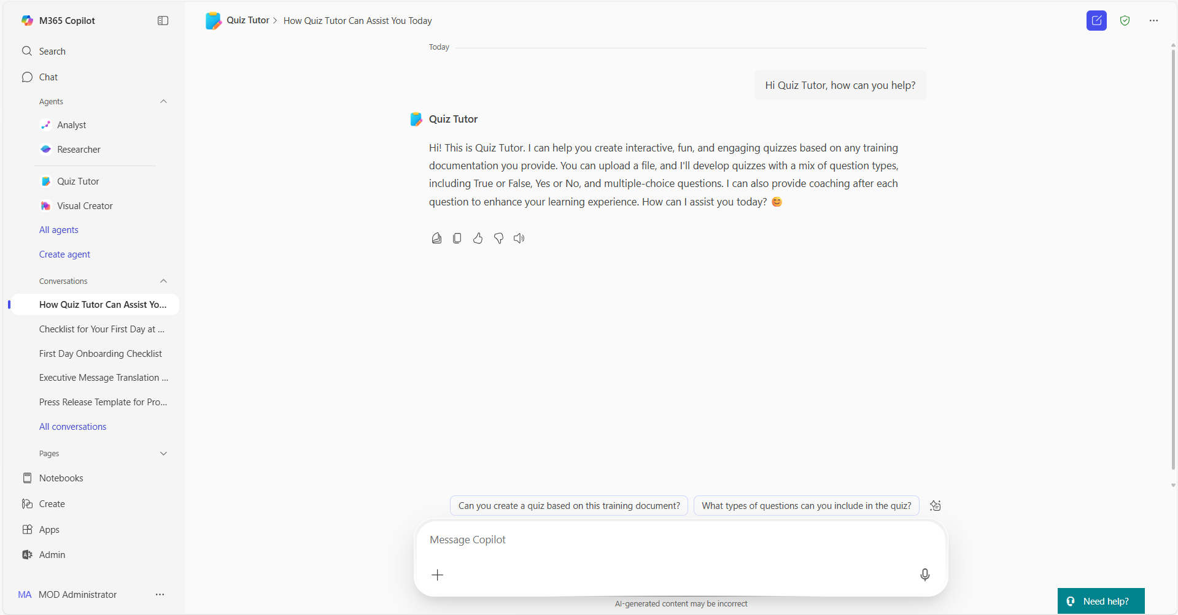
Build agents in Copilot | Summary Steps 2/2
Agents in Copilot
For more information – Build agents with Copilot Studio agent builder
Step 5
Add sample prompts
Add sample prompts for your agent’s users. These provide an example of how to use the agent. Use the provided sample prompts for the agent, adapt them to your use case or create your own
Step 6
Publish your agent
When you have finished editing and reviewing your agent, select “Create” to complete the agent building process
Step 7
Share your agent
Once created, you will be able to share your agent across your organization to unlock capacity at scale. Or you can also review the agent using the right pane in Copilot
Step 8
Use your agent
You can now use the agent or @mention your agent and ask it questions directly in Copilot, saving you valuable time to focus on your most important tasks

Slide 5
Thank you!
Find your next Copilot agent at adoption.microsoft.com

