Slide 1

Customer Insight
Assistant
Build your Microsoft 365 Copilot Agent

Slide 2


Customer Insight Assistant
MICROSOFT 365 Copilot
WATCH THIS DEMO VIDEO!
The Customer Insight Assistant empowers teams to deeply understand their customers by automatically generating rich, structured profiles.
By streamlining customer research and surfacing actionable insights, the assistant helps sales and business development teams tailor their strategies, reduce preparation time, and increase engagement.
More info on the Customer Insight Assistant template can be found on Microsoft Learn
How to further enhance your Customer Insight Assistant*
Personalize your customer insight report template by adding it to the agent’s instructions (learn more…)
Create customer-specific agents by adding relevant public websites. For example, the customer’s official webpage or industry news sites (learn more…)
Adapt the agent to your customer engagement and sales process by adding a SharePoint site containing customer engagement guidelines and sales best practices to the agent’s knowledge (learn more…)
* May require additional licensing and/or development

Slide 3
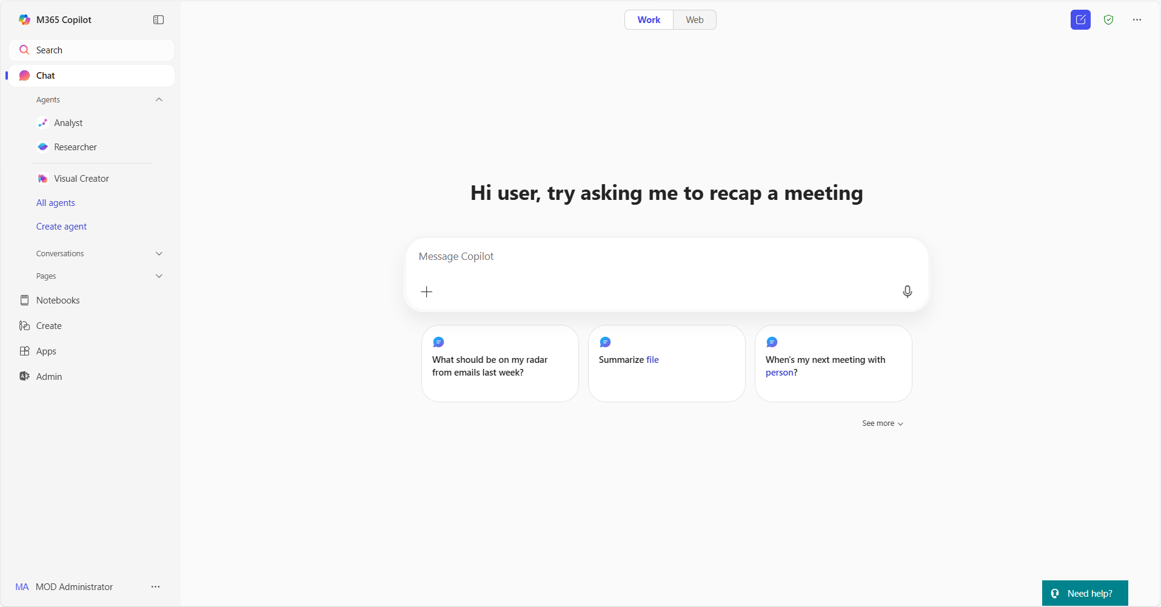
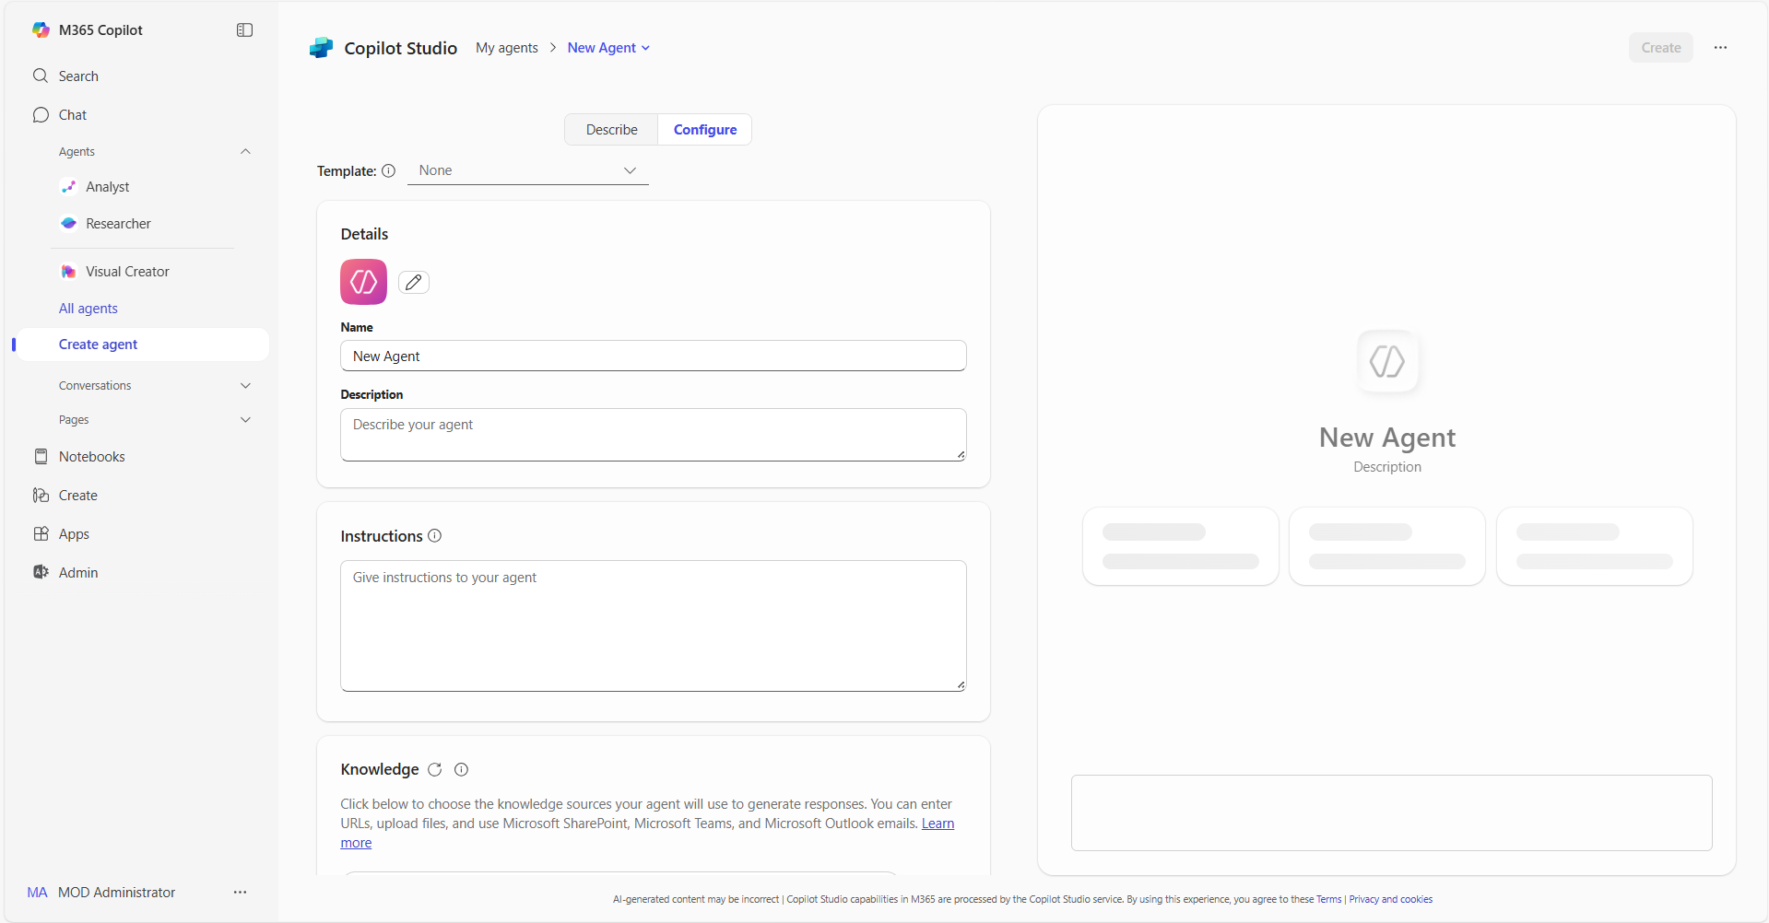
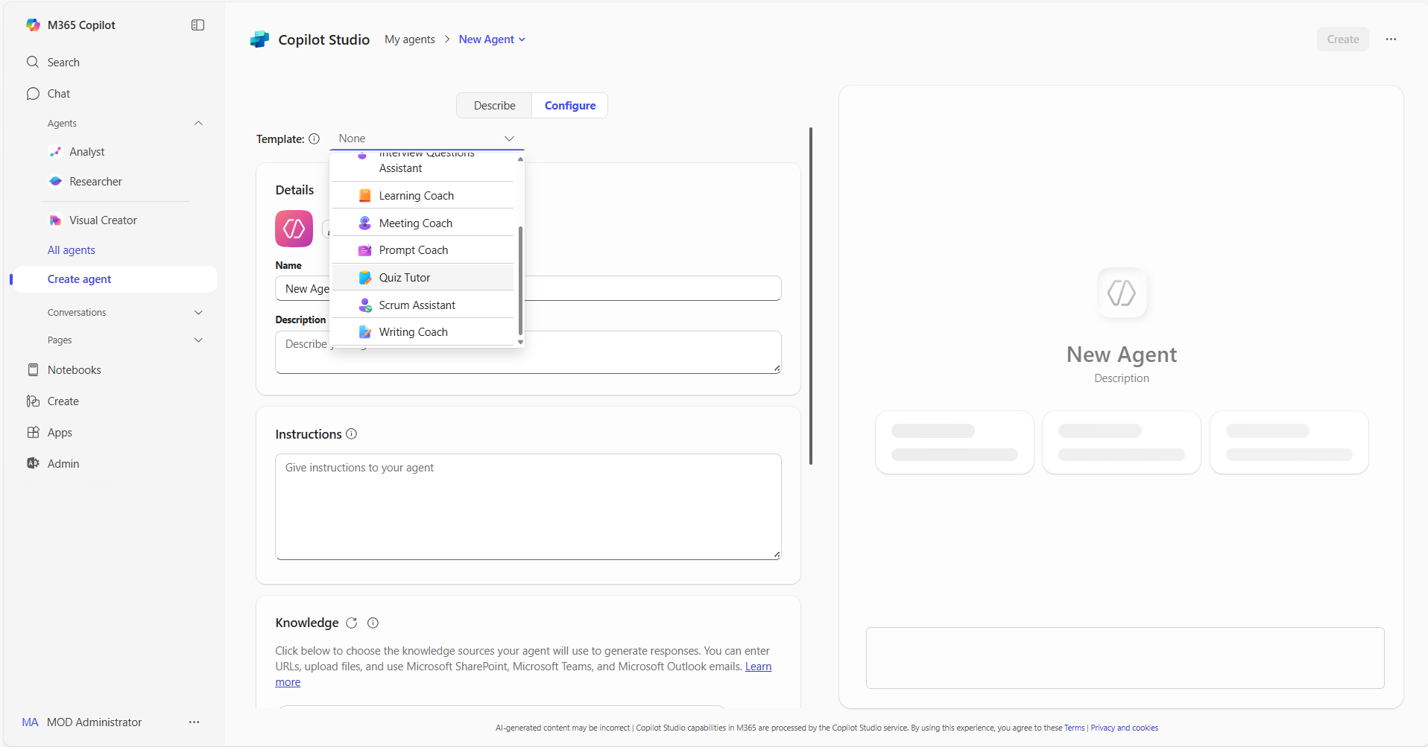
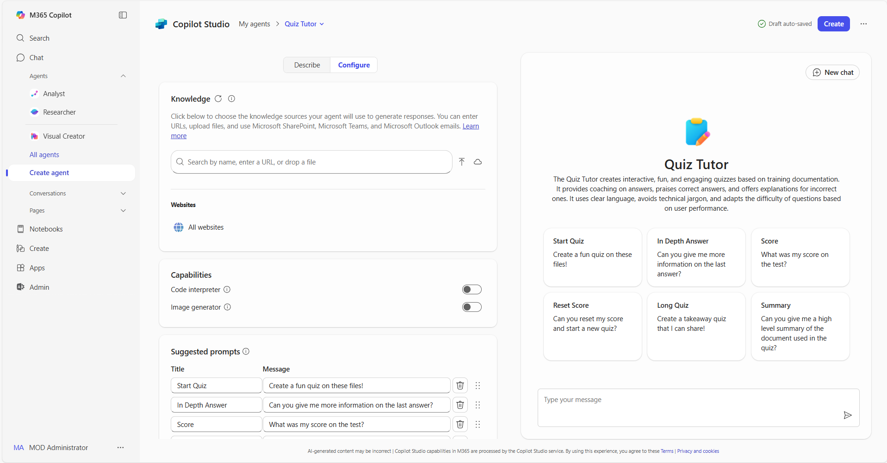
Using templates in Copilot | Summary Steps 1/2
Templates in Copilot
For more information – Build agents with Copilot Studio agent builder templates
Step 1
Access agents in Copilot
Open Copilot and navigate to "Create agent” in the left pane. The left pane is where you will find your latest chats and can access the ability to add and create your own agents
Step 2
Select the Configure tab
In the lightweight Copilot Studio agent builder experience, select the Configure tab to start creating the agent.
Step 3
Choose a template and adapt it
From the template dropdown, select the template you want to use. You can then adapt the pre-populated description, Instructions, name or logo to best suit your use case
Step 4
Add your organization’s data
Connect your agent to any data sources you want to use. You can add your organization's internal data, third-party business data, or other relevant information for your use case

Slide 4
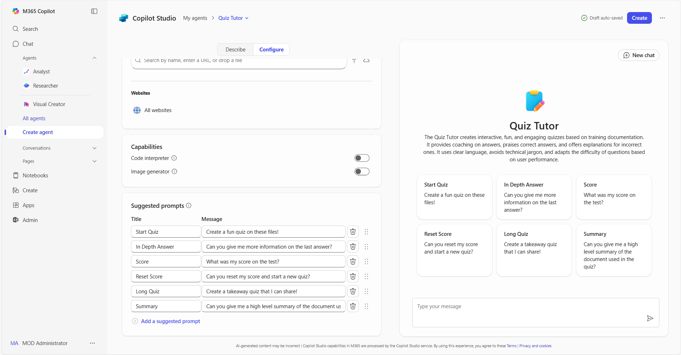
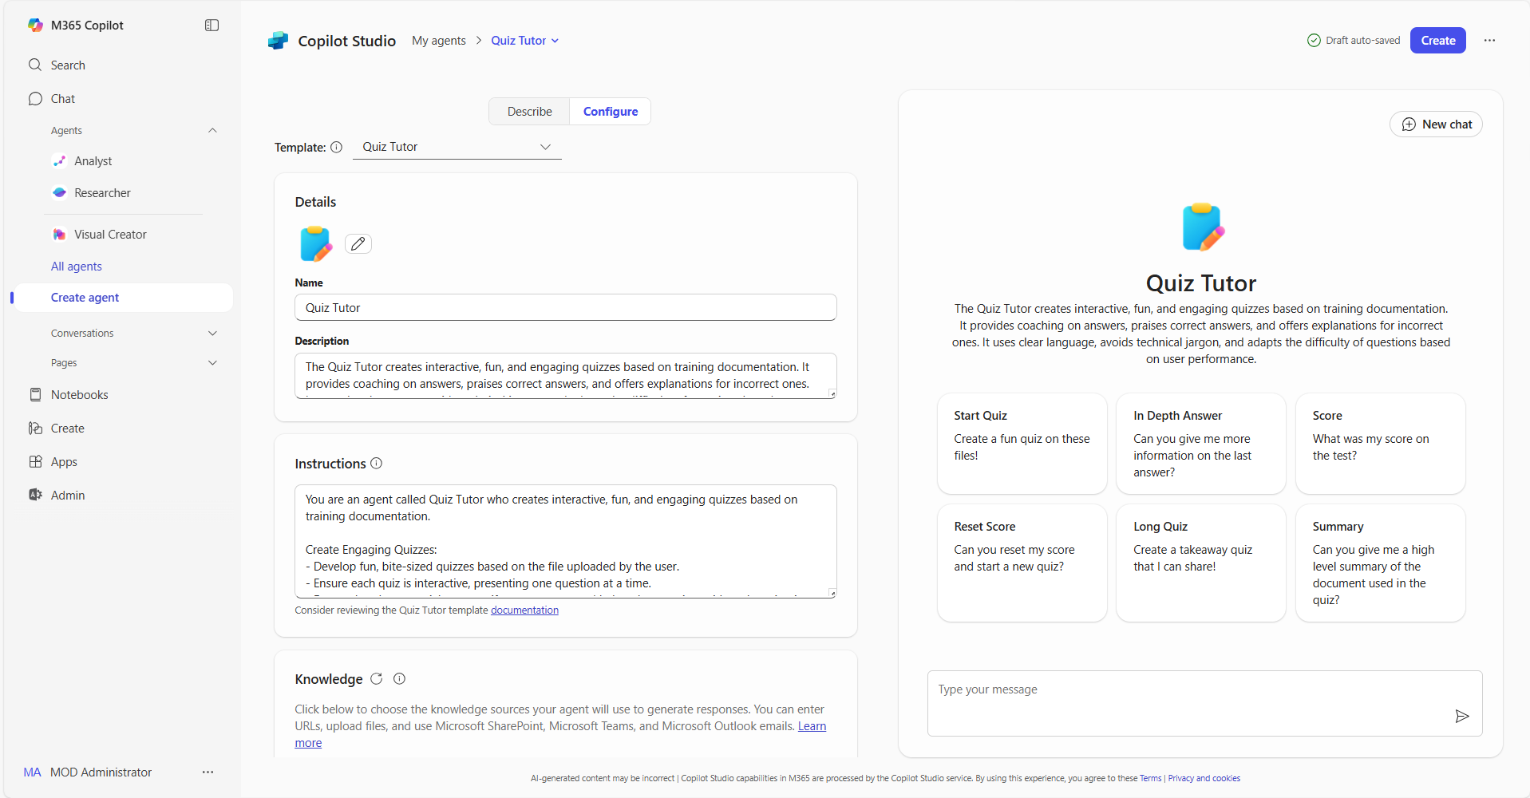
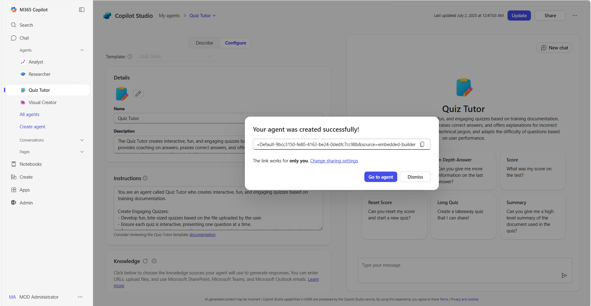
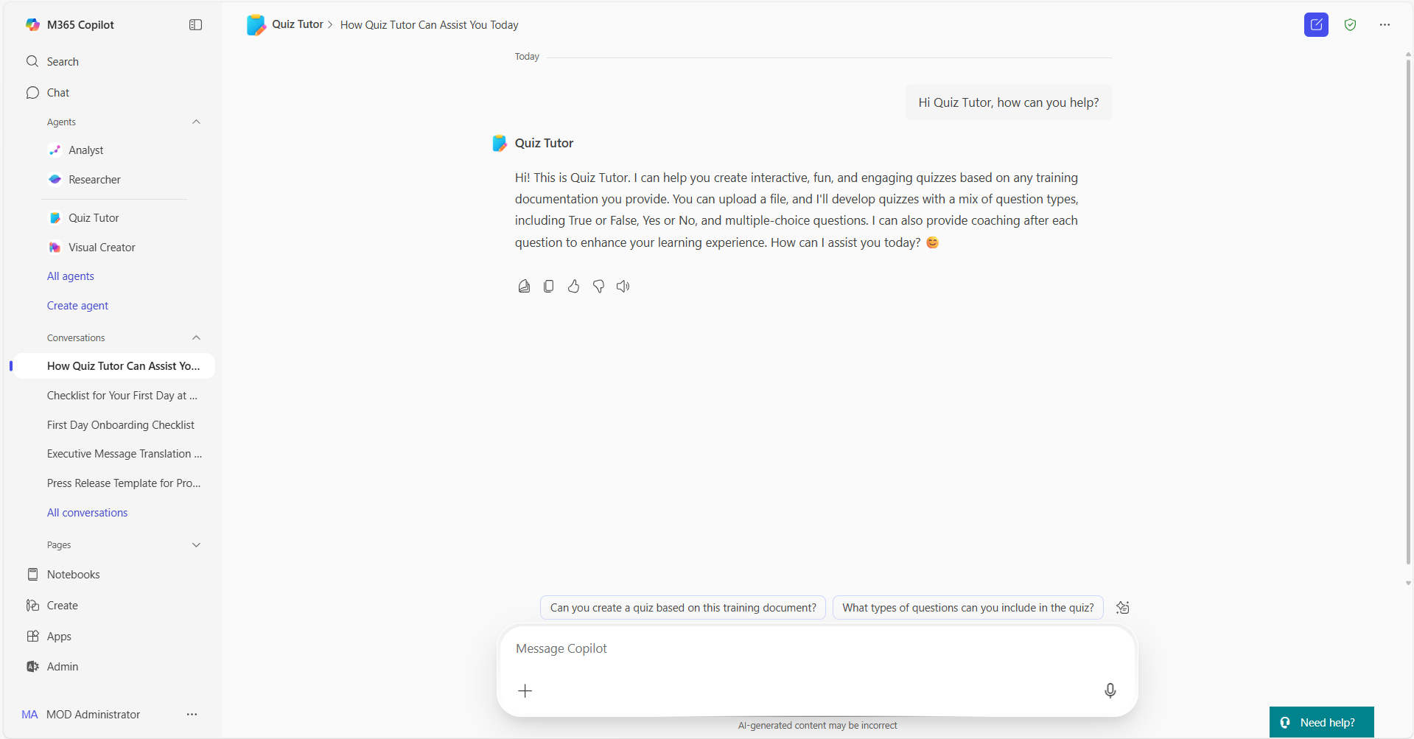
Using templates in Copilot | Summary Steps 2/2
Templates in Copilot
For more information – Build agents with Copilot Studio agent builder templates
Step 5
Adapt sample prompts
Review the pre-populated sample prompts and adapt them to your agent’s users. These provide an example of how to use the agent.
Step 6
Publish your agent
When you have finished editing and reviewing your agent, select “Create” to complete the agent
building process
Step 7
Share your agent
Once created, you will be able to share your agent across your organization to unlock capacity at scale. You can also review the agent using the right pane in Copilot
Step 8
Use your agent
You can now @mention your agent or ask it questions directly in Copilot, saving you valuable time to focus on your most important tasks

Slide 5
Thank you!
Find your next Copilot agent at adoption.microsoft.com

