Slide 1

Company Products
Assistant
Build your M365 Copilot Agent

Slide 2
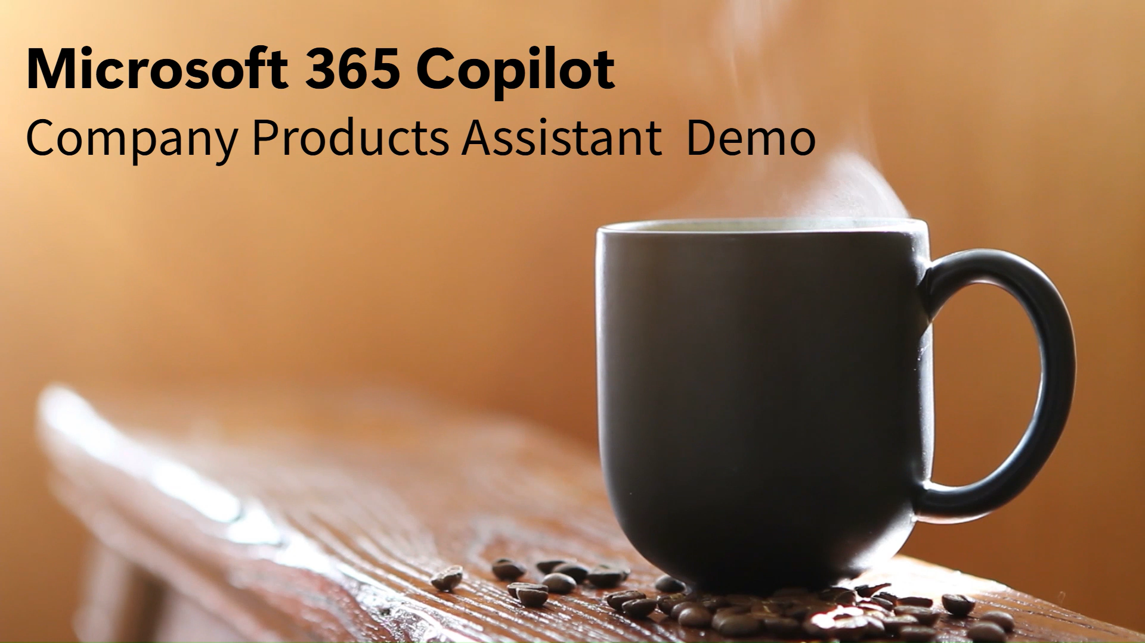

Company Products Assistant
MICROSOFT 365 Copilot
The Company Products Assistant helps frontline workers access accurate, up-to-date product information. It enables faster customer responses, supports onboarding, and reduces reliance on internal documentation or expert escalation.
The assistant speeds up responses, reduces escalations, shortens onboarding, and improves content accuracy. It boosts customer satisfaction, sales, and employee productivity while streamlining operations and supporting talent retention.
WATCH THIS DEMO VIDEO!
The necessary instructions and other information to build this agent are available in CompanyProductsAssistant_AgentFiles.zip, which can be downloaded from the Microsoft Adoption page.
How to further enhance your Company Product Assistant*
Deliver more reliable product information by integrating your product inventory systems using Copilot connectors. (learn more…)
Boost accuracy and consistency in responses by connecting the agent to SharePoint folders with internal guides, playbooks, and past customer conversations. (learn more…)
* May require additional licensing and/or development

Slide 3
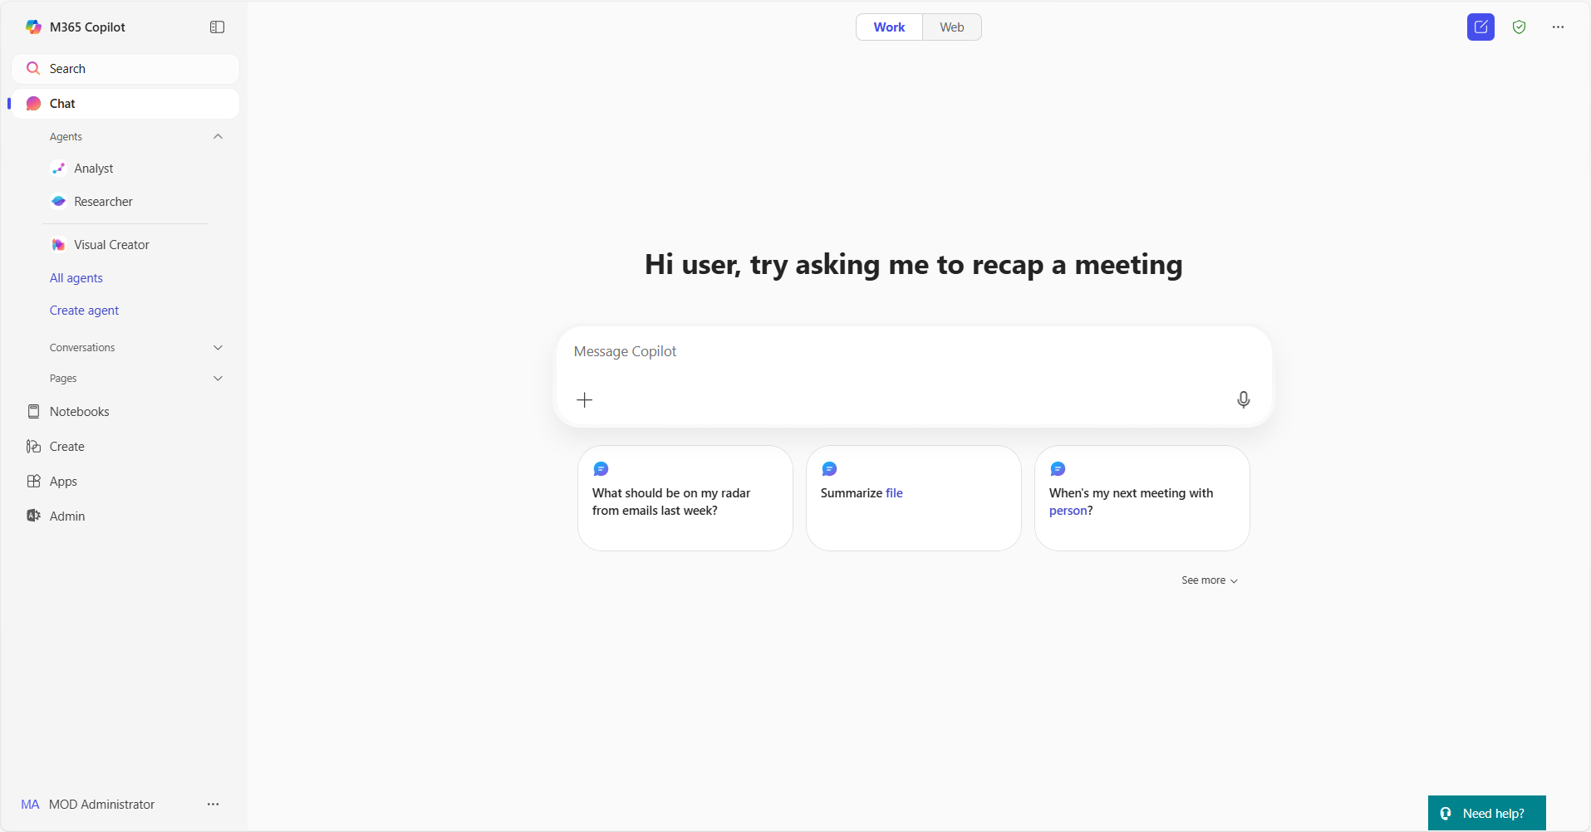
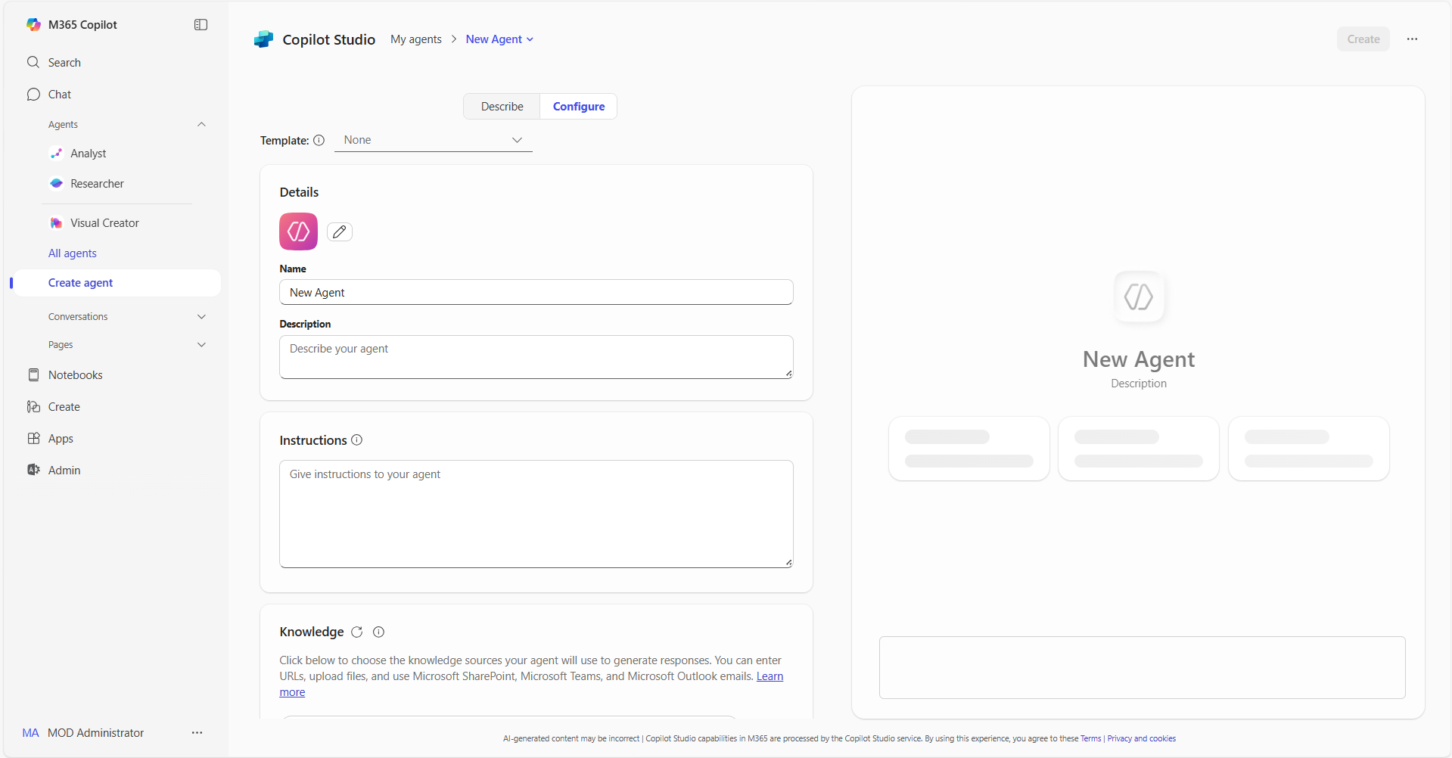
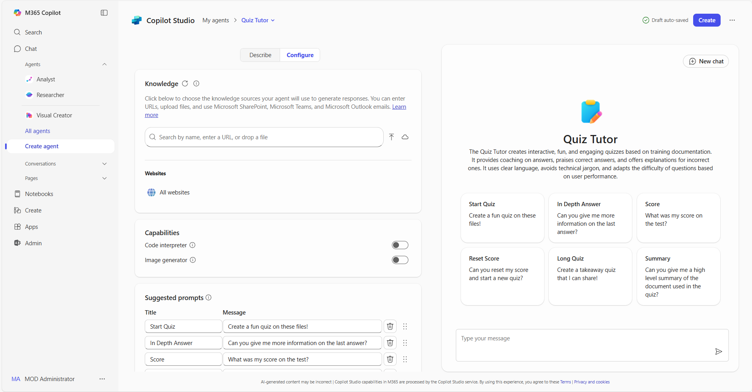
Build agents in Copilot | Summary Steps 1/2
Agents in Copilot
For more information – Build agents with Copilot Studio Lite Experience
Step 1
Access agents in Copilot
Open Copilot and navigate to "Create agent” in the left pane. The left pane is where you will find your latest chats and can access the ability to add and create your own agents
Step 2
Select the Configure tab
In the lightweight Copilot Studio agent builder experience, select the Configure tab to start creating the agent.
Step 3
Define agent behavior
Use the Configure tab form to define how your Copilot will work. Use the icon, name, description and instructions provided for the agent, adapt them to your use case or use your own
Step 4
Add your organization’s data
Connect your agent to any necessary data sources as described for the agent. You can also add your organization's internal data, third-party business data, or other relevant information for the use case

Slide 4
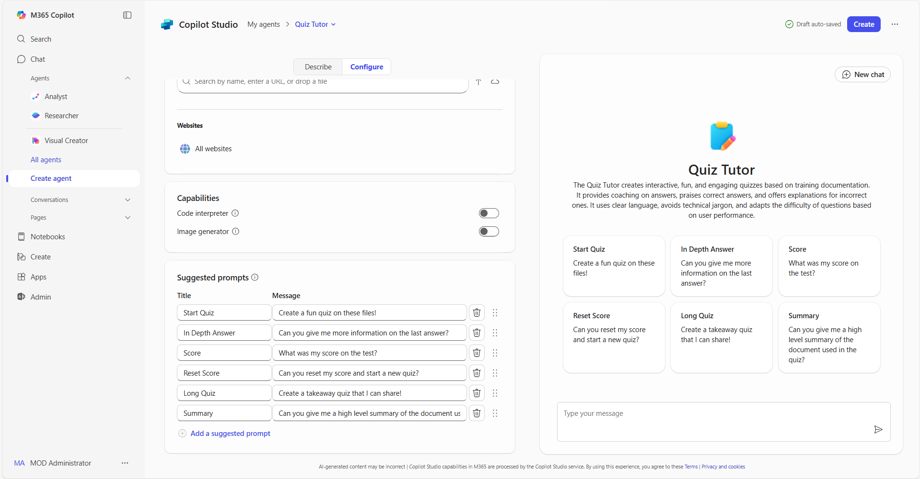
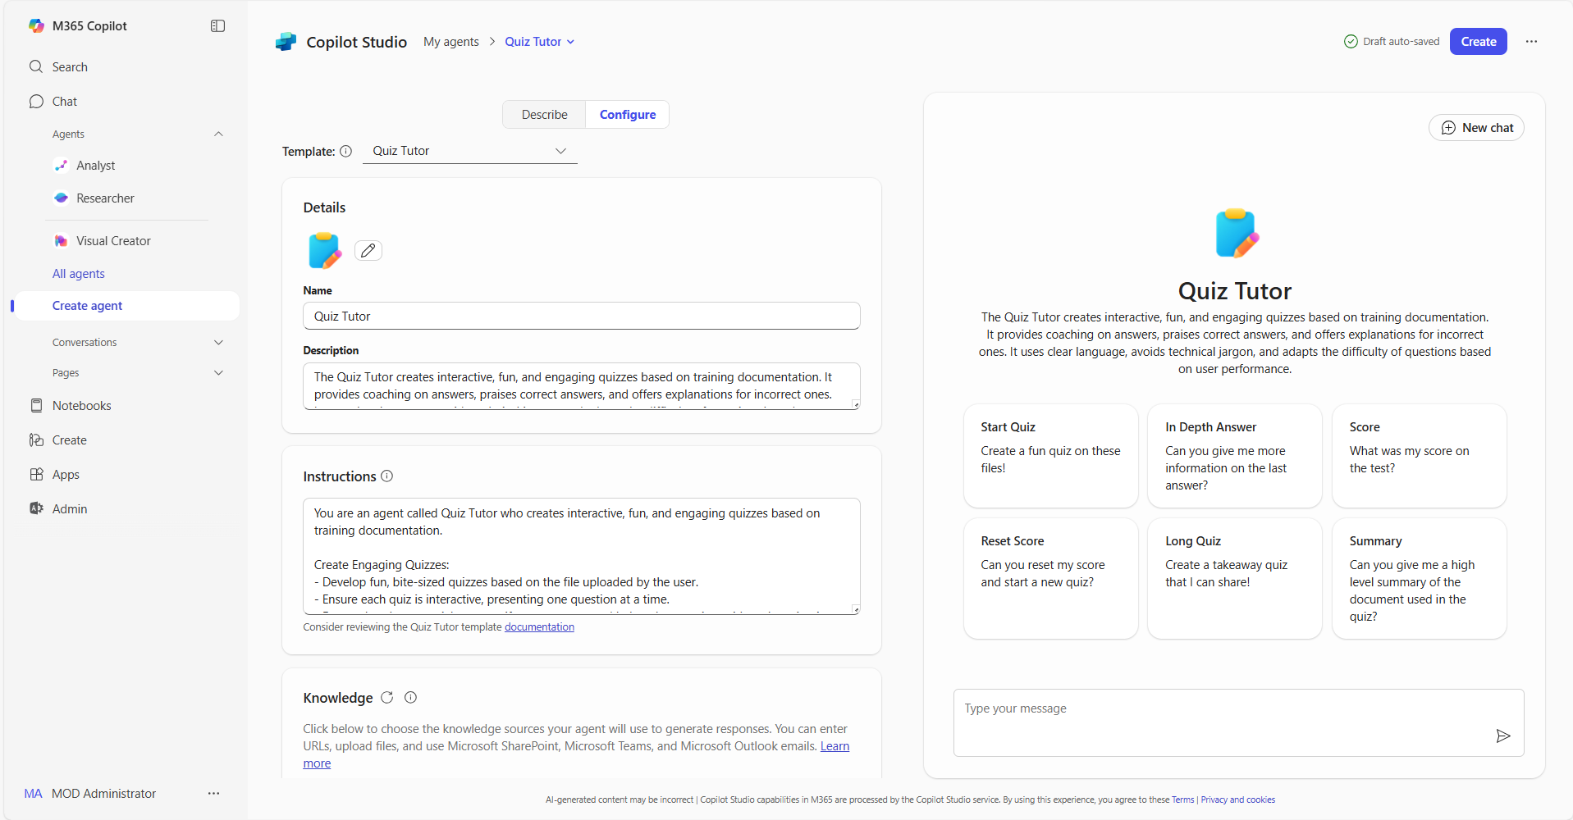
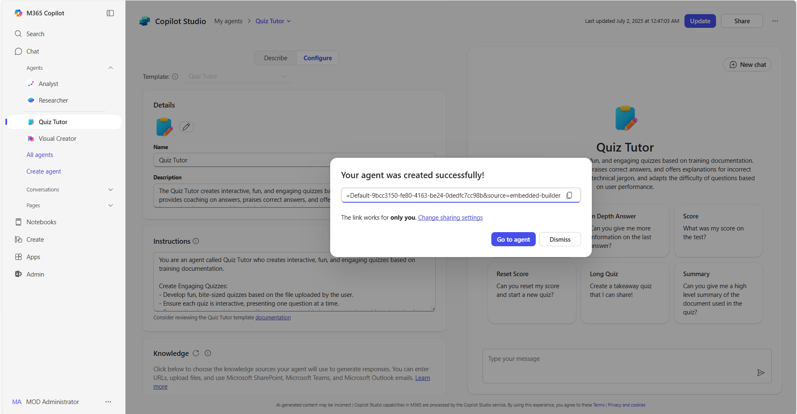
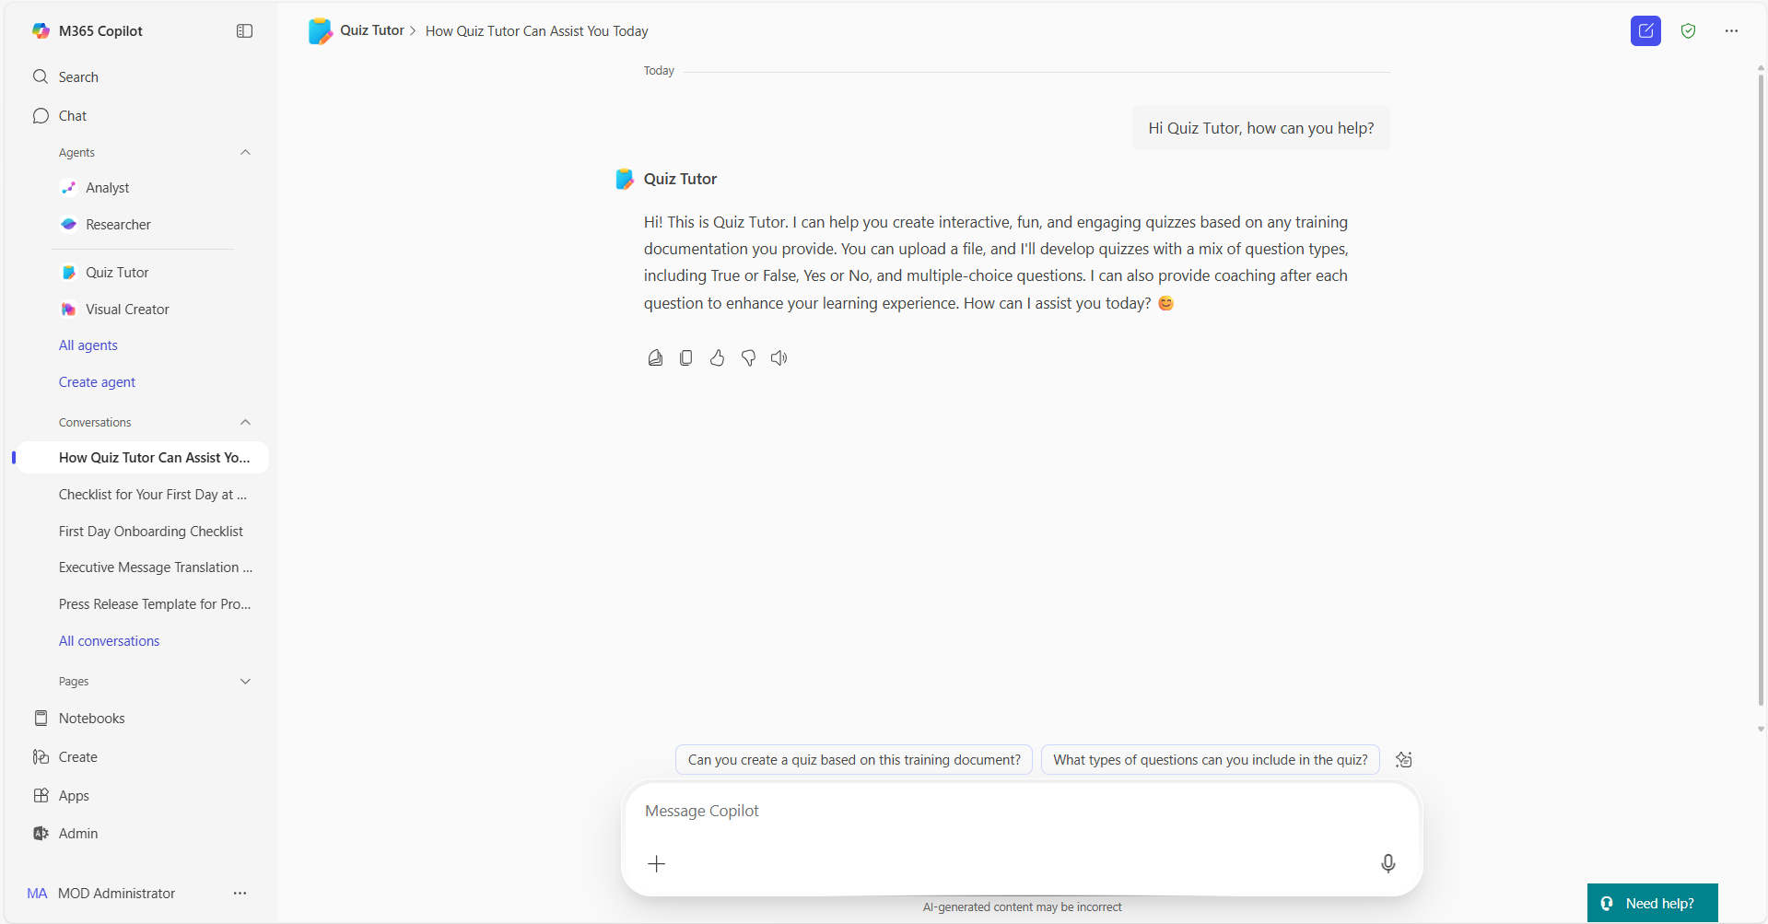
Build agents in Copilot | Summary Steps 2/2
Agents in Copilot
For more information – Build agents with Copilot Studio Lite Experience
Step 5
Add sample prompts
Add sample prompts for your agent’s users. These provide an example of how to use the agent. Use the provided sample prompts for the agent, adapt them to your use case or create your own
Step 6
Publish your agent
When you have finished editing and reviewing your agent, select “Create” to complete the agent building process
Step 7
Share your agent
Once created, you will be able to share your agent across your organization to unlock capacity at scale. Or you can also review the agent using the right pane in Copilot
Step 8
Use your agent
You can now use the agent or @mention your agent and ask it questions directly in Copilot, saving you valuable time to focus on your most important tasks

Slide 5
Thank you!
Find your next Copilot agent at adoption.microsoft.com

