Slide 1
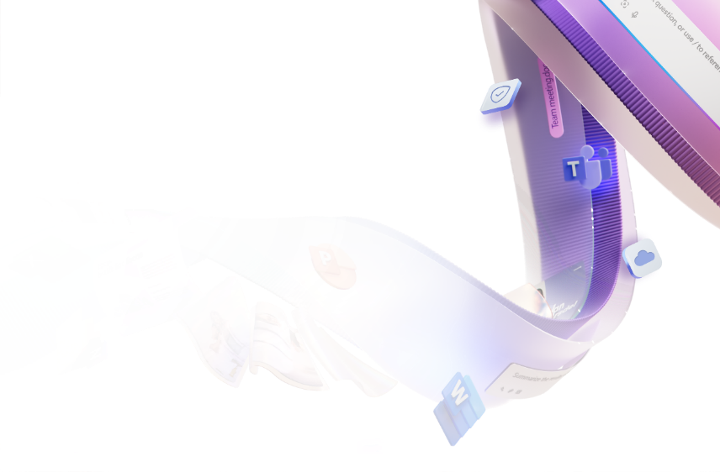
Event
Agenda
Copilot Agent Hackathon
10 mins | 08:30 – 08:40 | Welcome & Kick off
35 mins | 08:40 – 09:15 | Copilot: What’s new & the Art of Prompting
45 mins | 09:15 – 10:00 | Becoming a Frontier Firm with Copilot & Agents
15 mins | 10:00 – 10:15 | Coffee Break
45 mins | 10:15 – 11:00 | Hands-on Lab: Get Started With Agents
15 mins | 11:00 – 11:15 | Hackathon Kickoff
45 mins | 11:15 – 12:00 | Hackathon Ideation
60 mins | 12:00 – 13:00 | Lunch Break
45 mins | 13:00 – 13:45 | Hackathon continued
60 mins | 13:45 – 14:45 | Team Presentations: Agents Showcase
15 mins | 14:45 – 15:00 | Winner Announcement & Close

