Slide 1
Microsoft Viva Learning adoption guide

Slide 2
Table of contents
Overview
Plan
Assess
Deploy
Train and adopt
Drive value
Recommended best practices
Additional resources

Slide 3
Adoption guide overview
Adopting new technology brings change, and change can be daunting. The purpose of this document is to help you successfully navigate attaining company-wide adoption of Microsoft Viva Learning. This how-to guide will walk you through the steps of deploying Microsoft Viva Learning to your organization and driving adoption to help ensure your employees reach their learning objectives.
Purpose of this document
Adoption steps
Assess:
Understand gaps in your current learning ecosystem and what scenarios you are trying to enable
Plan:
Develop a learning ecosystem strategy with Viva Learning and align stakeholders
Deploy:
Set up and configure Viva Learning. Roll out to a pilot group
Train and adopt:
Rollout Viva Learning to your organization. Drive a culture of learning
Drive value:
Monitor success of learning adoption and reinforce value

Slide 4
Sample project plan
Step | Task | Accountability (SAMPLE) | Target Completion (SAMPLE)
Assess | Understand your current learning ecosystem and gaps | Customer organization, service partner (opt) | [Fill out with dates]
 | Define success criteria and KPIs | Customer organization, service partner (opt)
 | Identify target user scenarios | Customer organization, service partner (opt)
Plan | Align stakeholders and assign core team and R&Rs | Customer organization, service partner (opt)
 | Understand learning source connections | Customer organization, service partner (opt)
 | Develop learning ecosystem strategy | Customer organization, service partner (opt)
Deploy | Understand access requirements | Customer organization, service partner (opt)
 | Set up and configure Viva Learning | Customer organization, MSFT support, service partner (opt)
 | Deploy to pilot group | Customer organization, service partner (opt)
Train and adopt | Build awareness throughout organization (run comms plan) | Customer organization, service partner (opt)
 | Rollout to whole organization; Run training sessions | Customer organization, MSFT support for training
 | Drive a learning culture | Customer organization, service partner (opt)
Drive Value | Gather insights – monitor satisfaction and success metrics | Customer organization, MSFT support, service partner (opt)
 | Reinforce adoption | Customer organization

Slide 5
Sample timeline
Weeks 8-11
Deploy to pilot group
Pilot communications
Weeks 1-5
Plan, assess current ecosystem/plan strategy
Pre-work
Weeks 12-13
Feedback/ Readouts
Week 13
Pilot
End
Week 5
Finalize use cases/OKRs/core teams
Pre-work
Weeks 6-7
Configure Viva Learning
Pre-work
Week 10
Begin company rollout (continuous)
Pre-work: 7 weeks
Deployment and pilot: 6 weeks

Slide 6

Introduction
Viva Learning is part of Microsoft Viva, Microsoft’s employee experience platform that helps organizations create a thriving culture with engaged employees and inspiring leaders.
Viva Learning is the learning and development layer that brings learning into the flow of work by integrating natively with Microsoft Teams and Microsoft 365.
By creating a hub for learning in the platforms that employees are already using, and adding social learning capabilities and personalized suggestions, Viva Learning drives a new culture of learning at our customers’ organizations – driving employee retention and better business results.

Slide 7


Audiences for this document
IT leads/admins in charge of deployment and adoption, and who need to frame adoption requirements, resourcing, and effort to business stakeholders.
Business users looking to revitalize their organization’s Employee Experience, including, but not limited to, Champions, change management/adoption specialists, HR, and internal communications teams. Also, the person (or persons) made accountable by the business stakeholders to achieve maximum satisfaction of the Employee Experience.

Slide 8

Plan

Slide 9

Assemble your team
Adopting new technology requires buy-in and support from across the business. Below are key groups and team members who can help bridge technology and business outcomes that matter to your organization. Note that for successful rollout, IT, and HR departments will have to partner to align technical and employee experience scenarios and goals.
Key roles | Role | Responsibilities
 | Executive Sponsor | Communicate high-level vision and values of Microsoft Viva Learning company-wide
 | HR Specialists | Help develop plan for how Viva Learning will fit into the rest of the learning and employee ecosystem, inform company rollout, and drive adoption
 | IT Specialists | Oversee all technical aspects of the Microsoft Viva Learning setup, deployment, and rollout. Partner with HR to develop plan for fitting Viva Learning into company technology stack. IT specialists must have Microsoft Teams admin, Microsoft 365 global admin/SharePoint admin, and Knowledge admin permissions to set up and configure Viva Learning. Learn more here.
 | Success Owner | Ensure the business goals are realized from adoption of Microsoft Viva Learning
 | Program Manager | Oversee Viva Learning deployment process and logistics
 | Pilot participants | Use Viva Learning early on and provide feedback to help smooth out any issues ahead of broad launch to entire organization
 | Champions | Help evangelize Viva Learning and manage objection handling
 | Department Leads (Stakeholders) | Identify how department will use Viva Learning and encourage engagement
 | Communications Lead | Oversee company-wide communications about Viva Learning

Slide 10
Understand learning content sources
1. Microsoft owned
content sources
2. SharePoint hosted
custom content
3. 3rd party learning
content provider
4. Learning Management Systems (LMS)
Default enabled sources
LinkedIn Learning*+
Microsoft Learn
Microsoft 365 trainings
Supported file types
.doc
.ppt
.pdf
.mp4
Audio files
External links (YouTube, webpage, SharePoint page, etc.)
SCORM file
Announced
Skillsoft*
Pluralsight*
Coursera*
edX*
EdCast*
Harvard Bus. Publishing*
Go1*
Josh Bersin Academy*
Infosec*
OpenSesame*
Udacity*
Udemy*
Others via API*
Announced
Cornerstone OnDemand*
SAP SuccessFactors*
Saba*
Workday* (coming soon)
Others via API*
→
→
→
A curated selection of 125 LinkedIn Learning courses are available to all Viva Learning users (full library requires LiL subscription). All users gain access to the full library of Microsoft Learn and Microsoft 365 trainings.
Admins can set up a SharePoint connection to Viva Learning to enable organization-generated resources and external/web links to be discoverable and accessible in Viva Learning as learning objects.
Viva Learning is being built as a fully extensible learning platform. The partners listed are offered as out-of-the-box integrations, requiring simple setup through the admin center to connect.
In July 2022 we also released an employee learning API so the broader learning partner ecosystem can integrate with Viva Learning, outside of pre-configured partners. Customers and partners will be able to build LMS/provider connections with these APIs.
*These sources require a separately licensed subscription between your organization and the third party in order to access full library
+ Viva Learning integrates with the global content catalog licensed through LinkedIn Learning. It does not feature any tenant-specific or custom content

Slide 11

Develop learning ecosystem strategy
  Determine which learning sources to enable and how they will flow into Viva Learning
  What learning providers and/or LMS will you connect? Do you want to enable custom content through SharePoint?
  Will you connect your learning providers and LMS separately into Viva Learning, or connect learning providers to your LMS and have them flow into Viva Learning through the LMS connection?
  Determine the level of compliance and tracking your organization requires and where this will happen
  Will you maintain your LMS to manage mandatory trainings and assignments, and compliance tracking? (Recommended for any regulated industries or large enterprises.)
  Will you enable recommendations and self-reported progress tracking within Viva Learning? The recommend and manage feature can be toggled on/off through the admin center.
  Map out how employees will interact across the learning ecosystem – suggested flow on the next slide.

Slide 12
Develop learning ecosystem strategy
  Suggested flow: learning ecosystem
Learning provider
(if separate from LMS)
Learning content
Admins set up learning content
Viva Learning
LMS
Managers set up learning tabs for their teams
Employees discover and access learning content
Employees keep track of learning assignments and personally bookmarked content
Learning content and assignments
Admins set up learning assignments and content
Admins and leadership monitors reporting and insights (compliance)
SharePoint
Company SMEs and internal training teams create learning content
Admins upload custom learning content to SharePoint list
Custom content

Slide 13

Identify target scenarios
Target scenarios describe how your employees will use Microsoft Viva Learning to address business challenges and achieve organizational, cultural, tangible, or individual adoption outcomes.
Scenario identified | How it applies to the organization
Remember to spend time on learning | Provides employees an easy way to add learning content to their calendars to book focus learning time
Crowdsource learning content | Enable employees to upload custom content and resources as learning content and share with their teams
Foster a team culture of learning | Make it easy for managers to foster a culture of learning on their team with social learning features native to Microsoft Teams
Ease onboarding | Ease the onboarding process with simple ways to upload, organize, and share learning content

Slide 14




Target adoption scenario example: Learner
As someone in…
(Team)
I want to….
  (Description of
  what I want to do)
Using…
  (Specific application
  of the technology)
I’ll know this is
successful when….
(Solutions success
measure)
As someone in
Sales
I want to
Invest in my personal learning and development in addition to fulfill my day to day job responsibilities
Using
the personalized discovery features in the Viva Learning Home page, features like ‘add to calendar’ to dedicate focused learning time in my calendar, and Viva Learning social capabilities in Teams to learn with my peers and colleagues
I’ll know this is successful when
I’m engaging in learning activities throughout each week, learning new skills, and completing my trainings on time

Slide 15
Target adoption scenario example: Manager
As someone in…
(Team)
I want to….
  (Description of
  what I want to do)
Using…
  (Specific application
  of the technology)
I’ll know this is
successful when….
(Solutions success
measure)
As someone in
Sales Management
I want to
Encourage and inspire my team members to learn new skills and grow
Using
The Viva Learning Teams tab feature to create an onboarding and general learning tab for my team, the recommend feature in Viva Learning to recommend learning content to my team members, the send learning in Teams chat feature to send learning courses as they come up in 1:1 conversations
I’ll know this is successful when
My team members indicate they are satisfied with the learning opportunities they receive from their manager and work, team members complete learning content I recommend to them

Slide 16



Define success criteria
  Define goals
    What are you trying to accomplish?
    What does success look like?
    i.e., increase engagement with learning, accelerate onboarding, train sales and service teams, enable upskilling across roles
  Identify key performance indicator (OKRs)
  These should improve based on adoption and will show leadership the impact of Microsoft Viva Learning
  Establish OKR benchmarks
  Determine ways to gather and measure user satisfaction and progress against benchmarks

Slide 17
OKR examples
Choose criteria to demonstrate the impact of Microsoft Viva Learning against each success measure. Below are examples of success measures, methods for measuring, and desired goals.
Success measure | Method | Goal
Employee satisfaction Enable learning in the flow of work to increase engagement and improve satisfaction | Qualitative (sentiment) surveys | Higher workplace satisfaction rating compared to satisfaction before rolling out Microsoft Viva Learning
Increased learning engagement Streamline access to learning content to increase engagement | Qualitative surveys Viva Learning admin reporting (learn more about admin reporting here) LMS reporting | 100 learning objects shared in first two months (Viva Learning reporting) 20 learning tabs created in first two months (Viva Learning reporting) 2x increased avg time spent on learning per week “Engaged Quality Users”: 2+ elective (non-mandatory) courses consumed per month
Increased assignment completion Streamline access to learning assignments from connected learning management systems to improve assignment completion | LMS reporting | 2x increase in assignments completed ahead of deadlines compared to before rolling out Microsoft Viva Learning
Increased job competency Access to relevant content to develop new skills needed to improve performance | Qualitative (sentiment) surveys | All employees at competency for current role Employees feel they are properly skilled for current and future role
Busines outcomes Streamline employee development, onboarding, and upskilling to improve business results and employee retention | Internal business metrics (HR) | Lower cost of new hires Increased promotions Internal transfers Employee retention

Slide 18
Understand common adoption concerns
Concern
How does Microsoft protect the privacy and security of Viva Learning users?
Concern
How does data residency work for Viva Learning?
→
→
Resolution
With state-of-the-art encryption, Microsoft protects your data both at rest and in transit. Our encryption protocols erect barriers against unauthorized access to the data, including two or more independent encryption layers to protect against compromises of any one layer.
Your data is your business, and you can access, modify, or delete it at any time. Microsoft will not use your data without your agreement, and when we have your agreement, we use your data to provide only the services you have chosen.
Please refer to the Microsoft Trust Center (HERE) for additional information.
Resolution
Viva Learning data residency is tenant specific and follows the standard Microsoft 365 data storage guidelines by available geography. For more information, see the Where is my Microsoft 365 customer data stored docs page.
For SharePoint, we currently only support sites hosted from the home geography of the tenant. Example: A French provisioned tenant can only link to SharePoint sites hosted in France to Viva Learning.
Viva Learning is GoLocal compliant. For customers located within geographies covered by a GoLocal datacenter, Viva Learning data will be stored within that GoLocal by default.

Slide 19
Understand common adoption concerns
Concern
What is the implementation time for Viva Learning?
Concern
How does Viva Learning handle multilanguage needs?
→
→
Resolution
Implementation time varies by customer and scenario. Admin configuration and setup of Viva Learning can be simple if just leveraging pre-integrated learning partners in Viva Learning, or require more work if you are building a custom solution. From our experience with customers, configuration time can vary around 18 hours depending on complexity of the existing learning environment and how many learning sources/systems the customer is connecting to Viva Learning. Learning content will start showing up in Viva Learning from connected sources between 1-7 days after.
After setup, rollout and adoption time also varies per customer. Typically, a pilot can last around 1 month after setup, and company-wide rollout can occur over the next few months.
Resolution
The Viva Learning UI will be localized according to the users’ preferred language settings in Microsoft Teams. Viva Learning supports all the same languages Teams supports. The learning content itself will not be translated, but search results and recommendations will show items from the users preferred language first, followed by the content in English.

Slide 20

Assess

Slide 21
Assess organizational readiness
What is readiness
Readiness assessment questions
Willingness and preparedness of your users and your organization to use Microsoft Viva Learning.
It’s important to determine how receptive your users will likely be to changing the way they work and adopting new technology. Your rollout plan should reflect the readiness of your organization.
Determine readiness by asking these questions:
What were the success factors when previously rolling out new technology? What were the pitfalls?
Are there other major rollouts happening in the organization?
What internal resources can be leveraged to help spread awareness? (i.e., communication channels, training cadence, leadership events, etc.)
What are the benefits and risks with this roll out?
  How can you highlight benefits?
  How can you mitigate the risks?
Readiness factors
Determining readiness and appetite for change requires:
Clear vision of organization shift
Clear vision of user shift
Amount of overall change required
Executive alignment
What will the impacting changes be?
Identify who will be most impacted by the change of Viva Learning adoption. Create a collaboration space for these individuals to discuss experiences, tips/best practices for driving adoption, and scenarios. For example, this may be the early adopter leads for each team at your company who wouldn’t normally interact much with each other.

Slide 22

Assess your current learning ecosystem
  Take inventory of your current learning investments
    Does your organization subscribe to any learning content providers (LinkedIn Learning, Skillsoft, Pluralsight, Coursera)?
    Does your organization use a learning management system (SAP SuccessFactors, Cornerstone OnDemand, Workday)? How do you use it – as a system of record/compliance, to set up required trainings, to get learning reporting/insights, for learning discovery?
    Determine gaps
    What does learning engagement currently look like across your organization?
    Do employees consume learning content outside of required trainings?
    Do employees have (or feel that they have) enough time to dedicate to learning and development? Is learning an important part of your company culture?
    Are there any learning investments/solutions that are not being utilized?
    For example, many organizations see low engagement with learning outside of required trainings. A successful learning-forward organization builds regular learning and development into company culture.
  Understand where Viva Learning fits in.
  Viva Learning is a flow of work learning platform. It is a user-friendly, front-end platform that is fully integrated throughout the tools that employees are already using. Viva Learning should be leveraged to increase engagement with learning and maximize the impacts of your other learning investments by bringing them into the flow of work throughout Microsoft Teams and Microsoft 365.
  Think about how Viva Learning fills gaps that your other learning solutions leave.

Slide 23
Assess your technical readiness
  Technical readiness is key to ensuring your organization is ready for launch. Use this checklist to identify items that need to be completed before go-live.
Readiness Item | Complete? Y/N | Plan to Complete
Complete legal & security review
Review service capabilities with legal & security teams
Decide guest access and provisioning policies
Allow-list Microsoft 365 URL's & IP addresses
Implement enterprise policies and Microsoft 365 group governance policies
Assign report reader roles
Complete network assessment (for Voice & Video services)
Guest access Bandwidth planning
Review minimum requirements spec and include mobile devices strategy
Review Microsoft 365 Admin reporting
Assign report reader role as needed
Prepare help desk

Slide 24

Deploy

Slide 25
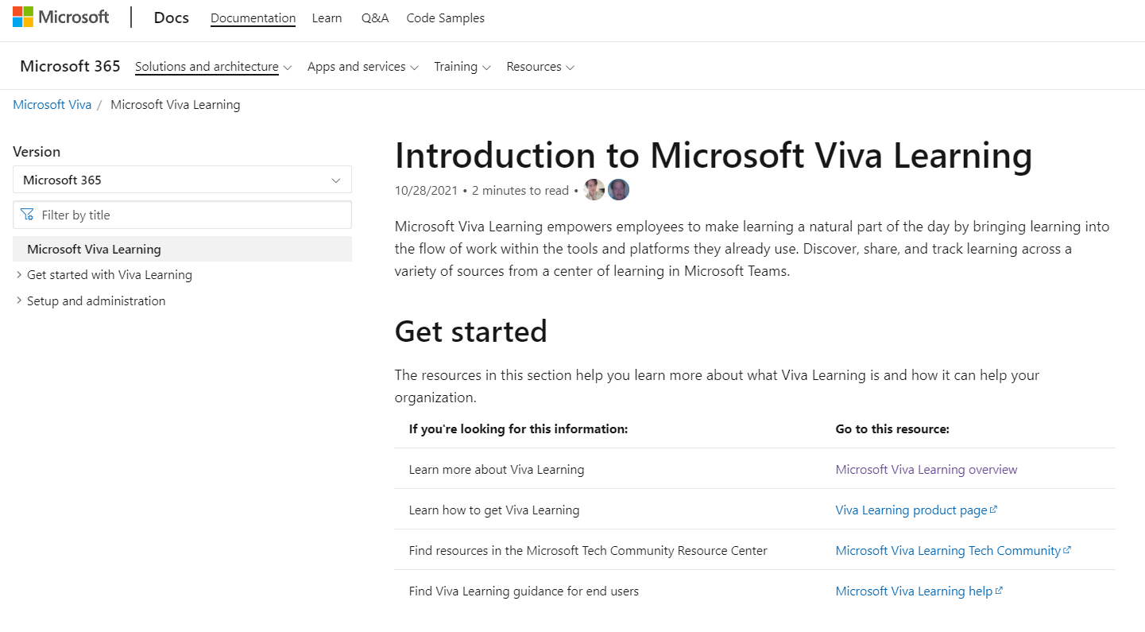

Resources for planning your deployment
Leverage these resources to plan for your Viva Learning deployment.
Aka.ms/VivaLearningDocs
TIP
Be sure to review and understand the adoption recommendations detailed in this document before you begin the deployment phase.

Slide 26
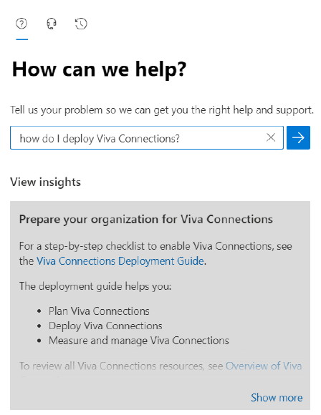
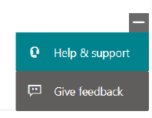
Advanced Deployment Guides
Advanced Deployment Guides are step-by-step online guides that are embedded within your tenant’s administration experience. They allow you to track every step of your deployment journey, and in some cases help you automate it.
To locate the Advanced Deployment Guide, click on the Help & Support button in your Microsoft 365 admin center and search using the plain text search. Here is an example for Viva Connections.
TIP
You can also go directly to your tenant’s Advanced Deployment Guides repository for Employee Experience by visiting https://aka.ms/EmployeeExperienceDashboard.

Slide 27
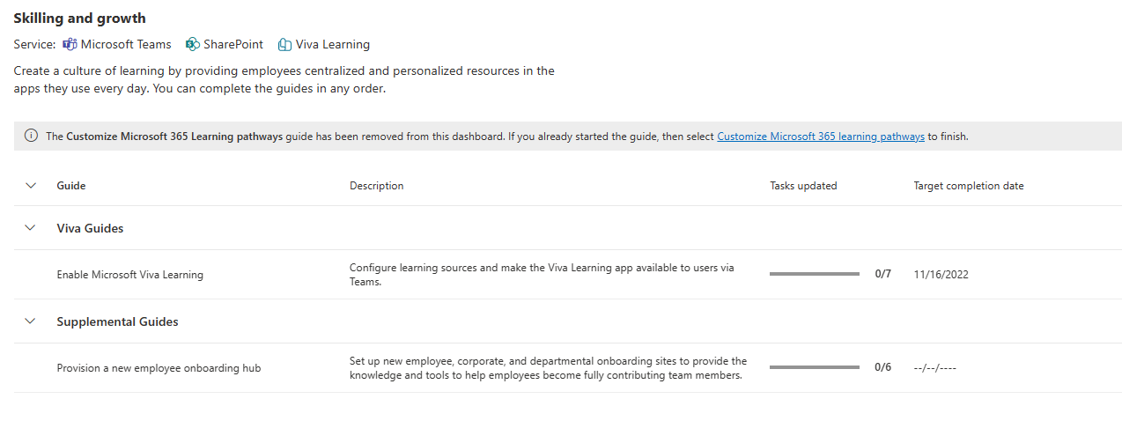
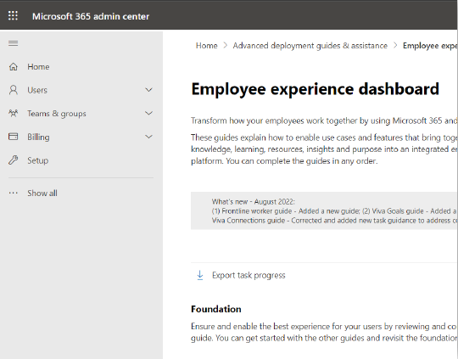
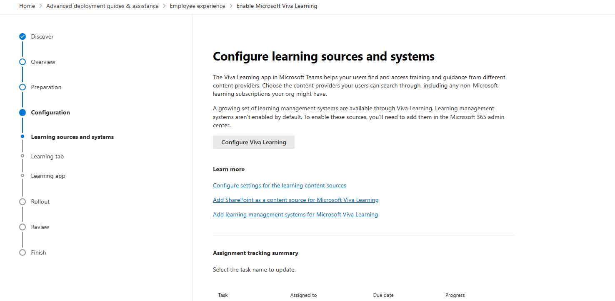
Advanced Deployment Guides
The two Advanced Deployment Guides currently available for Viva Learning.
The Employee Experience dashboard in Microsoft 365 admin center.
Each guide allows you to track every step in the deployment, provides detailed guidance, and allows you to assign tasks with due dates to your team and track progress.

Slide 28
Understand access requirements
Microsoft or Office 365 subscription
Special considerations
The Viva Learning app will be discoverable to all users with a paid Microsoft or Office 365 subscription and access to Microsoft Teams
GCC tenants – Viva Learning is not currently available for GCC
EDU tenants – Only faculty & staff will have access for EDU tenants. Students will not have access to Viva Learning
Not required, but can enhance the Viva Learning experience:
SharePoint – Allows for organization-generated resources and external links to show up as learning content in Viva Learning
Existing subscriptions with content providers - LinkedIn Learning, Skillsoft, Pluralsight, Go1, etc.
Existing subscription with Learning Management Systems – SAP SuccessFactors, Cornerstone OnDemand, Saba Cloud

Slide 29






Learning creation and admin roles
Everyone
Company SMEs
Learning Program Manager
Knowledge Manager
Knowledge Administrator
M365 Administrator
Discovers, shares, and interacts with learning through Viva Learning
Upload custom content to Viva Learning teams tabs through Bring your own content
Contributes learning resources to be included in connected Viva Learning SharePoint site (Knowledge manager/admin will do the actual upload)
Creates learning paths and featured learning sets in Viva Learning (coming soon with delegation flows)
Create and manage learning content
Creates learning paths and featured learning sets in Viva Learning
Performs learning management tasks such as reviewing resources from company SMEs in SharePoint and external sources
Configure security groups
Full access to all knowledge, learning and intelligent features settings in admin center
Manage learning sources in Viva Learning
Manage learning catalog permissions
Configure security groups
Assigns knowledge and learning program manager roles
General admin and management features across Microsoft
Reset passwords for all users
Add and manage domains

Slide 30

Deploy to pilot group
Why is it important to pilot first?
Especially for large organizations, deploying new technology to a smaller group can help inform how your employees will react to the new technology, what questions they may have so you can provide relevant guidance, and understand user scenarios in practice.
What are the goals of a pilot rollout?
Goals for a pilot can include:
Understanding how people are using the product
Testing product messaging for announcements and company-wide communications
Testing features within product to understand which are the most intuitive vs. more advanced
Understanding common confusion points and questions to include in company-wide guidance when rolling out
Informing rollout plan for a successful company-wide rollout and adoption

Slide 31
Pilot steps
Step 1: Define goals of your pilot
Step 2: Assign roles and responsibilities for members running the pilot. Identify pilot participants – this can be volunteer-based, or leverage an existing early adopter program if your organization has one
Step 3: Communicate Viva Learning scenarios and value proposition with pilot participants. Deliver training.
Step 3: Test Viva Learning in stages with pilot participants. Gather feedback regularly and adjust organization-wide rollout plan accordingly
Step 4: Roll out Viva Learning across your organization in stages just like the pilot. Many customers prefer to do this in parallel with the pilot group – ie. test stage 1, rollout stage 1 across company while testing stage 2 with pilot, rollout stage 2 across company…
Step 5: Continuously iterate between steps 3 and 4 until Viva Learning is successfully deployed and adopted across your organization
See the pilot guide for detailed steps, examples, and best practices for running a successful Viva Learning pilot
Notes:
Blocker slide for each source & support channel

Slide 32

Common deployment blockers
Double-check that all the keys from the learning provider/LMS sources are entered correctly. Extra spaces, line breaks, and adding an “https://” when not necessary can all slow down the configuration process. Follow instructions for the specific provider in the documentation.
There may be a slight delay between entering provider keys and seeing content appear in Viva Learning; ie. it can take up to 1 week for SAP SuccessFactors and SharePoint content to show up in Viva Learning after setting up the connection in the Microsoft Admin Center. Details on expected sync time are in the documentation.
In the case of a custom learning source integration using the employee learning API, more work is required to configure the connection. Make sure there are committed engineers and IT members dedicated to the setup that are familiar with both the employee learning API and the LMS API. Working with representatives from the LMS directly is usually helpful for this.

Slide 33
Train and adopt

Slide 34
Communication plan
Teaser Campaign
First Day Set Up
Tips Campaign
Campaign to raise awareness across your company about the value Viva Learning will provide
Email blast to company introducing Viva Learning. Leverage the Viva Learning adoption GIFs in email.
Highlight scenarios of value that Viva Learning will provide to organization and key roles (refer to scenario slides in Assess section)
Generate excitement and awareness regarding the app
Gain staff buy-in for project by outlining ‘what’s in it for them’
Download email/communication templates from the Viva adoption page
Share user guides and help articles to help employees get set up quickly and easily
See next slides for assets
Campaign focused on key scenarios and tips for Viva Learning to help employees get the most value from using Viva Learning
Make it top of mind for staff regarding how to work in new ways with Viva Learning
Reinforce new behaviors and resources to support – outline key stop, start, continue behaviors
Share common scenarios and tips and tricks with the Viva Learning scenario guide and tips and tricks email templates (See following slides for templates)
Launch/Buzz Campaigns
Quick demo in company Town Hall
Announcement email with links to how-to instructions to help end users get set up quickly and easily (See next slide for templates). Leverage the Viva Learning adoption GIFs in announcement emails.
Scenario-focused events and email campaigns that showcase the user experience
PRE-LAUNCH
LAUNCH
POST-LAUNCH

Slide 35




Training strategy
Focus on the why
Make sure employees know why the change is
happening, what’s in it for them, and why they’re being asked to change.
Use real work scenarios
Use tasks or processes familiar to your audience to draw them into learning how to use the technology.
Use multiple formats
Training end users should take on multiple forms to accommodate different learning styles, geographical barriers, and resource constraints.
Reinforce
Make the training stick with reinforcement options like on-demand training, lunch and learn sessions, and new employee training options

Slide 36
Align training strategy to launch plan
Design your training strategy to scale with your launch. Start with the groups that will champion Microsoft Viva Learning and IT, before launching to the broader organization.
1
2
3
4
Audience
group
Core team
Stakeholders
Company-wide
Ongoing engagement
Audience members
  Success Owner
  Early Adopters (pilot group)
  Champions
  Program Manager
  IT Specialists
  Communications Lead
  Executive Sponsors
  Department Leads (Stakeholders) – manager training
  All users
  All users
Type of
training
Full user and admin training
User training
User training
User training
Training methods
  Live training sessions
  End-user support pages and tutorials
  Viva Learning Quickstart guide
  Live training sessions
  End-user support pages and tutorials
  Viva Learning Quickstart guide
  On-demand training sessions
  Brown bag training sessions
  End-user support pages and tutorials
  Viva Learning Quickstart guide
  Lunch and Learns
  Tips and tricks

Slide 37
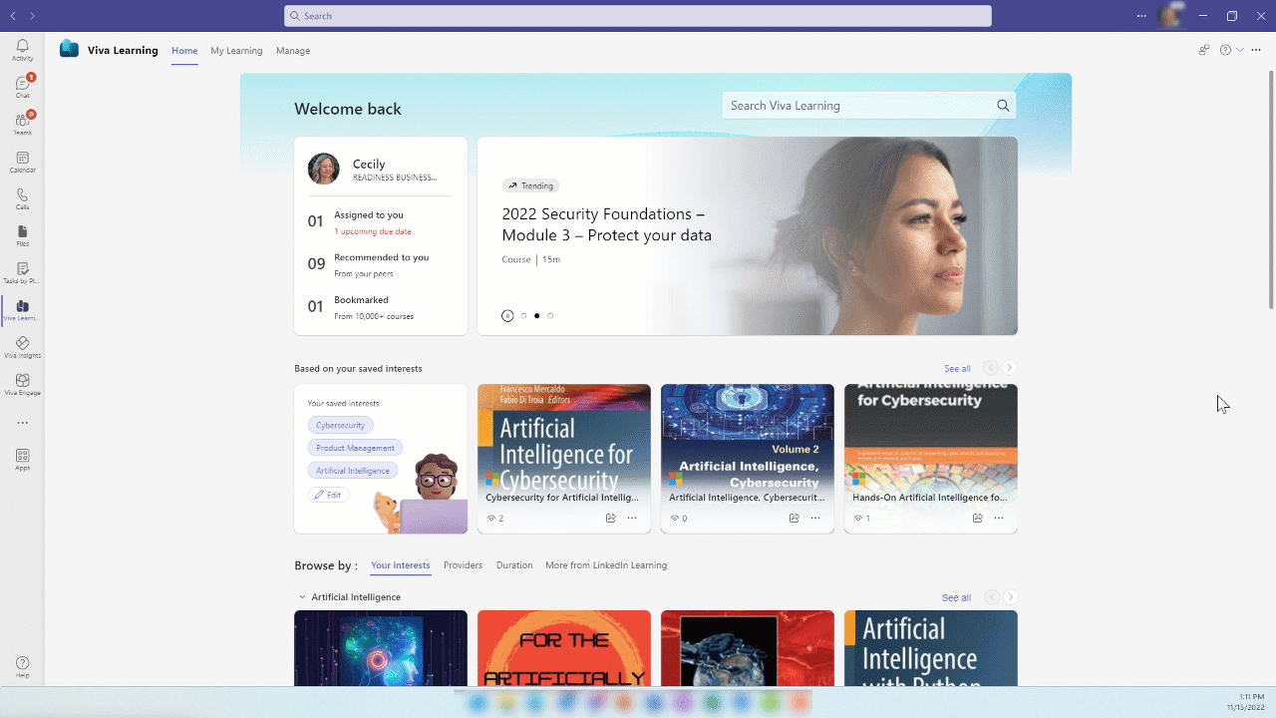
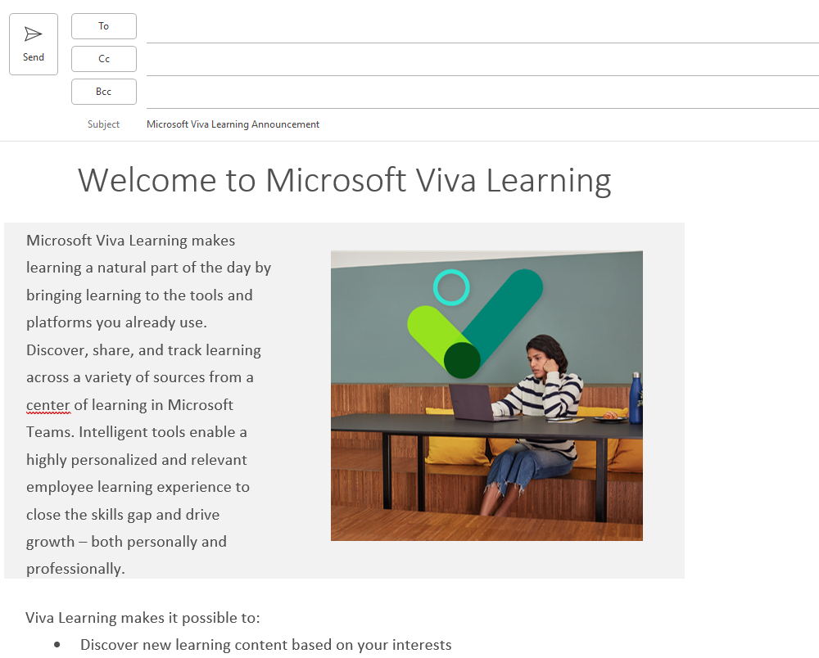
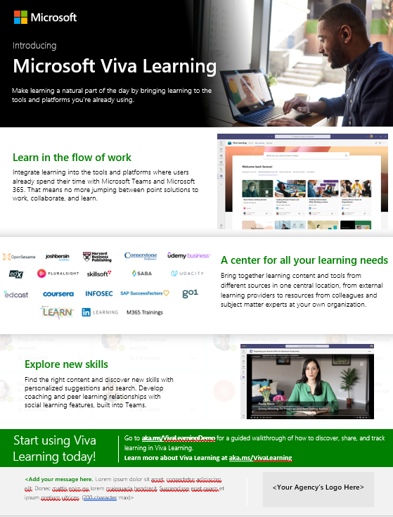
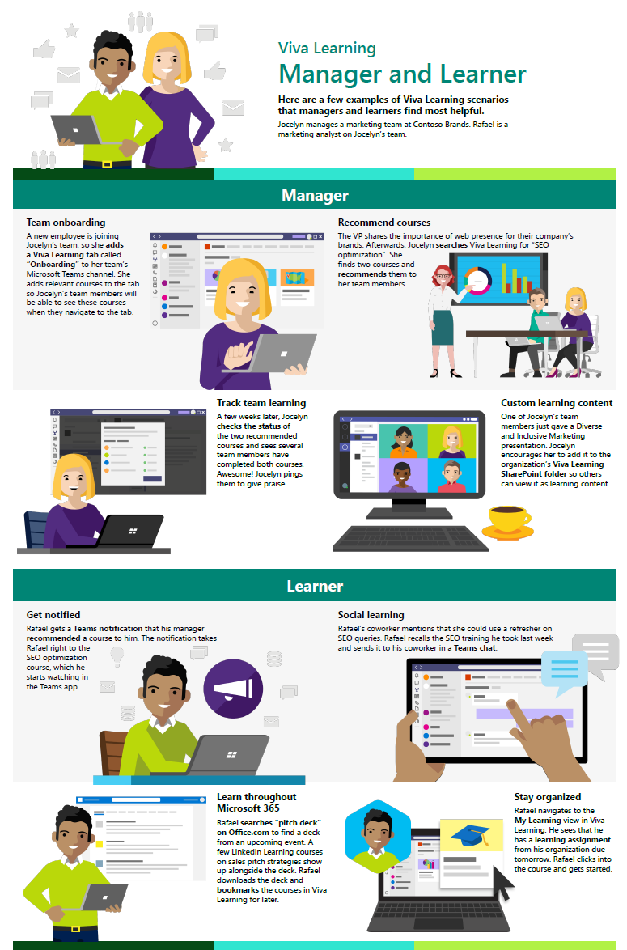
Build awareness
Make announcements and share resources to help employees across your organization understand why they should use Viva Learning.
Download templates and guides at aka.ms/VivaLearningAdoption.
Adoption GIFs
Viva Learning announcement email template
Intro to Viva Learning flyer
Viva Learning scenario guide

Slide 38

Driving a learning culture
  Driving a learning culture is crucial to ensuring long term engagement and growth
    Align department stakeholders (HR, L&D, and IT) on learning adoption efforts. All three departments should be dedicated to driving learning at your organization.
    Train leaders and managers on learning in the flow: shift attitude from learning being only for required trainings to being part of the regular workday. Employees should be regularly learning new skills in addition to just required trainings. Managers should encourage their employees to dedicate time for personal learning and leverage learning to drive connection between teammates and colleagues (ie. social/cohort learning, mentorship).
  Keep learning dynamic and relevant
    Ensure content is constantly refreshed and relevant. Maintain governance of learning content (internally hosted on SharePoint and from connected sources)
    Advise employees on learning trends, opportunities, and skills to look out for. For example, send out regular reports and suggestions on trending skills and topics

Slide 39
Drive value

Slide 40
Gather insights
Having a system of learning is a great opportunity to measure engagement with learning at your organization and the impacts of streamlined employee learning.
1
    Leverage built-in Viva Learning reporting (available on the M365 admin center) to monitor product adoption and understand learning behavior in your organization. Refer to OKRs identified in Assess stage.
2
    [Partner opportunity] Leverage partners/agencies or internal analyst teams to build dashboards that synthesize reporting from Viva Learning and analytics from your LMS to get comprehensive insight on learning adoption, engagement, trends and compliance across your organization
3
Present trends and progress on OKRs identified earlier to leadership

Slide 41
Monitor satisfaction
Surveys are a great tool to gather data about user sentiment toward Viva Learning. The results can help you determine the success of the rollout and get you thinking about necessary next steps.
1
Circulate a baseline survey shortly before users begin using Microsoft Viva Learning.
  Example questions for survey:
  Please indicate how much you agree or disagree with the following statements (on a scale from strongly disagree to strongly agree):
  I actively engage in professional learning and development.
  I wish I spent more time on professional learning and development.
  I have access to learning and training resources that help me be successful at work.
  I don’t know what learning subjects would be the most valuable for me.
  I find it difficult to prioritize learning in my current role/team.
  Compare results before and after rolling out Viva Learning.
2
Conduct a survey halfway through launch to gather data about users’ experiences.
3
Use the results to make any necessary adjustments.
4
Create new awareness or training content to address outstanding needs that arise.
5
Release final survey 90 days after launch, and then in quarterly increments, to help measure user satisfaction and productivity.

Slide 42

Reinforce adoption
  Cultural evolution is critical to adoption. Continuous adoption activities are the key to long term engagement.
Update examples and trainings often so employees can relate to them. Share success stories of Viva Learning
Add Microsoft Viva Learning training to employee onboarding process
Teach people to use the tools as a set –talk about Microsoft Teams and Microsoft Viva Learning together
Continue to find your Champions – advocates for change within the business – including executives, managers, and admins

Slide 43
Adoption best practices

Slide 44

Adoption best practices
Understand the technical lift you’ll require to configure Viva Learning for your organization, considering your unique set of learning needs. Do you use a custom LMS that you need to manually configure with the employee learning APIs? Or are you only leveraging the pre-built connectors with Viva Learning partner solutions? Ensure your team has the capacity and commitment to see it through.
Set a hard date for transitioning employees to Viva Learning. For example, if your trainings were previously delivered through your LMS, set a date for when trainings must be taken from Viva Learning rather than in the LMS.
Test and rollout Viva Learning to a pilot group first before rolling out to your whole organization. Continuously gather feedback from pilot group.
Rollout product in steps rather than all in one – test announcement messaging and comms, basic features of the product, and then more advanced features.
Continue leveraging the pilot group throughout broader rollout. The process is iterative – don’t be afraid to go back and adjust parts of the rollout plan based on feedback from the pilot.
Have admin configure settings to encourage Viva Learning usage; for example, adjust settings so Viva Learning is pinned in your company’s Microsoft Teams toolbar by default, and make Viva Learning notifications automatically enabled.

Slide 45

Recommended best practices from the Viva Learning community
  Example activities your organization can do to promote learning
    Set a dedicated learning day (i.e., one meeting-free day per month) at your company for employees to complete learning requirements and voluntary learning courses.
    Set up your company so employees book learning time as they do annual leave, using the same booking system. This creates hard-booked slots for learning, agreed with the employee and their manager that it is as uninterruptable as annual leave.
    Establish mentoring sessions where designated people will research and present on learning needs.
    Show that leadership is personally committed to their own learning; this will lead to learning being baked into culture. Have leaders share examples of how they are dedicating time and focus to their personal development.
    If your company uses OKRs or any goal/KPI tracking process, have teams include a learning-related goal (i.e., take two voluntary learning courses this semester).

Slide 46
Additional resources

Slide 47
Resources
Microsoft adoption resources
Learn more about Viva Learning
Review and download resources from the Microsoft Viva adoption page, including Viva Learning scenario guide, quickstart guide, communication templates, and more.
Microsoft FastTrack for Viva: Deployment assistance including support from Microsoft engineers with technical expertise on Microsoft Viva, Viva Learning, and other Microsoft tools
Viva Learning deployment guide and wizard: self-service help tool for admins to deploy Viva Learning
Other Microsoft reps: contact your account lead to see what is available to you for adoption support – ie. customer success reps, consultants, etc.
Check out the Viva Learning guided simulation for a walkthrough of using the product as a learner, manager, and admin
Watch the end-to-end Viva Learning demo video
Read the Viva Learning documentation pages for detailed instructions on technical deployment and admin setup

