Slide 1
Simplify your Firstline work with low-code solutions in Teams
Daniel Hidalgo & Addy Quirk

Slide 2
Agenda
Challenges serving your Firstline workers
Teams + Power Platform solutions for the Firstline
Customers putting digital tools to work for Firstline workers

Slide 3
Firstline workers are essential
First to engage with customers
First in line of production
First to represent your brand
Notes:
[Establish who the Firstline Worker is and how they drive impact toward a customer’s goals]
Firstline Workers are defined as those individuals that are in service or task-oriented roles. For example, a sales associate at a retail store or a machinist at a factory. Firstline Workers also typically work in shifts.
Firstline Workers often compose the majority of the workforce and are in roles where they are the first to engage customers, the first to see products and services in action, and the first to represent your brand.
These are the moments that matter most.
It is their ambition, creativity and action that can unlock new ideas, differentiate the customer experience, and bring the strategies of the organization to life.
We can’t ignore the unique opportunity and potential that these workers represent, and the tremendous value that can be unlocked by empowering them to do their best work.

Slide 4
Firstline workers are underserved
78%
of business leaders see empowering Firstline Workers as critical to their long-term strategy
67%
say increasing productivity and efficiency are the primary investment drivers
24%
of Firstline Workers indicate they have right technology to do their jobs
Source: Making Firstline workforces the new focus for digital transformation, HBR Pulse Survey, January 2020 survey
Notes:
Goal: Establish the unique role of firstline workers within the organization.
Firstline Workers are the backbone of your business. These are the workers in customer facing roles or functions that have a direct impact on business growth and operations.
These workers typically comprise the majority of the workforce and it’s their actions that translate strategies into action, delight customers and move the organization forward.
It’s time to design and deliver firstline employee experiences that deliver back to the bottom line with powerful and intuitive tools and devices that help every employee succeed and contribute to your success.
--
What is a firstline worker?
Firstline workers are vitally important in companies both big and small. They use a wealth of knowledge – both institutional knowledge of the company and first-hand customer insights – to provide essential services.
Because those services are sometimes routine, firstline workers may unfortunately be overlooked during digital transformation efforts. Don’t leave them behind.
These workers include: retail associates, factory line workers, customer service representatives, first-responders, housekeeping staff, call-center teams, support technicians, field service workers and front desk/registration staff.
Firstline workers make up a massive segment of the workforce (more than two billion world wide). Firstline workers are found in all major industries, but are particularly relevant in industries with distributed sites of employees and locations (retail, manufacturing, travel & transportation, government, healthcare, retail banking, agriculture, construction, etc.)

Slide 5
Challenges serving your Firstline Workers
Disconnected
From corporate communication and business goals
< 25%
of Firstline Workers have the right tools to do their jobs
Outdated
Legacy tools, apps and devices
Fragmented
Fragmented systems and manual processes
At risk
Growing security and compliance challenges with shadow IT
During these challenging times, virtual communication, digital processes and security continue to be essential for Firstline Workers and business continuity
Notes:
Trust is a critical aspect of productivity.
Four important areas when it comes to trust: security, compliance, identity, and privacy.
Security – applies AI to both protect against increasingly sophisticated threats and to act as a force multiplier (because you'll never have enough people)
Compliance – applies AI to increasingly complex problem of keeping up with internal and external policies and regulations (because, again, you're never going to have enough people to do this right otherwise)
Identity – really the foundation of trust; you can't do anything without a solid approach to identity
Privacy – because privacy is becoming a defining issue of our age, and your productivity technology not only has to ensure you respect the privacy of your users, it also has to ensure that you comply with privacy legislation.

Slide 6
Where to start?
Experiences
1
It all starts by providing simple and intuitive experiences that appeal to Firstline Workers
2
As workers have good experiences, they feel ownership over their work and drive business value
Partner apps
4
The link between Firstline Workers and business results hasn’t gone unnoticed
3
This allows organizations to better engage customers, optimize operations, reduce employee turnover and deliver results
Results

Slide 7
Teams + Power Platform empowers your Firstline
Seamlessly manage shifts and tasks Access shift management and task tracking apps in Teams to save time and ease workforce management
Modernize processes with apps, flows, and bots
Capitalize on Power Apps, Power Automate, and Power Virtual Agents to digitize and automate processes across your organization.
Protect your organization
Take advantage of built-in security and compliance features that safeguard your business without slowing Firstline performance.

Slide 8
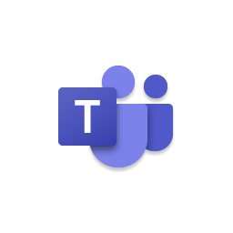
Teams + Power Platform empowers your Firstline
Power Automate
Automate intelligent workflows to improve agility and productivity
Power Apps
Create custom apps to modernize processes to meet your needs, enhancing efficiency and collaboration
Microsoft Teams
Power Virtual Agents
Build and deploy low-code chatbots to provide a conversational AI-driven insights and information
Notes:
[Talk about this in the context of the demo]

Slide 9
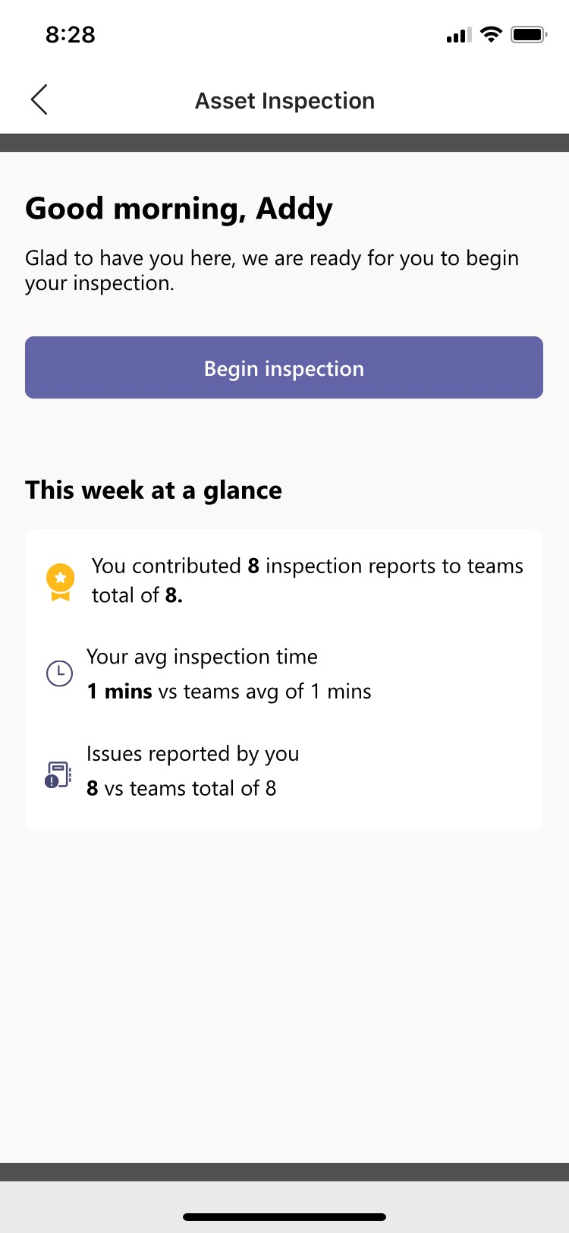
Teams + Power Platform empowers your Firstline
Power Automate
Automate intelligent workflows to improve agility and productivity
Power Apps
Create custom apps to modernize processes to meet your needs, enhancing efficiency and collaboration
Microsoft Teams
Power Virtual Agents
Build and deploy low-code chatbots to provide a conversational AI-driven insights and information
Notes:
[Talk about this in the context of the demo]

Slide 10
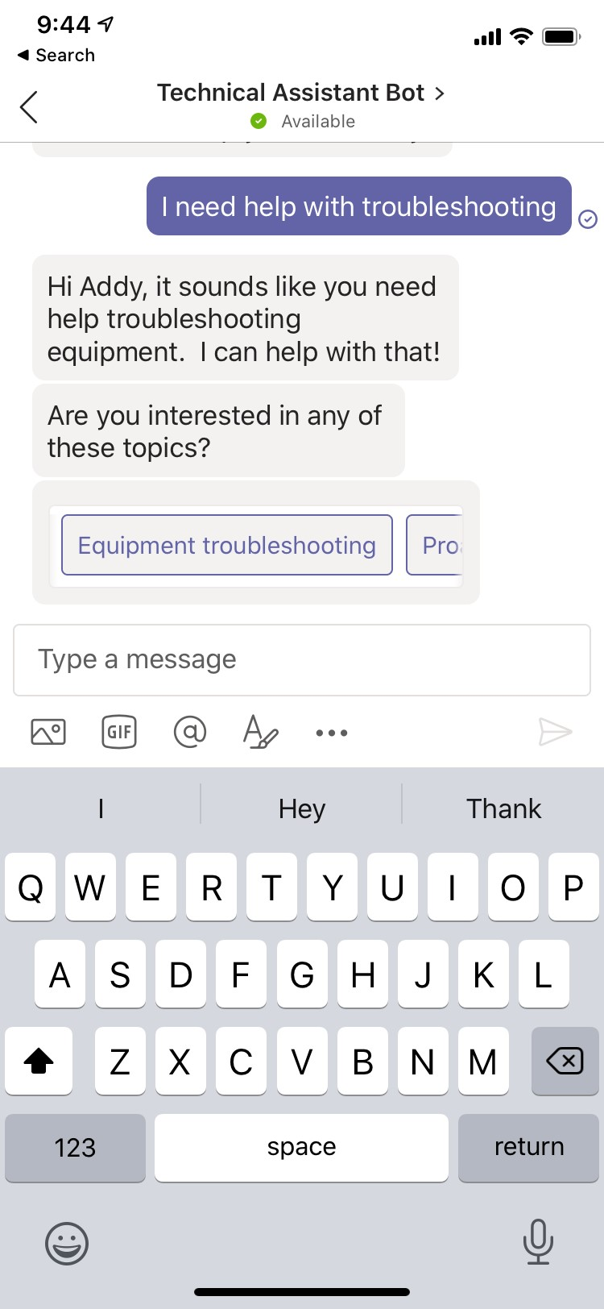
Teams + Power Platform empowers your Firstline
Power Automate
Automate intelligent workflows to improve agility and productivity
Power Apps
Create custom apps to modernize processes to meet your needs, enhancing efficiency and collaboration
Microsoft Teams
Power Virtual Agents
Build and deploy low-code chatbots to provide a conversational AI-driven insights and information
Notes:
[Talk about this in the context of the demo]

Slide 11
Other solutions for your Firstline
Power Automate
Notifications about new sales promotions
Reminders about outstanding tasks
Messages to new employees with onboarding resources
Power Apps
Submit and track customer feedback
Documenting on-site repairs
Inventory requests
Power Virtual Agents
Get contact and location information for clients
Answers to questions on company policies
Retrieve documents from large file systems
Notes:
Onboard employees quickly and help them learn new skills faster with engaging and immersive experiences and content.
You can:
Speed onboarding and time to productivity
Deliver personalized information through custom user portal.
Help employees learn and apply new skills faster with easy access to job-related content.
Inform and engage with intelligent video (Stream), connect everyone with Yammer, and build employee portals on SharePoint.
Highlights include:
.Personalized user portals
Stream on-demand video content
Learning in Teams
Live Events
Teams channels
Yammer communities
Works with existing HR system

Slide 12
Firstline workers putting digital tools to work
“
“
“
Microsoft Teams and Power Apps represents a real shift in how we communicate, how reporting works, and the ways in which employees can build upon the tools they have at their disposal”
I probably save 90 minutes a day using the app, and I no longer have to carry a stack of papers around …Everything I need to know is right in the app, and the tasks required for each patient on my floor are clearly laid out”
Power Apps and Power Automate in Teams are easy to use and adaptable enough to solve a lot of problems. If I can make our CSTs and my life easier as we work for customers, that’s a good thing”
Notes:
We like to hypothesize about what customers will do with the Teams and Power Platform integration, but the scenarios that we end up hearing about are much more impressive. Whether it’s streamlining meetings and communication at PayPal, putting digital tools in the hands of field employees at Teltra, digitizing paper-based processes at Northwell Health, or just pulling important information together at the American Red Cross.
https://customers.microsoft.com/en-us/story/794051-paypal-banking-capital-markets-teams
https://customers.microsoft.com/en-us/story/780527-northwell-casestudy-healthcare-microsoft365
https://customers.microsoft.com/en-us/story/765534-telstra-telecommunications-teams
https://www.youtube.com/watch?v=5TcuUPywQxA

Slide 13
Resources to help empower your firstline workers
Ignite sessions
Product resources
Training resources
Modernize business processes with the low-code Teams + Power Platform integration
Digitally Transform an Essential Part of your Organization, the Firstline Workforce ​
Enable Business Continuity for your Firstline Workforce with Microsoft Teams​
Teams Tech Community https://aka.ms/TeamsTC_blog
Customer stories https://aka.ms/TeamsCustomerStories
Teams + Power Apps whitepaper https://aka.ms/PowerAppsTeams_whitepaper
Microsoft Teams for Firstline workers aka.ms/FirstlineTeams
Power Platform https://aka.ms/PP_Learning
App In a Day training content https://aka.ms/appinaday

