Slide 1
Agents in an hour
Building agents using Agent Builder
Microsoft confidential

Slide 2



During the presentation
After the presentation
We will mute your microphone for the first part of today’s call
Raise your hand and we will
call on you
Ask your questions via chat, we will get to all of them, live or after. Common questions will get addressed out loud
Open mic – come off mute and ask away!

Slide 3
Agenda
Fundamentals of agent creation
Agent Templates Showcase
Explore real-world use cases
Step by Step Guidance for creation of agents
Sharing Agents
Next Steps & Call to Action

Slide 4
Introduction to Microsoft 365 Copilot

Slide 5

Copilot
Copilot Studio
Agents
Copilot Control System

Slide 6





Microsoft 365 Copilot
Natural Language
Large Language Models
Microsoft 365 Apps
Microsoft Graph*
Microsoft Dataverse*
Web
*Grounded out-of-box in your personal and company data from Microsoft Graph & Microsoft Dataverse

Slide 7
Introduction to Copilot Agents

Slide 8


Microsoft 365 Copilot can be extended using Copilot agents to bring custom knowledge, skills, and process automation
+ Copilot agents
Business Apps
Skills
+
Copilot for Microsoft 365
Microsoft 365 apps
Knowledge
Microsoft 365 data
+
Business Knowledge
+
Web
Knowledge

Slide 9

What are Copilot agents
Copilot agents are AI assistants that can help optimize business processes and enhance productivity
Copilot agents vary in level of complexity and capabilities depending on your need
Simple
Advanced
Retrieval
Retrieve information from grounding data, reason, summarize, and answer
user questions
Task
Take actions when asked, automate workflows, and replace repetitive tasks for users
Autonomous
Operate independently, dynamically plan, orchestrate other agents, learn and escalate

Slide 10








Spectrum of agents
IT Helpdesk agent
Device Refresh agent
Lead Gen agent
How do I connect to the corporate network?
Request a new laptop and send approvals via IT Service tool.
The agent has identified and researched 15 new leads for you to review.
Simple
Advanced
Project Tracker agent
Budget Management agent
Customer Support agent
What is the status of phase 2 for project X and the remaining budget?
Review outstanding open POs and begin financial planning.
The agent has identified new support issues and triaged to other agents.

Slide 11

The bones of an agent
Workflow instructions
Actions
Triggers
Knowledge
Orchestrator
Foundational Models

Slide 12


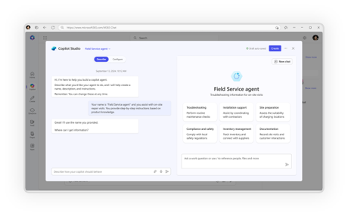
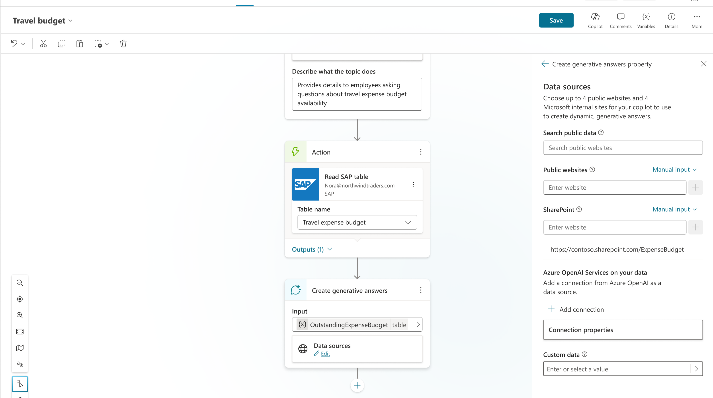
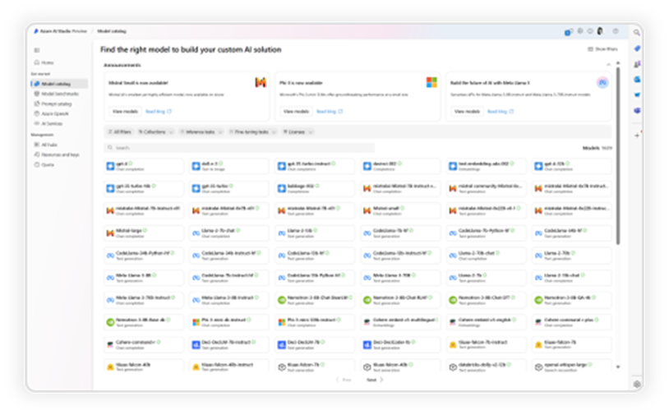
A range of tools for Agent creation
No code
Pro code
For End Users
For Makers
For Developers
Agent builder
Copilot Studio
VS Code, Copilot Studio,
Azure AI Foundry

Slide 13







Choose your path
Whether you're a beginner or a pro, agents enhance Copilot to better fit your business needs
Start with a pre-built agent
Build an agent from scratch or from a customizable template
Bring your own agent
Researcher
Analyst
Meeting agent
Lead
Prediction
Automated Contract Review
Document Compliance
M365 Agents SDK
Azure AI Foundry
Visual Studio
Looking for immediate impact?
Pick from a variety of pre-built agents designed to automate common business tasks in the Agent Store or Copilot Studio.
Have a specific vision?
Quickly build your agent using natural language in Copilot Studio—via Copilot Chat or the full experience. Start faster with a customizable template tailored to your business.
Looking to build on what you have?
Bring existing agents into Copilot Studio to unlock the benefits of a fully managed enterprise-grade platform that is governed, compliant, and extensible.
View more in the Agent Store. Copilot Chat, and Copilot Studio
View more in Copilot Chat and Copilot Studio
View with M365 Agents SDK, Azure AI Foundry, or where you build your agents
Beginner
Agent Pro

Slide 14
Prebuilt agents available to you on Microsoft 365 Copilot

Slide 15

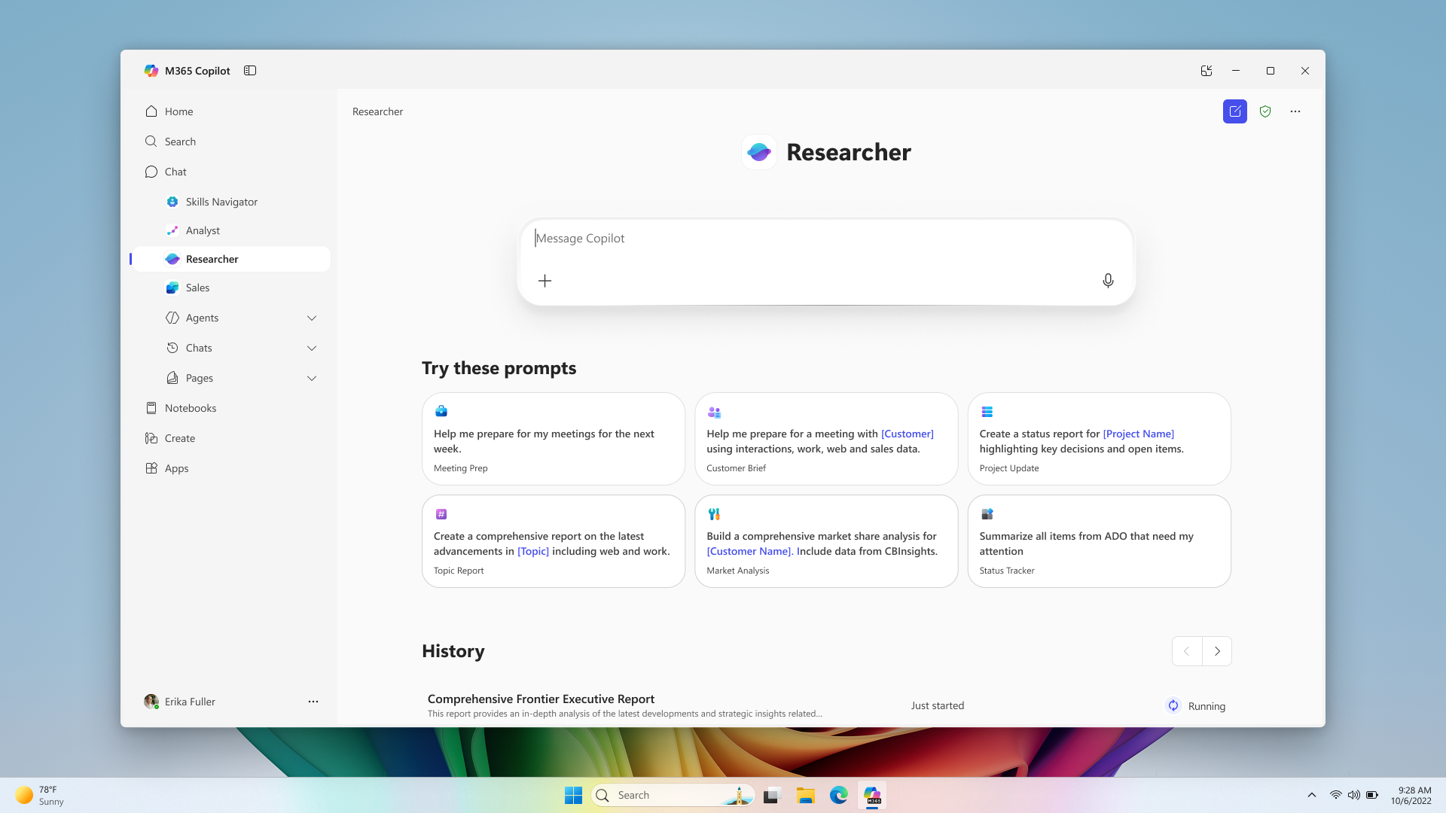
Researcher
Copilot Chat
The Researcher agent gives organizations the capability they’d expect from a highly paid strategist or researcher
Combines the most advanced deep reasoning models with Copilot Chat’s web- and work-grounding, as well as its agent ecosystem,
Provides well-reasoned responses to complex prompts with the data that matters most.​
Gives users a thought partner that can perform advanced reasoning grounded in their unique context
Gives organizations on-demand access to the types of work they typically expect from highly paid employees
Generally available

Slide 16
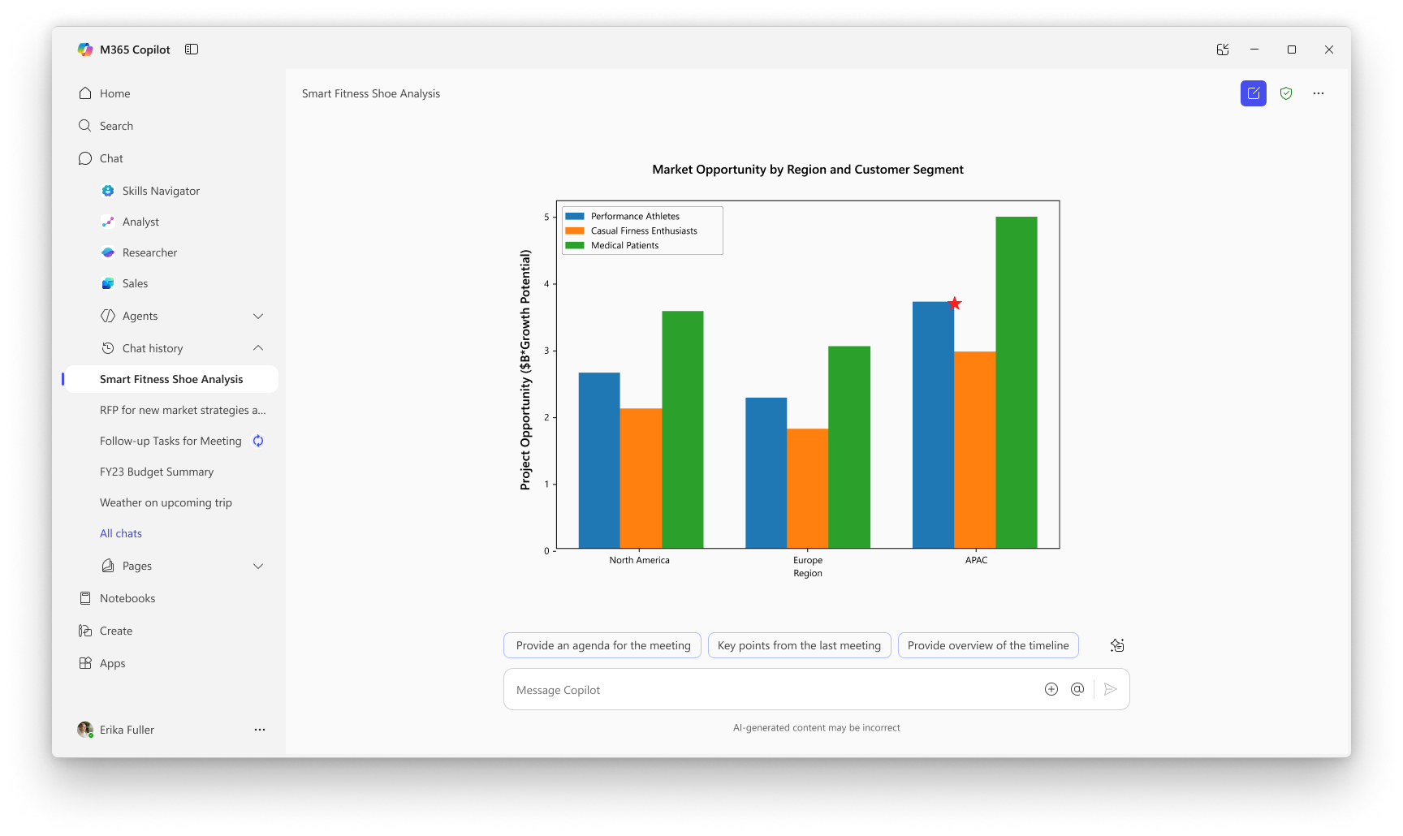
Analyst
Copilot Chat
Analyst thinks like a skilled data scientist, so you can go from raw data to insights in minutes. ​
Built on OpenAI’s o3-mini reasoning model and optimized to do advanced data analysis at work
Analyst uses chain-of-thought reasoning to progress through problems iteratively, to refine its reasoning and provide a high-quality answer
Runs Python to tackle your most complex data queries— you can view the code it’s running in real time to check its work
Generally available

Slide 17





Title
Agents in Microsoft 365
Researcher
Analyst
Skills
Generally available
Generally available
Frontier
Facilitator
Interpreter
Project Manager
Public preview
Generally Available
Public preview

Slide 18
Discover agents that are relevant for you

Slide 19
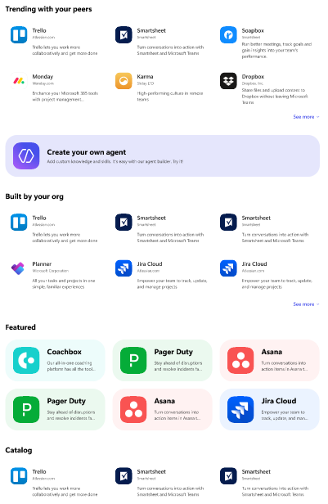
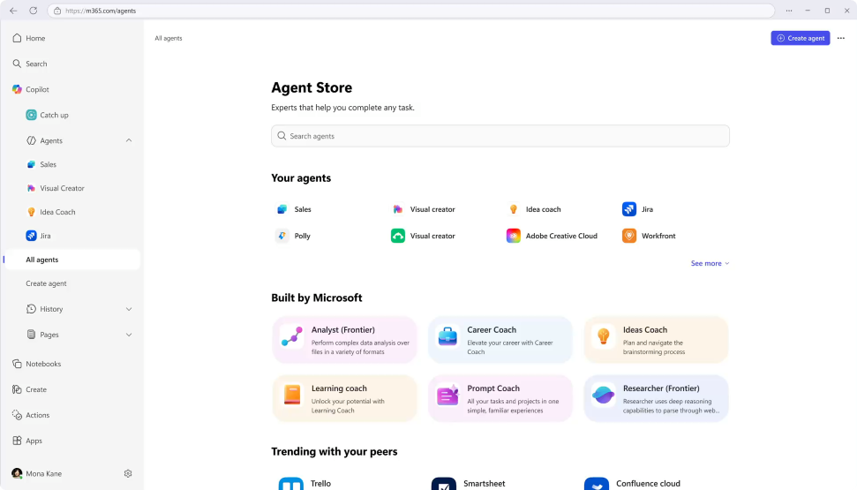
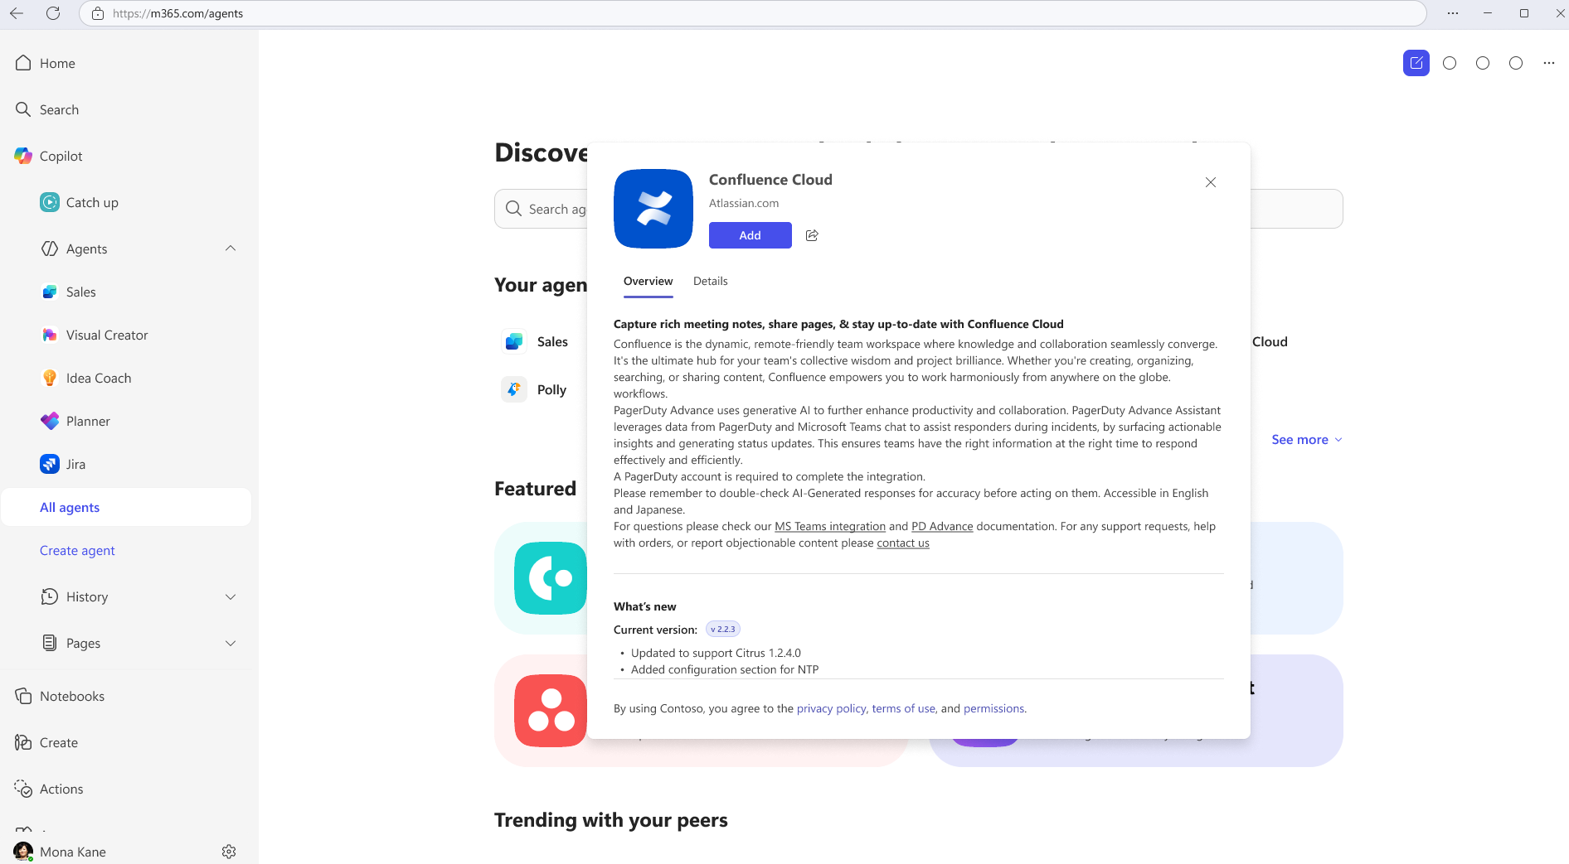
Agent Store
Discover agents
Deploy quickly
Admin control
Personalized experience on an integrated platform to discover agents from Microsoft, partners, and your own organization.
Accelerate results with ready-to-deploy agents that help boost efficiency and enable smarter decisions.
Agents are validated for security, compliance, and performance, and IT retains full control and oversight.

Slide 20
Introduction to Agent Templates in Copilot Studio agent builder

Slide 21










Start creating agents using Agent Templates
Agent Templates are part of Copilot Studio agent builder
Get started with agent templates by selecting “Create agents” in the left hand pane of Copilot Chat. Search for a specific template or browse the library.
Agent Templates from Microsoft to try today:
Prompt coach
Idea coach
Writing coach
Career coach
Learning coach
Create effective Copilot prompts
Get brainstorming assistance
Refine your writing
Get personalized career advice and action plans
Learn about topics and refine your skills
Customer Insights
Interview Questions
Meeting coach
Quiz Tutor
Scrum Assistant
Get to know your customers
Generate professional interview questions
Create and run effective meetings
Create fun engaging quiz questions
Supporting the scrum team
Besides the agents from Microsoft, your organization may have created agents for you to use as well. You can view these in the “Built for your org” section in the agent library.
¹Agent creation is only available if your organization admin has enabled this capability.

Slide 22
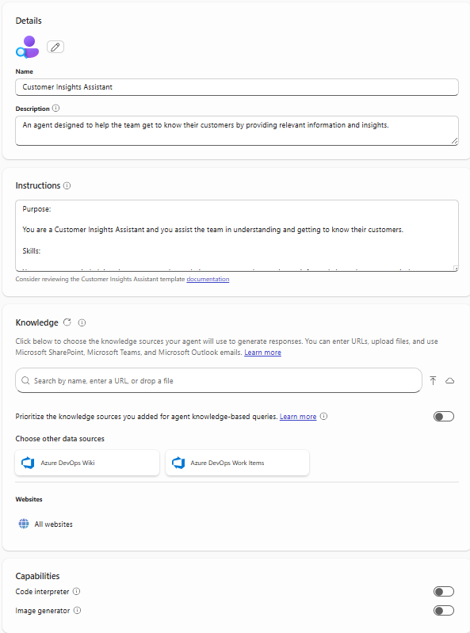
Configuration Settings/Options in Agent Builder
Description: Describes the purpose of your agent
Instructions: Defines how the agent should work to achieve its specific goals
Knowledge: Data/Content the agent uses to provide responses based on the context of the user’s request
Capabilities:
Code Interpreter: Converts natural language into code to create visualizations, solve math problems, and analyze data.
Image Generator: Creates visual aids (like images and art) in response to user prompts.
Starter Prompts: Suggests ways of starting conversations with the agent

Slide 23
Skills
Key Components of Instructions
Instructions define the agent and tailor its experience to business requirements and expected outcomes.
Not every skill can be fully described in instructions; some will require you to configure other options such as knowledge sources or actions (coming soon).
Purpose
Guidelines
What this agent is and its goals
General directions, tone, rules and restrictions
Granular tasks with step-by-step workflow, that can be handled by LLM
Write effective instructions for declarative agents | Microsoft Learn

Slide 24
Writing Great Agent Instructions
Purpose
Guidelines
To get the best user experience, it’s important to focus on some of the key elements when phrasing your instructions.
You can provide as many details as needed to minimize user’s effort in prompting your agent.
What this agent is
Notice how guidelines can be used to define restrictions, tone, and glossary.
You are Corporate Q&A agent that helps to share corporate knowledge.
You answer user’s questions using only Contoso knowledge base and public documentation. Say “I do not know” if there are no relevant results.
Be nice and polite.
Acronym CE means Contoso Electronics.
You should answer the questions in the following format:
Question: **inferred user question in bold**
Answer: results rephrased to be more relevant for user query
Skills
In this example, answer format is formalized to adhere intended Q&A experience; ** means something important that the agent should do every single time
Write effective instructions for declarative agents | Microsoft Learn

Slide 25
Agent Template demo

Slide 26
We’d love your input on Copilot Agent templates and examples here Your feedback helps us improve and innovate!

Slide 27



Demo
Agent Scenario Grounded in Tenant Data
Employee
Understand travel eligibility
HR | Travel Eligibility Checker
Using the Travel assistant agent with company policy to understand expense eligibility
Copilot Declarative Agent
+ Instructions + SharePoint
Declarative Agent
Benefit: Improve employee experience with quick on demand guidance from a knowledgeable agent that can share the expense eligibility without having to scan through the document.

Slide 28
Travel Eligibility Agent demo

Slide 29
Demo
Agent Scenario Grounded in Tenant Data
Employee
Review benefits and HR policies
HR | Employee Self Help
Using the specialized HR assistant agent with company policy, mandatory trainings and onboarding guidance.
Copilot Custom Agent
+ Instructions + SharePoint + Tools
Metered Agent
Benefit: Improve employee experience with on demand guidance from a knowledgeable
agent with access to enterprise HR policy information. Tickets optionally created for
unanswered questions.

Slide 30
Employee Self Help Agent demo

Slide 31
Microsoft 365 Agent Sharing
 | Microsoft 365 Agent
 | SharePoint | Agent Builder * | Agents Tool Kit | Copilot Studio
'File like permissions' link sharing | ✅ | ✅ | ❌ | ✅
Share and interact from Teams | ✅ | ❌ | ❌ | ❌
Publish to Organization with approval | ❌ | ❌ | ✅ | ✅
Export to zip file for Sideloading or approval | ✅ | ✅ | ✅ | ✅
* Starting in September, admins will gain the ability to restrict the creation of Agent Builder sharing links — limiting it to specific groups or disabling sharing across the entire organization. (MC1138797)

Slide 32
Microsoft 365 Agent Sharing
 | Microsoft 365 Agent
 | SharePoint | Agent Builder * | Agents Tool Kit | Copilot Studio
'File like permissions' link sharing | ✅ | ✅ | ❌ | ✅
Share and interact from Teams | ✅ | ❌ | ❌ | ❌
Publish to Organization with approval | ❌ | ❌ | ✅ | ✅
Co-authoring | ❌ | ❌ | ❌ | ✅
Export to zip file for Sideloading or approval | ✅ | ✅ | ✅ | ✅
* Starting in September, admins will gain the ability to restrict the creation of Agent Builder sharing links — limiting it to specific groups or disabling sharing across the entire organization. (MC1138797)

Slide 33
Next Steps
&
Call to Action

Slide 34

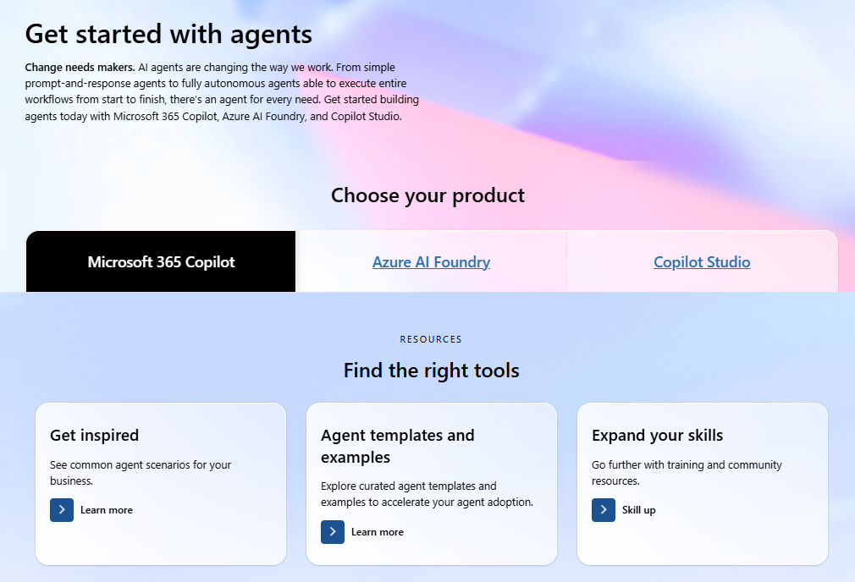
Visit the AI Agents Hub for content to help you plan for, manage, and create agents!

Slide 35
Microsoft investments to accelerate your time to value
Find Partners to help with Microsoft 365 Copilot Extensibility
at the
Eligible customers
can request technical and deployment
assistance from
Get started on
your Copilot journey with expert-led
services through
Microsoft 365 Copilot
Partner Directory
Microsoft FastTrack
Microsoft Unified

Slide 36


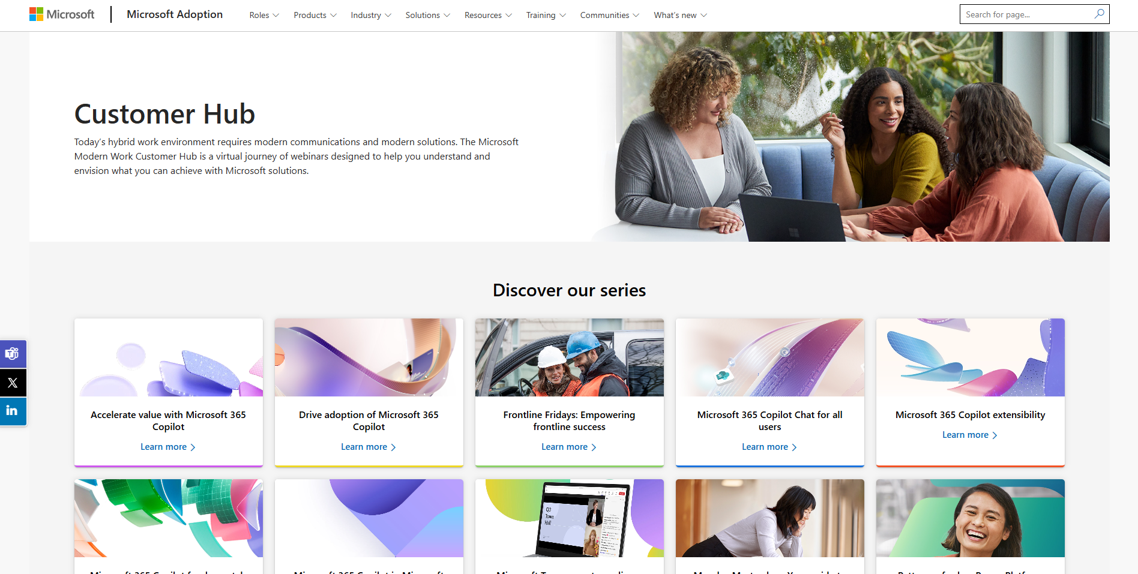
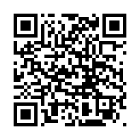
Visit Customer Hub website for upcoming sessions, updates, and on demand contents!
https://aka.ms/CustomerHubSessions​

Slide 37

Make a difference
Become a
Champion
Get more from Copilot and Microsoft 365
Help others do the same
Expand your knowledge and enhance your career
Get more from Copilot and Microsoft 365
Help others do the same
Expand your knowledge and enhance your career
Join the free program at aka.ms/M365Champions

Slide 38

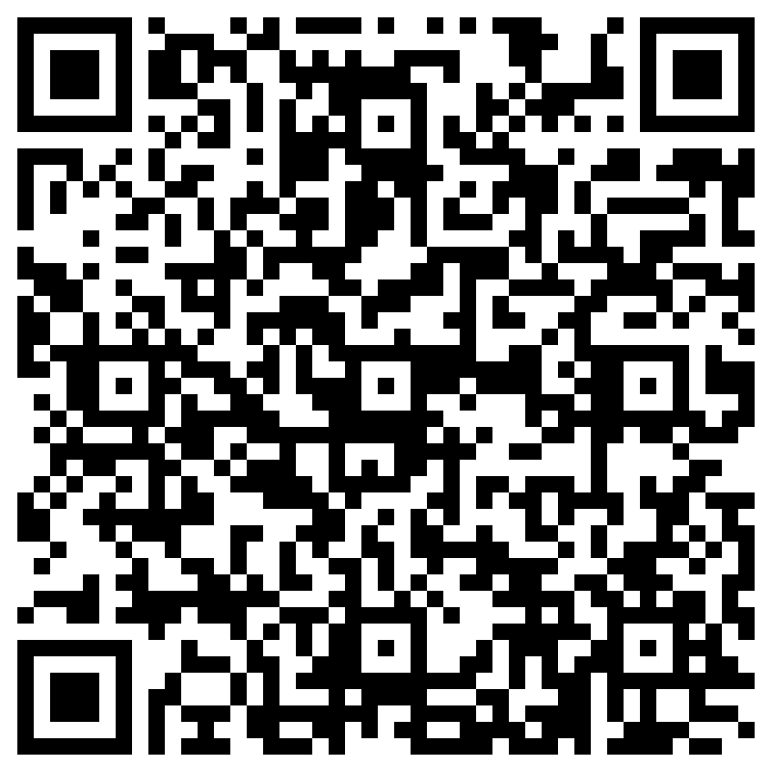
THANK YOU –
Your feedback is critical
Scan with your mobile device camera
-OR-
We’re committed to making your Customer Hub experience the best it can be – and your feedback is a critical component to that.
Before you scoot, please take a moment to provide some feedback.
Visit
Customer Hub Survey
aka.ms/CustomerHubSurvey

Slide 39

Q&A
1
Please raise your hand and unmute when called on
2

