Slide 1
Microsoft 365 Copilot Chat GCC
Your AI assistant for US public sector employees
March 2025

Slide 2

Microsoft 365 Copilot Chat
Introducing

Slide 3
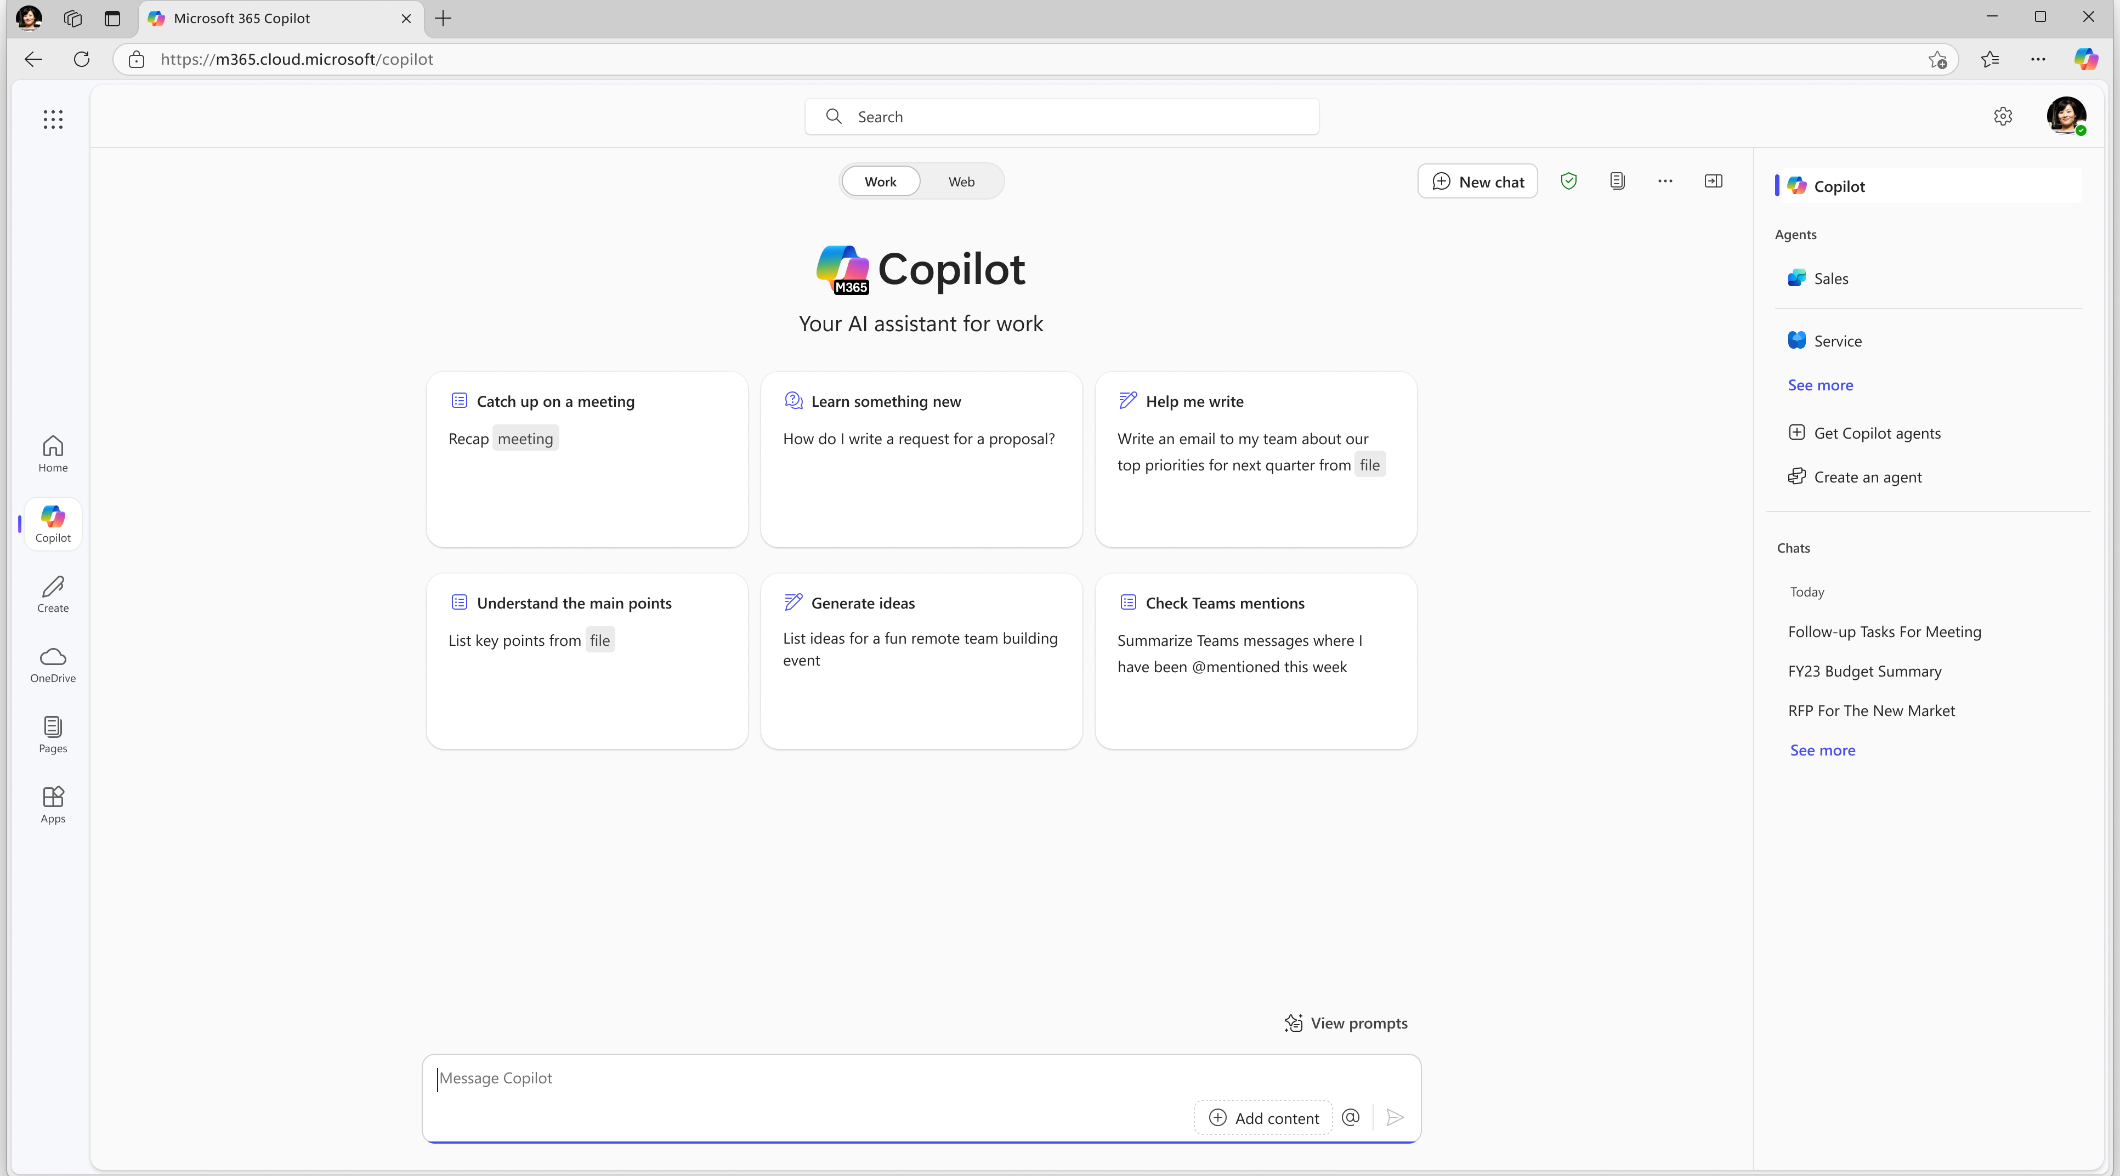
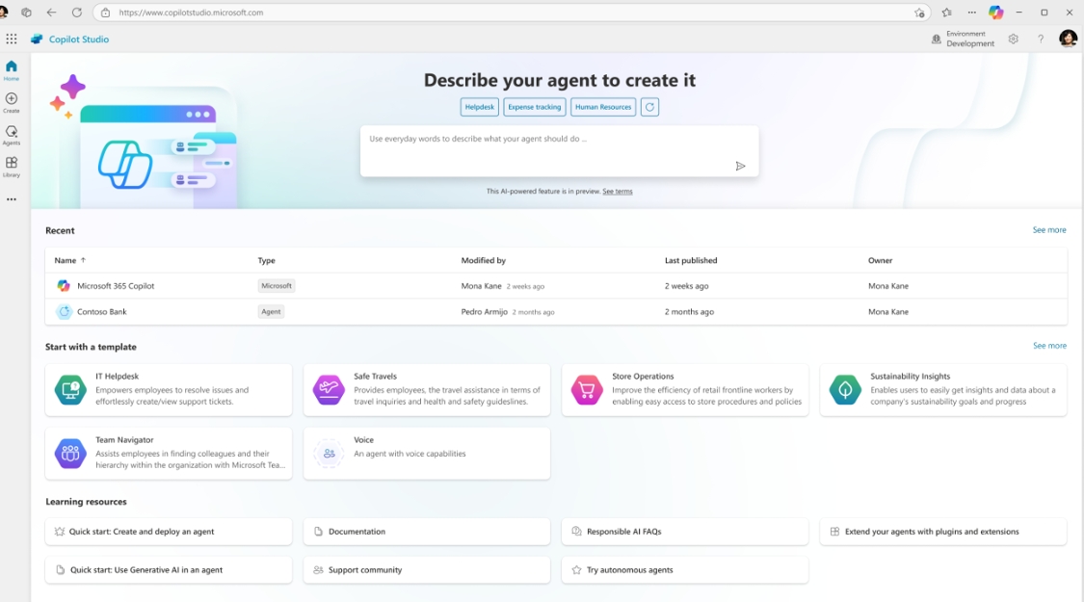
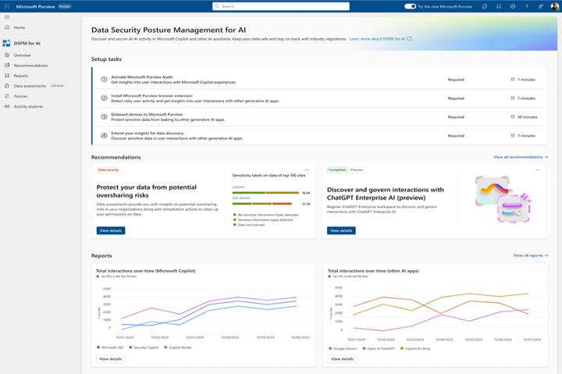
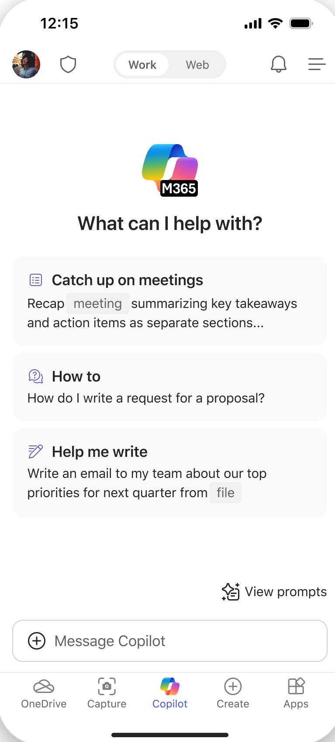
Microsoft 365 Copilot Chat GCC
Bringing AI to everyone through a simple UI with chat and agents and solid ROI since you only pay for what you use.
Chat
Agents (Coming Soon!)
IT Controls
Free, secure AI chat –
powered by GPT 4o
Integrated into the chat experience and paid for on a consumption basis
Enterprise Data Protection
and agent management

Slide 4



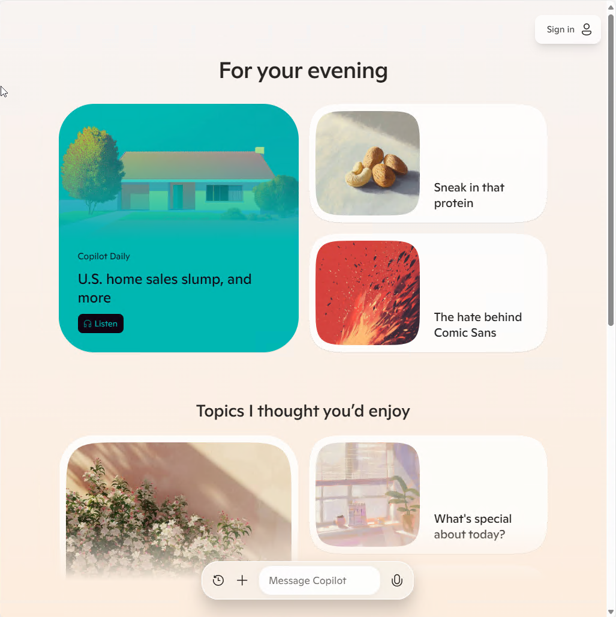
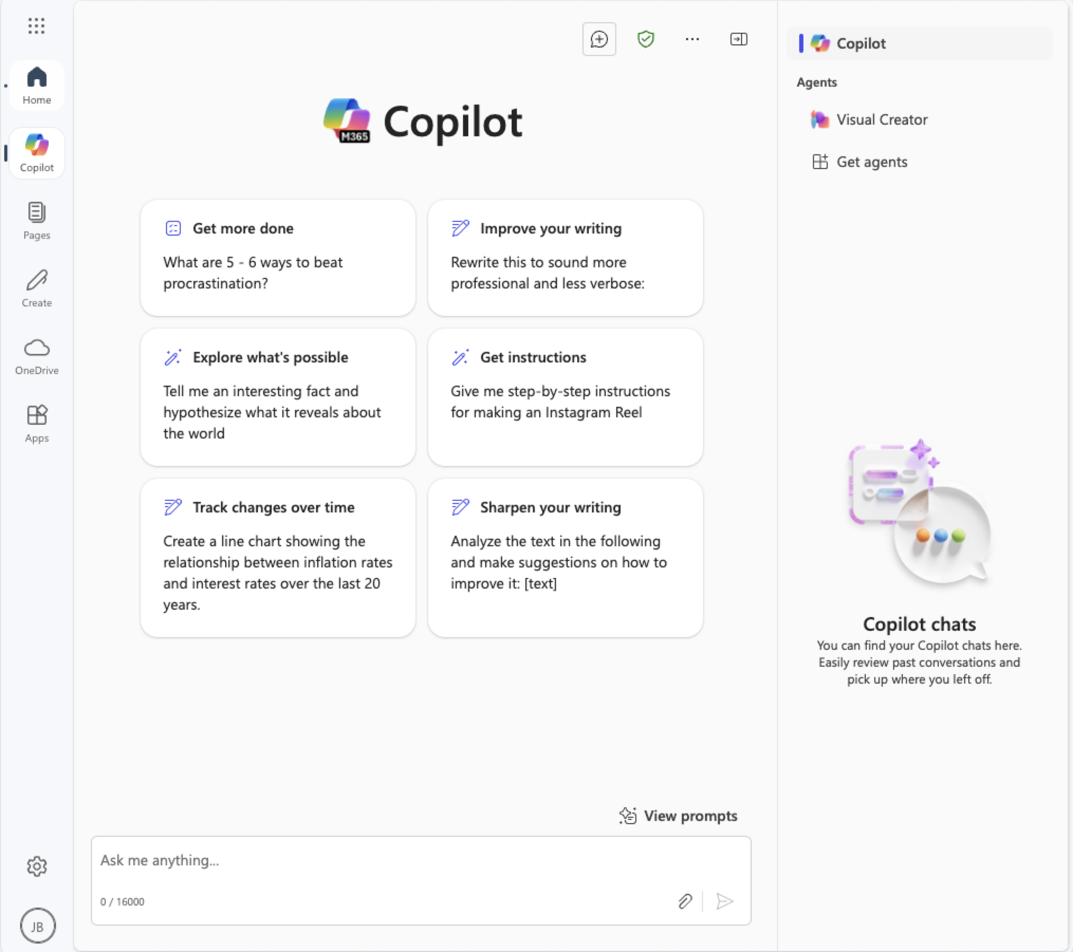
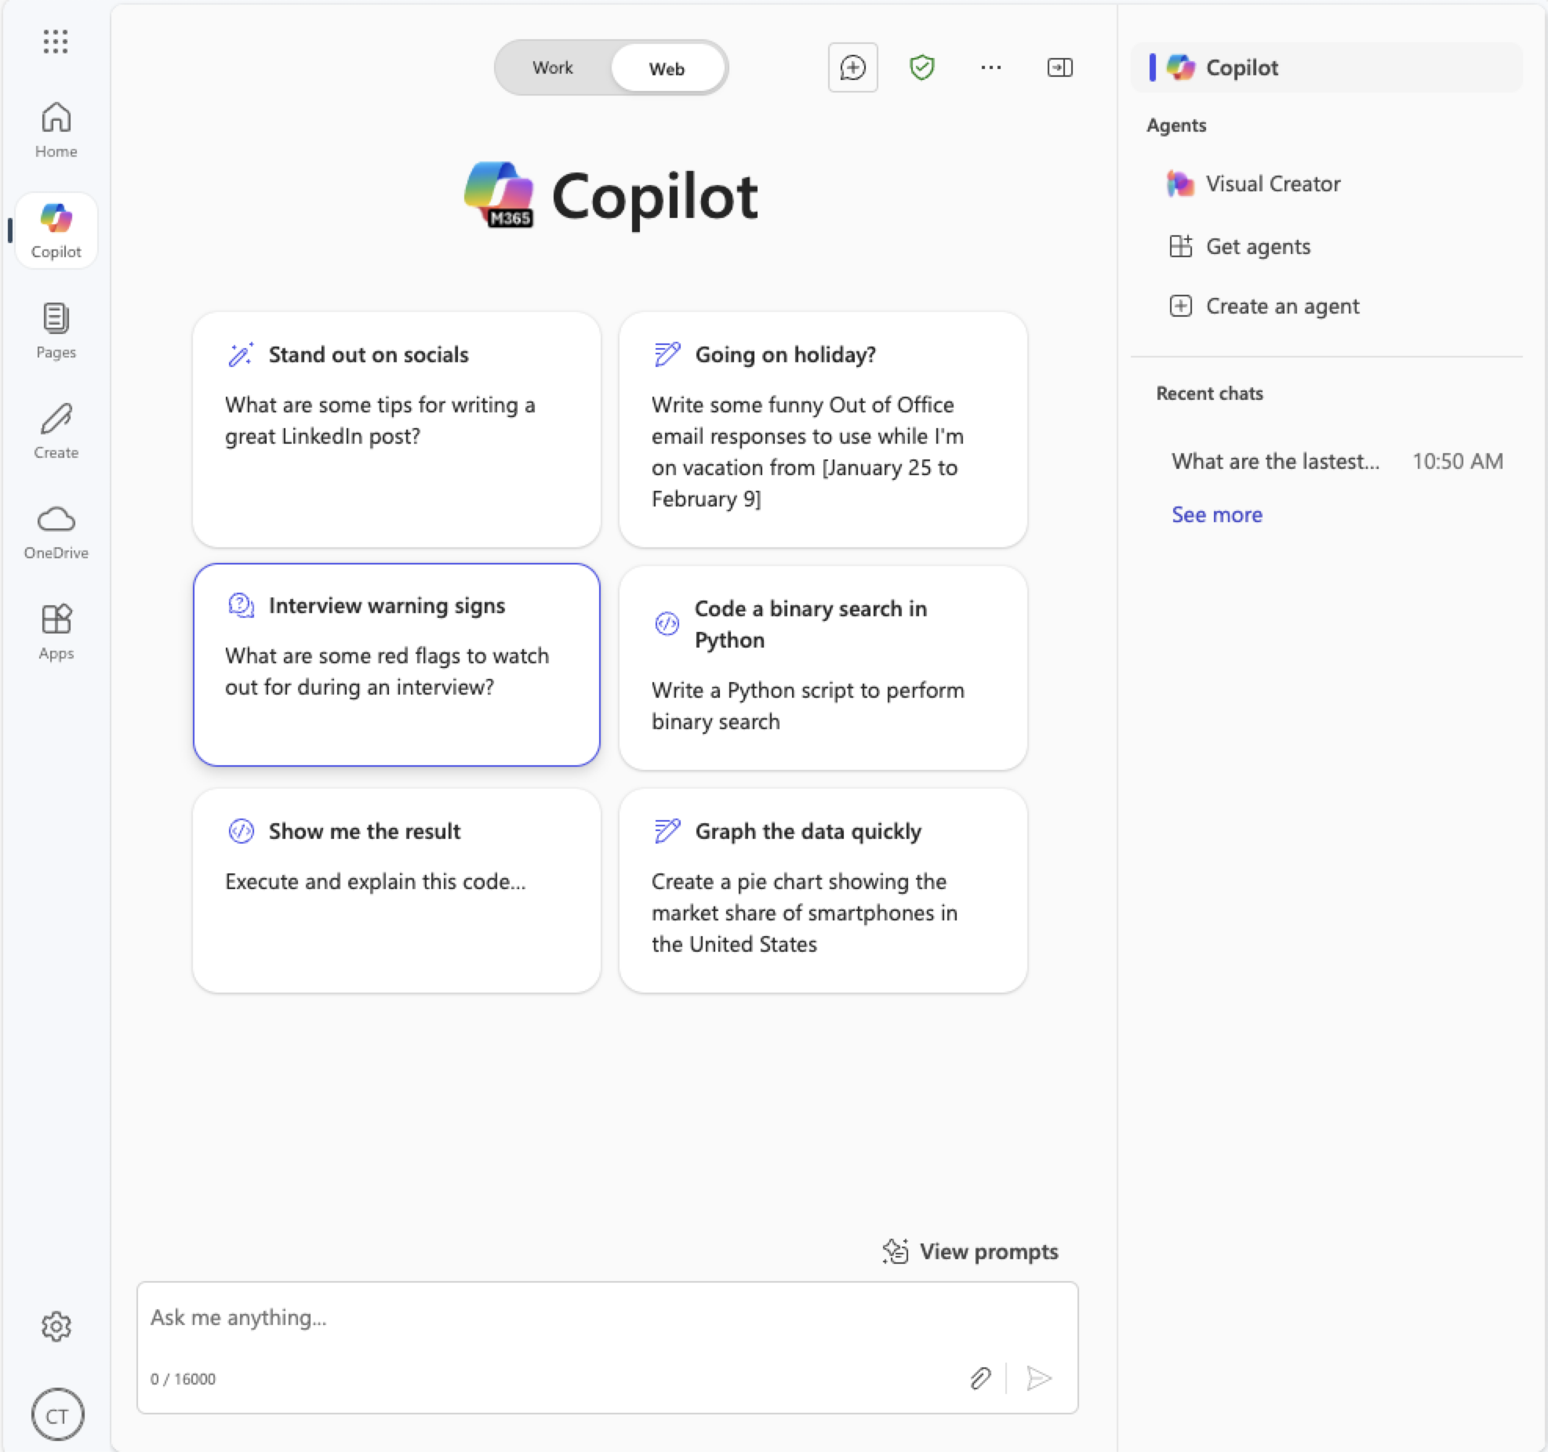

Different Microsoft Copilots
Entra ID signed in user
+ Microsoft 365 Copilot license
Microsoft Copilot
Microsoft 365 Copilot Chat
Microsoft 365 Copilot
Notes:
Yes, there are Copilots everywhere.
We understand it may get confusing sometimes when we're talking about some different Copilots.
Let’s Talk about the differences.
We start with Copilot Personal and this is available for everyone.
Personal is free and is a fun assistant. It’s not meant for you to use with any enterprise data.
Scenarios around this are just asking it questions to help you figure out everyday challenges. It can be a companion and do tons of other things like help you plan that family trip.
Then we move to M365 copilot chat. There is the Free version (included in enterprise licensing) and the full stack M365 Copilot licenses.
Regardless, if you are using it for Work of for Web, they require you to be signed into your corporate identity.
We talked about a lot of the differences already, M365 Copilot for Work allows you to practically search everything that you personally already have access to and include it in your Copilot interactions.
The Web version only will allow you to use Agents, upload work documents and use the power of the LLM and web queries to help you with your needs.

Slide 5
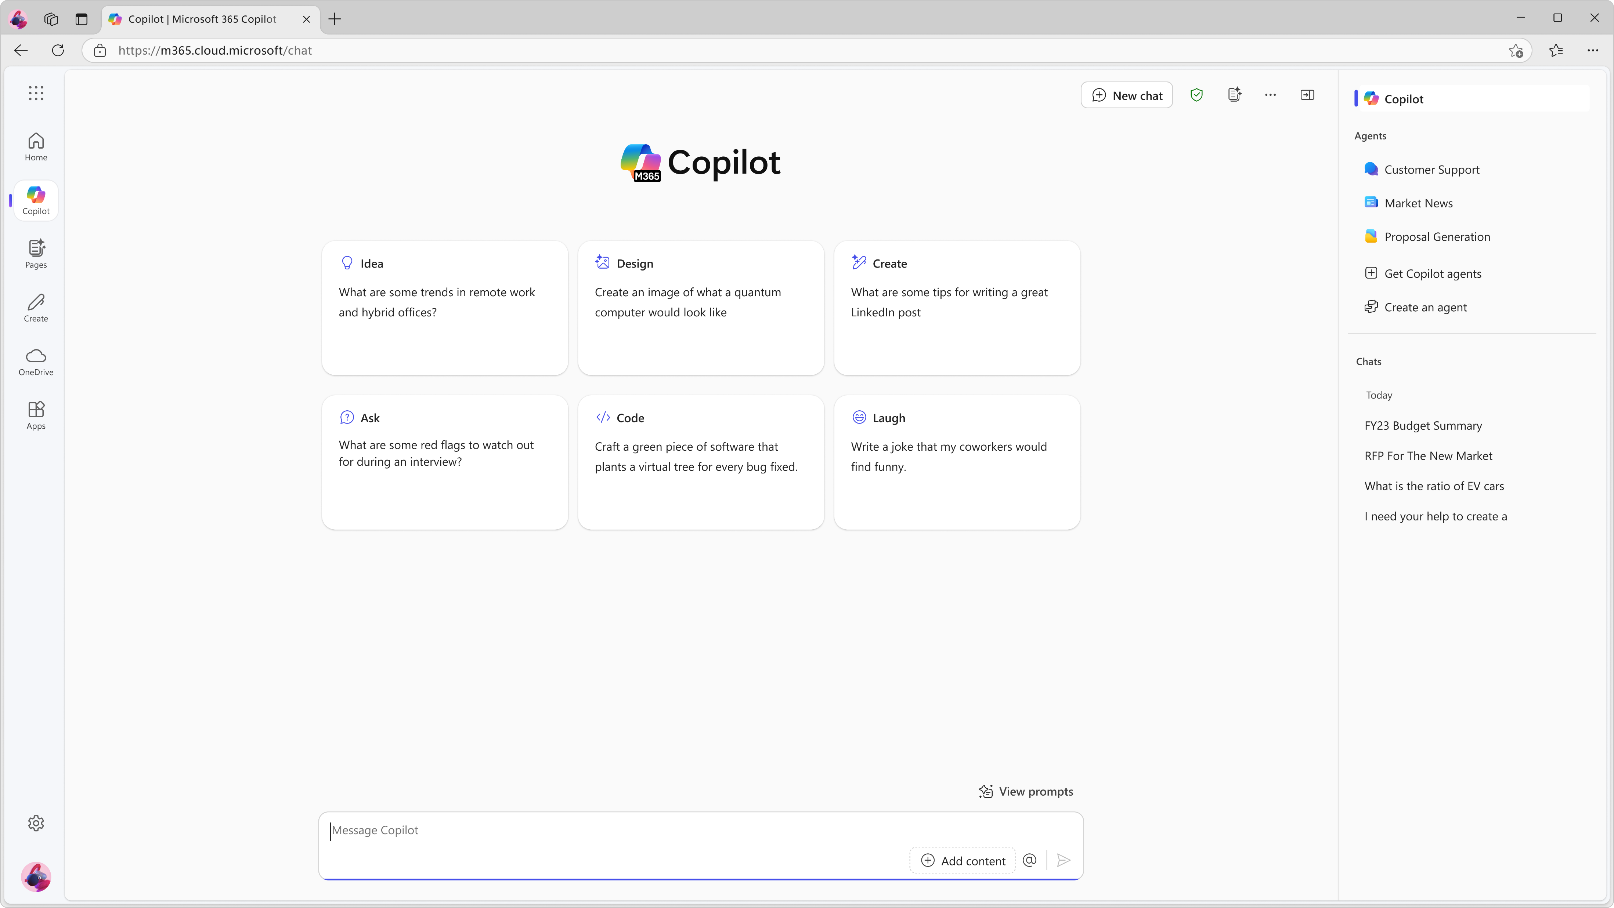
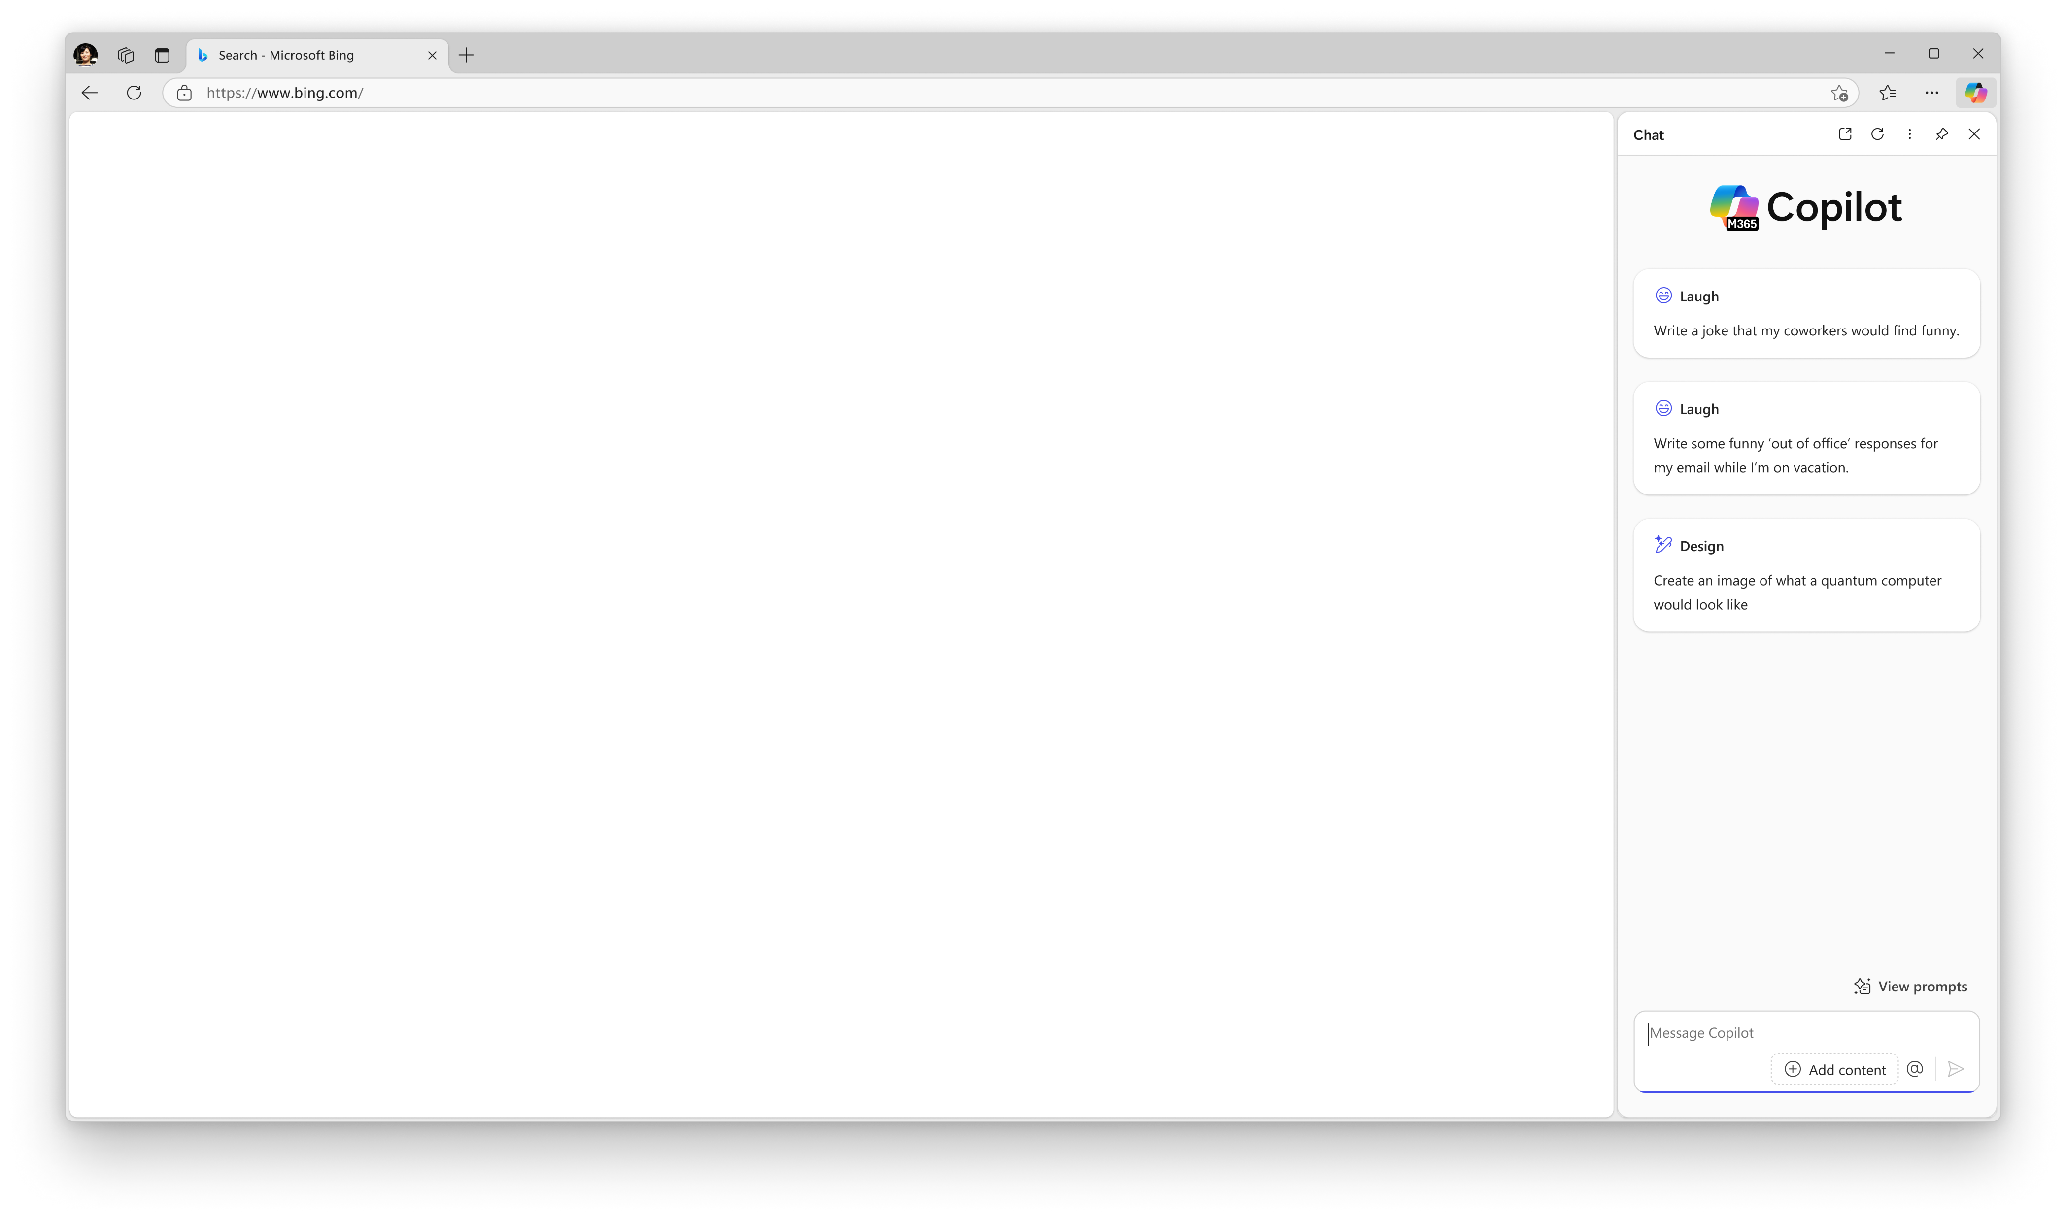
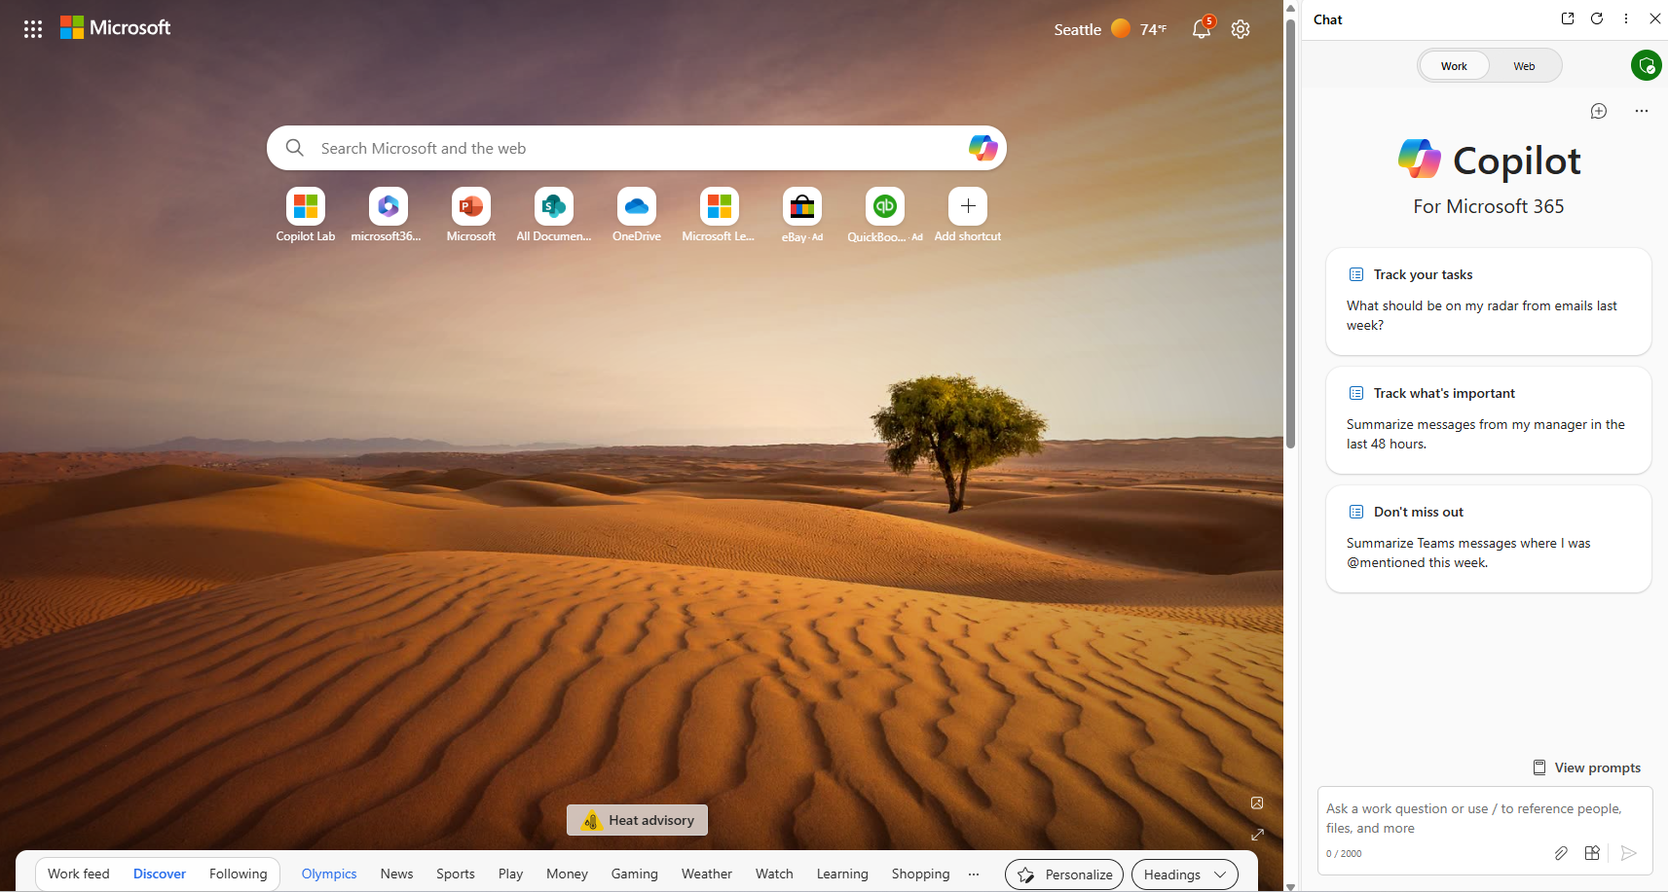
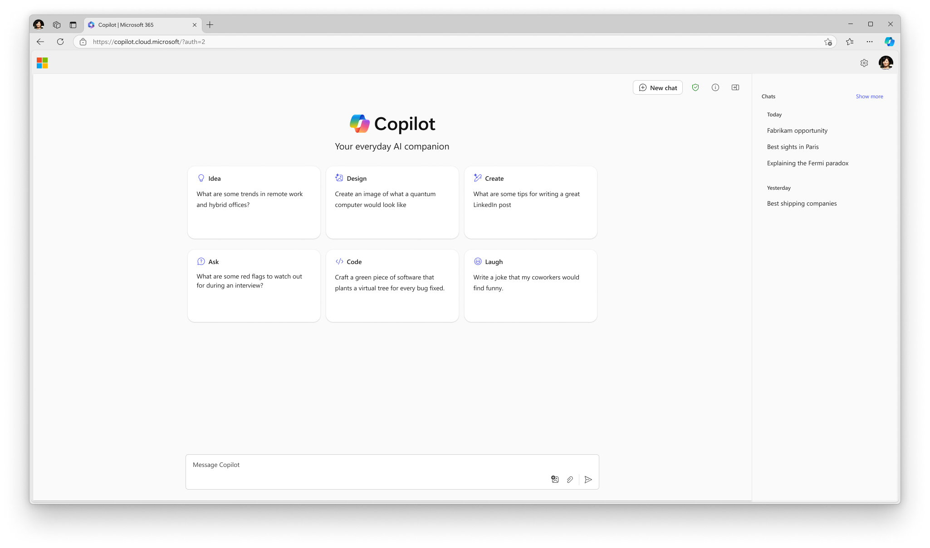
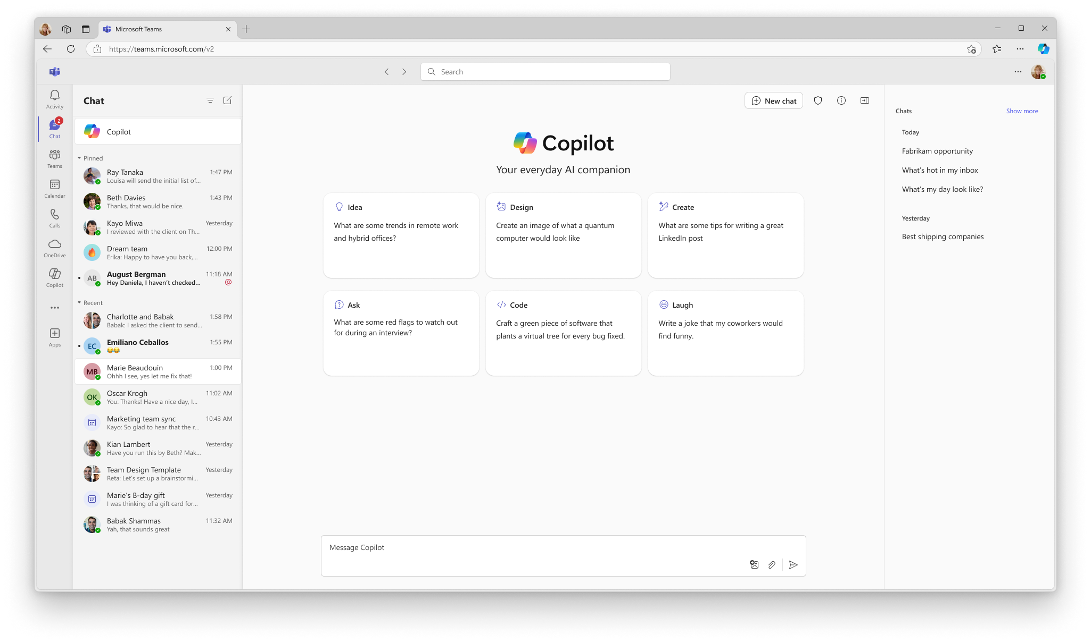
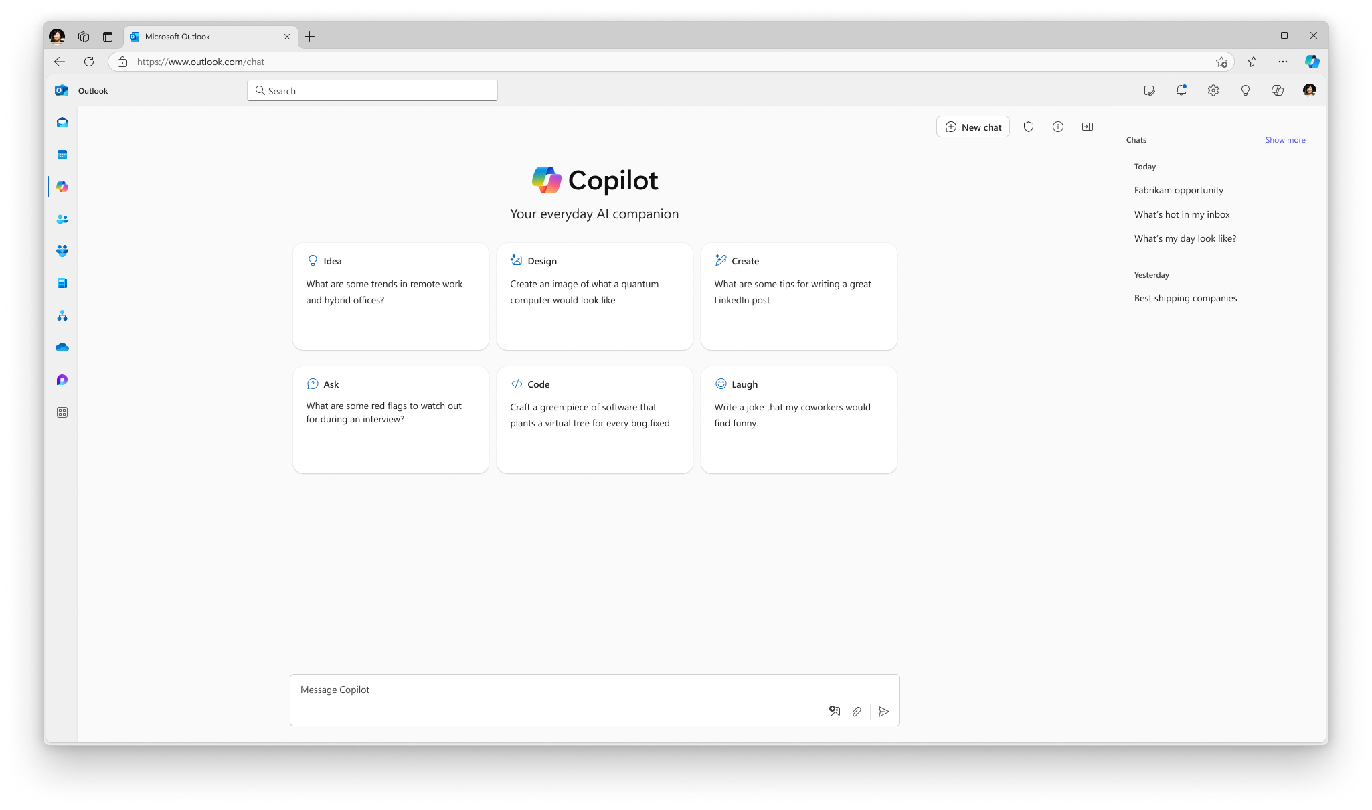
Access Copilot Chat from where you’re working
M365Copilot.com
Microsoft 365 Copilot app*
Edge browser sidebar
Microsoft 365 app
copilot.cloud.microsoft
Microsoft 365 app
Teams app (Pinned)*
Outlook app (Pinned)*
*Ensure Copilot is pinned to your left navigation across Teams, Outlook, and the Microsoft 365 app.
Notes:
Accessing Copilot Chat is designed to be seamless across various platforms, enhancing your productivity wherever you are. You can utilize the Microsoft 365 app, the dedicated Copilot website, or the M365 Copilot app for a streamlined experience. Additionally, the integration with the Edge browser sidebar allows for quick access while browsing. Keep an eye out for upcoming features in the Teams and Outlook apps, which will further enhance collaboration.
It's crucial to pin Copilot to your left navigation in Teams, Outlook, and the Microsoft 365 app to ensure easy access. This integration reflects our commitment to making AI tools readily available in your daily workflow, meeting the employee where they are and reducing context switching.

Slide 6
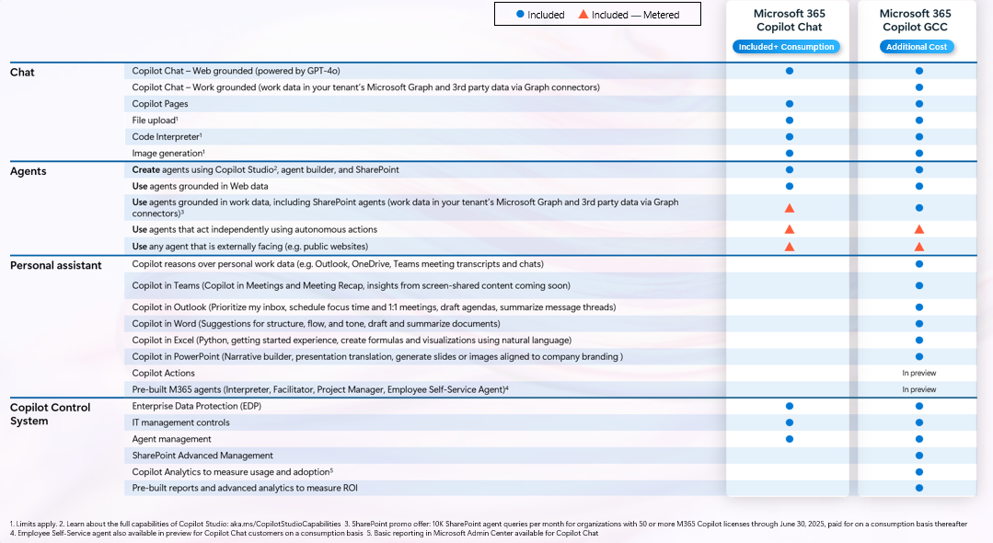
M365 Copilot Chat vs. M365 Copilot GCC Comparison
Not available at initial launch

Slide 7
How to enable web search
March 2025

Slide 8
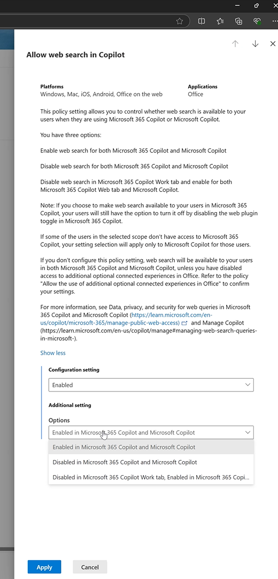
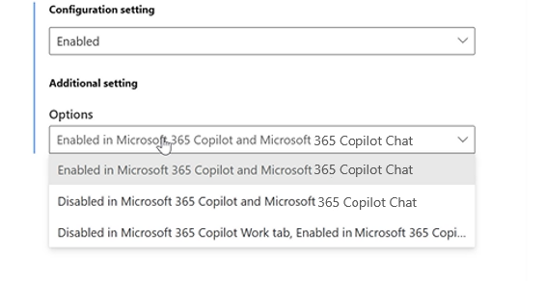
Copilot web search control
Control who can use web search
OCPS policy: “Allow Web Search in Copilot”
For M365 Copilot and Copilot Chat
Can be applied at user or group level
Permits following values:
Not configured (= Follows OCE policy)
0 (= Web search on for both work and web - Recommended)
1 (= Web search off in both work and web)
2 (= Web search off in work but on in web)
Chat
Available now

Slide 9

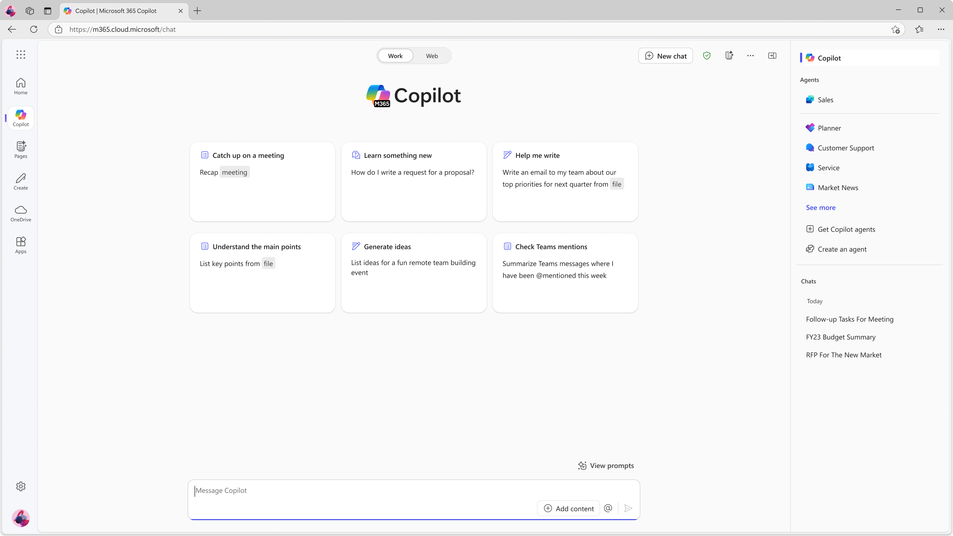
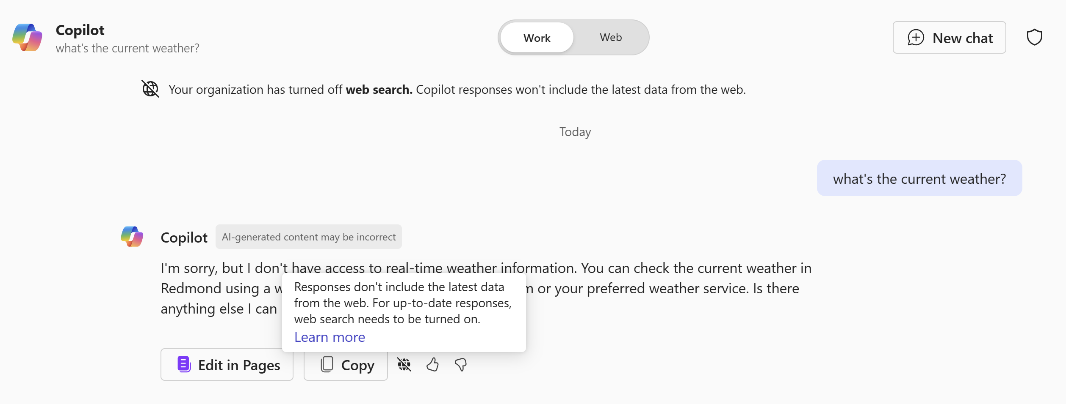
Turning off web search in Microsoft 365 Copilot Chat: LLM-only experience
Example of results returned when web search is turned off. Note the knowledge cutoff because it’s LLM Only.
User experience in Microsoft 365 Copilot web tab and Microsoft 365 Copilot Chat when admin turns off web search with OCE policy.
Notes:
When web search is turned off in Microsoft 365 Copilot Chat or Microsoft 365 Copilot web tab, you can still use LLM Only mode, which solely returns the knowledge on which the LLM was trained plus information from your prompt. The LLM still has a wealth of knowledge but has a training knowledge cutoff date.

Slide 10
How Copilot uses queries when web grounding
Example
The prompt is written by the user.
The Copilot LLM generates web queries that are sent to the Bing search API:
Documents and files are not sent to Bing search service; only search key words are sent.
Queries sent to Bing by Copilot are disassociated from the user ID or tenant ID.
Web search queries generally don’t contain all the words from a user's prompt (unless very short). They're generally based off a few terms used to find relevant information on the web. However, they may still include some confidential data, depending on what the user included in the prompt.
The response is generated by the Copilot LLM.
Prompt (written by the user)
We're considering a possible acquisition of Fabrikam. Help me put together a 200-word summary report of publicly available financial information on the company, including their business strategy.​
Web queries (generated by Copilot and sent to the search service)
Fabrikam strategy​ Fabrikam financials​
Response (generated by Copilot)
Fabrikam is a CPG startup that offers healthier food alternatives but with the same familiar taste as traditional brands. The company gathered $4.5 million in seed funding in 2019 and raised $31.5 million in a series B funding round in 2022. As of January 2023, Fabrikam raised a total of $83.4 million in funding and is on target to more than double its sales this year.​ ​ As the pandemic hit, Fabrikam faced the challenge of pivoting from brick-and-mortar stores to online sales, and that’s where their influencer marketing strategy came into play. Instead of relying on in-store events and promotions, Fabrikam turned to social media and influencer partnerships to build brand awareness and reach a wider audience. The company also approached innovation from a genuine angle, balancing traditional consumption drivers with better-for-you offerings and having a holistic, robust distribution strategy.​ ​ In summary, Fabrikam has raised over $55 million in funding and has a strong influencer marketing strategy that has helped them pivot to online sales during the pandemic.

Slide 11
Get started with Copilot Chat GCC

Slide 12
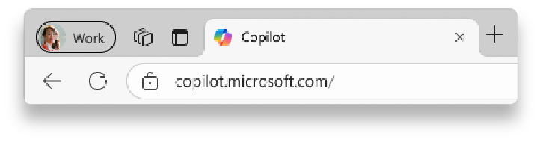



Sign in with your work account
1
2
1
Navigate to M365Copilot.com on your preferred browser on your device to get to Copilot Chat.
https://M365Copilot.com
2
Ensure you’re signed in with your work account.
You will know you are successfully signed in to Copilot Chat when you see the green shield icon next to “New chat” and the Microsoft 365 Copilot icon at the top of the page.
If you are not signed in with your work account, Enterprise Data Protection does not apply.

Slide 13
Get to know Copilot Chat
Start at
M365Copilot.com
Here is a visual tour of Copilot Chat:
Start a new chat button
Clear your past chat and start a new conversation.
Agents (Coming Soon!) Use existing agents or create new ones¹. Learn more about agents in slide 17.
Suggested prompts If you’re not sure what to ask, try or modify a sample prompt!
Recent chats Return to a previous chat to continue the conversation
Copilot Prompt Gallery View additional prompt suggestions, including saved prompts.
Prompt box
Start your conversation here.
Send your prompt!
Upload files If you’d like Copilot to source responses from information in specific files, add them here.
Chat with an agent (Coming Soon!) Add an agent to your Copilot prompt to chat with it.

Slide 14





How to chat in 3 steps
1. Enter your prompt
2. Check sources
3. Continue the conversation
Enter your detailed prompt in the text box at the bottom. If you would like Copilot to source information from any reference files, you can upload them in your prompt by selecting the “Add content” button.
Copilot Chat is transparent about the sources of its information. See these sources listed underneath the answer.
Vet these sources and validate your answers.
You can ask follow-up questions as you would in a conversation. You can refine the answer too.
For example, try “Write a shorter answer" or "Give me more detail." You can also select suggested prompts.

Slide 15
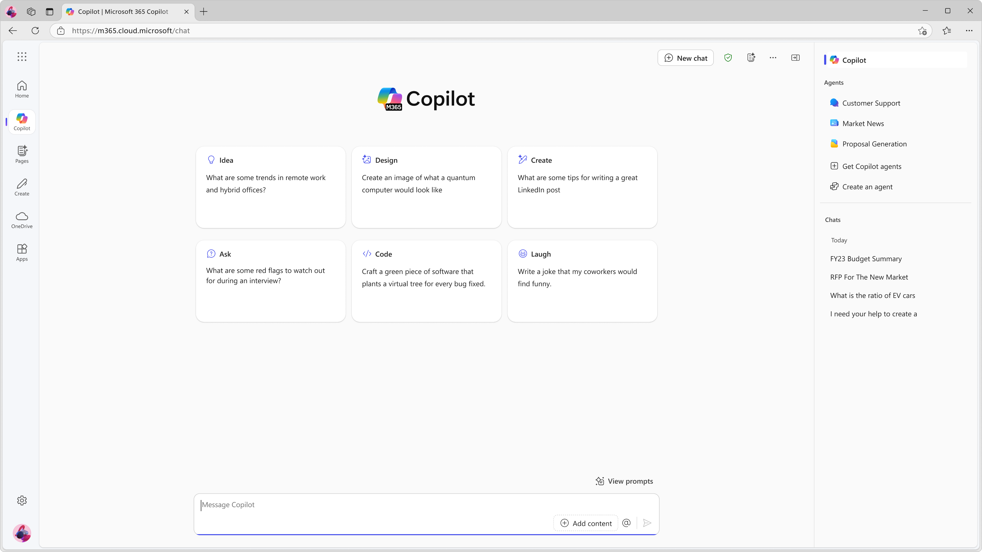

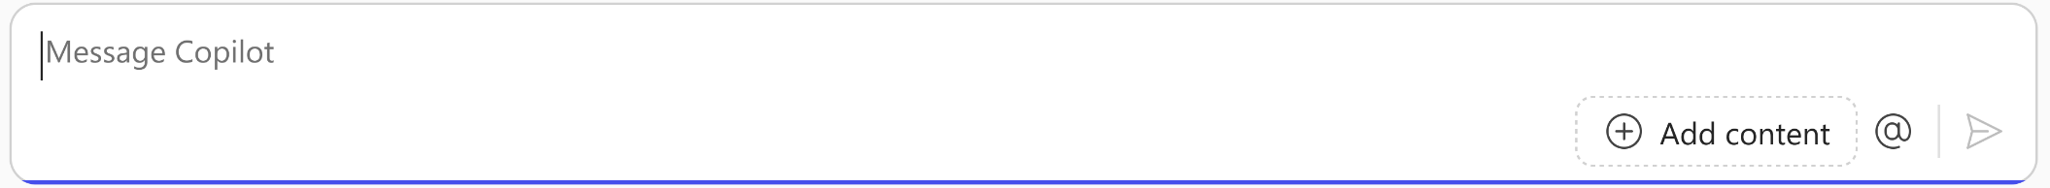
What is a “prompt?“
Prompts are how you have a conversation with Copilot
Use plain but clear language and provide context like you would with an assistant.
Enter your first prompt in the text box at the bottom of your screen, like “Draft a cold call email to a customer.”
Get started by entering your prompt in the text box

Slide 16


What makes an effective prompt?
Less Effective
More Effective
Vague
Just a few words
No context on preferred output
Example: Summarize news about [company name].
The recap may be more vague than desired, or in a format that you were not seeking.
Specific and detailed
In full sentences, with instructions
States the tone, purpose, preferred format, etc.
Example: I work in marketing and focus on competitor research. Give me a concise summary of recent news about [company name]. Focus on announcements about new product lines. Provide the answer in two to three paragraphs and use a business tone.
But there are no ‘wrong’ prompts because natural, conversational language is welcome.
Experiment away!

Slide 17
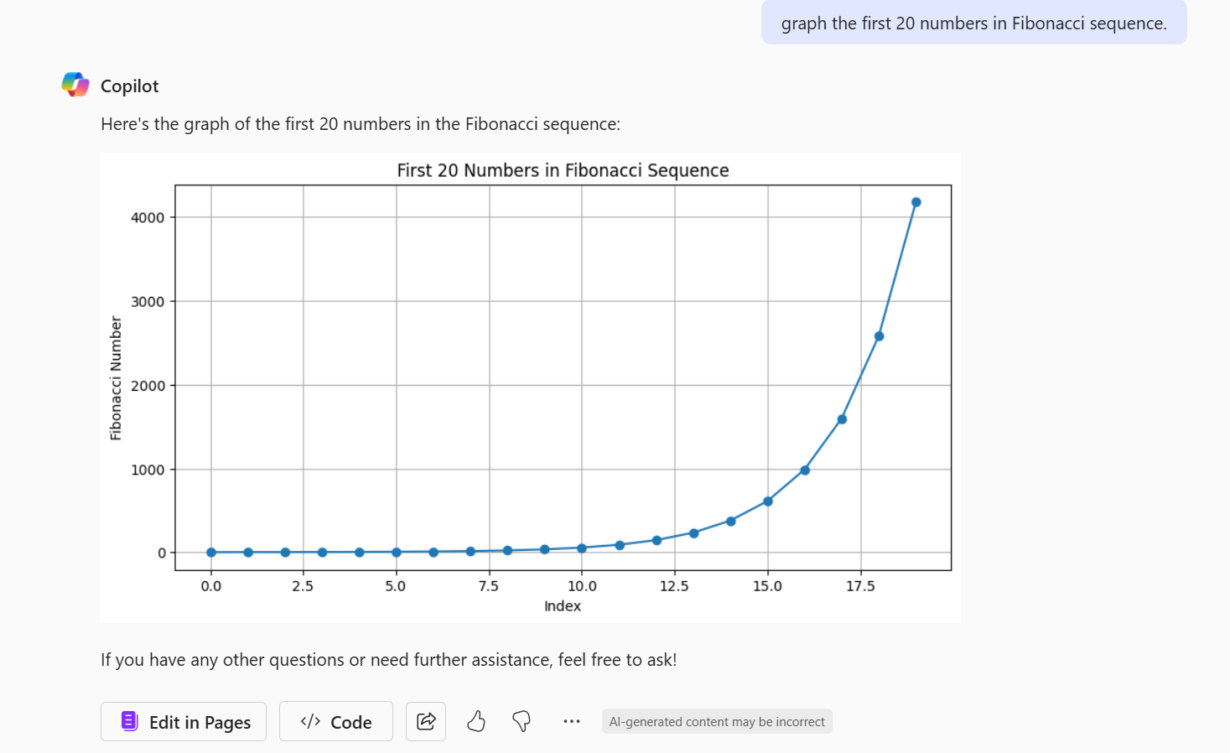
Use Copilot Chat to visualize data
Copilot Chat has built-in capabilities to graph and visualize data as it’s relevant to your prompt.
For example, use the prompt: “Graph the first 20 numbers in Fibonacci sequence”.

Slide 18
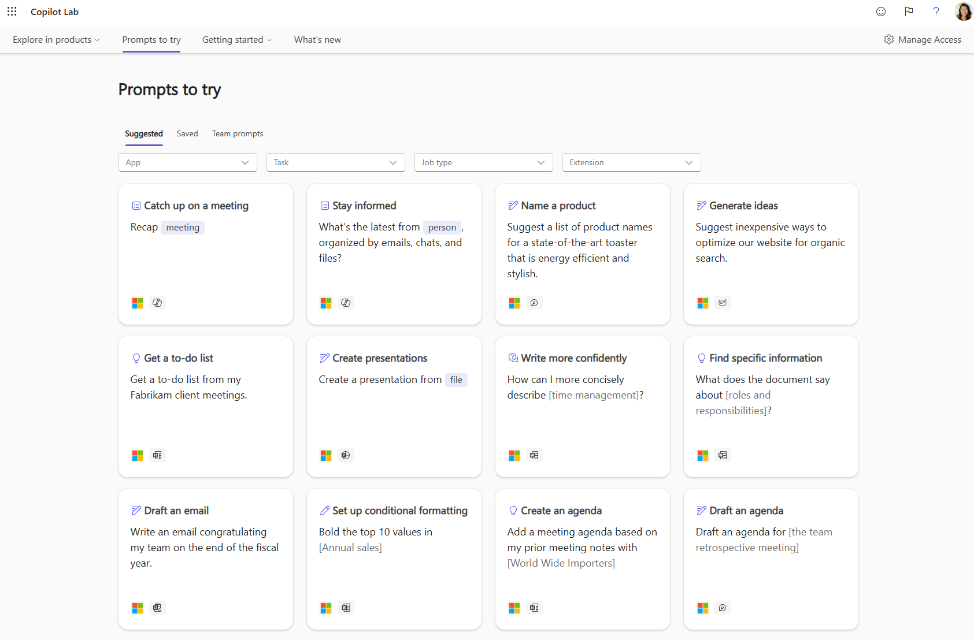
Discover and share Copilot prompts
Copilot Prompt Gallery (formerly known as Copilot Lab) helps you find prompting inspiration so you can take greater advantage of Copilot in your daily work.
Explore the curated selection of Copilot prompts
Save your favorite prompts
Share your favorite prompts with colleagues
Find prompting inspiration from others
Watch the video to see it in action

Slide 19
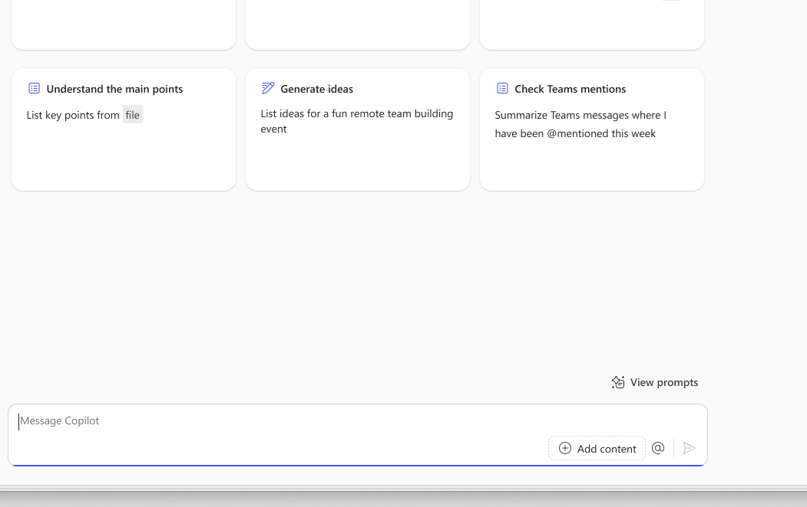
Navigating to the Copilot Prompt Gallery
In-product experience
Select “View prompts” next to the Copilot prompt box. Here, you’ll see suggested Copilot prompts and your saved prompts.
Prompt Gallery website
Go to aka.ms/Prompts to access the full Prompt Gallery experience. Here, you can find relevant Copilot prompt examples using the filters, view prompts that you and your team saved, and share useful prompts.

Slide 20
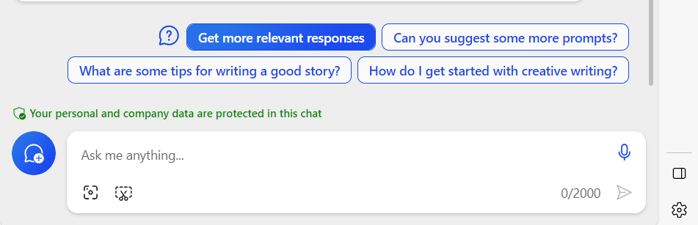
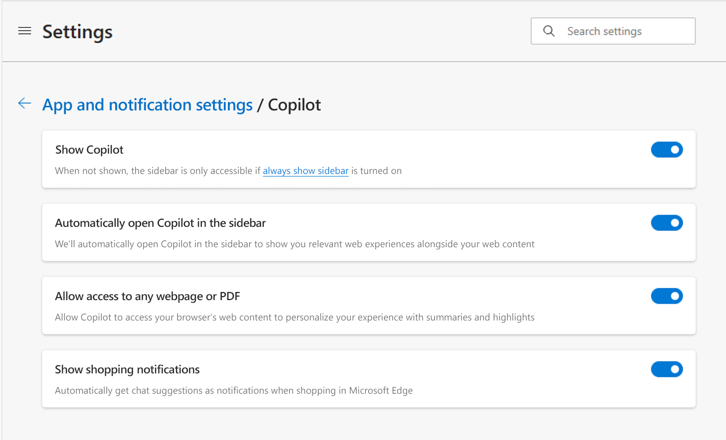
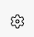
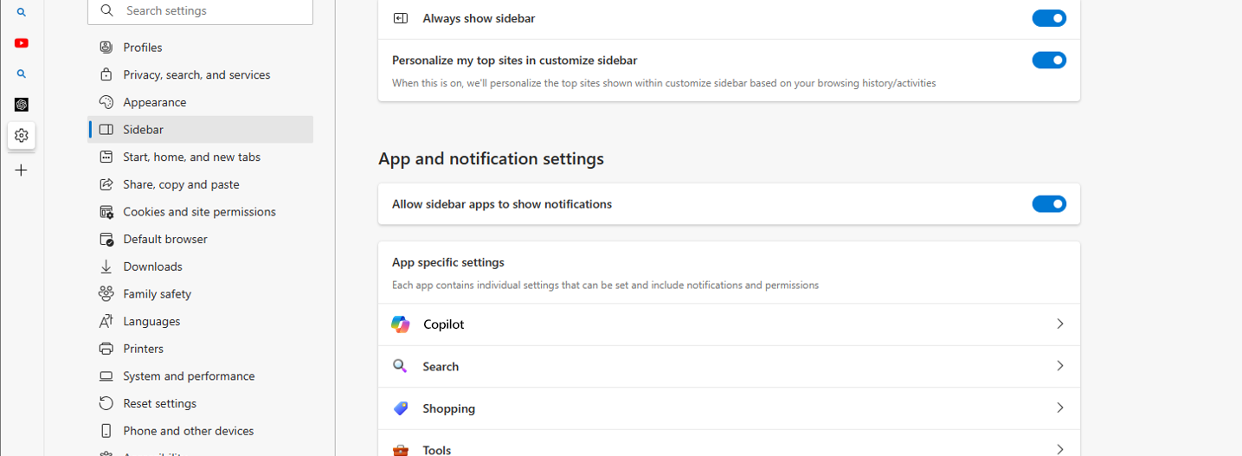
If Edge sidebar cannot “read” an open PDF or webpage, you may need to change your settings
Follow these steps to enable Copilot Chat to “read” the open PDF or webpage
1
First, select the gear icon at the bottom right of the Edge sidebar
3
Enable the “Allow access to any webpage or PDF” setting switch (see below)
2
Select “Copilot” within the list of apps

Slide 21
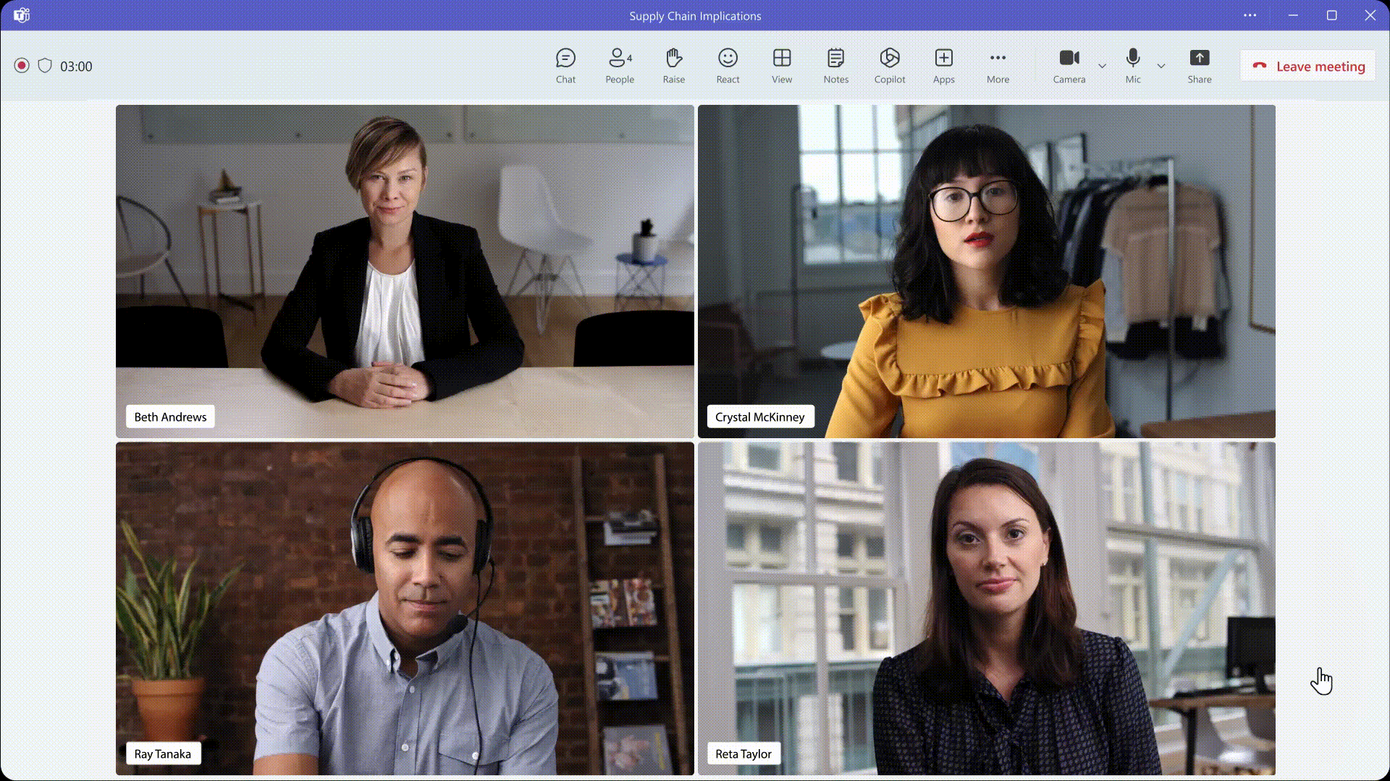
Did you know you could do more with Microsoft 365 Copilot?
Microsoft 365 Copilot is more than just Copilot Chat.
With a full Microsoft 365 Copilot license, you’ll have access to additional Copilot capabilities in the Microsoft 365 apps you use regularly, like:
Recapping a meeting in Teams
Revising an email in Outlook
Revising a document in Word
Creating a PowerPoint presentation from an outline
Formatting Excel spreadsheets
If you’d like to learn more about how you can get access to the full Microsoft 365 Copilot experience, reach out to your IT admin.

